Slide 1
PSHE – LI: Can I understand some of the reasons why people use bullying behaviours?

Slide 2
BACK IN THE PLAYGROUND BLUES
I dreamed I was back in the playground, I was about four feet high
Yes I dreamed I was back in the playground, standing about four feet high
Well the playground was three miles long and the playground was five miles wide
It was broken black tarmac with a high wire fence all around
Broken black dusty tarmac with a high fence running all around
And it had a special name to it, they called it The Killing Ground
Got a mother and a father they're one thousand years away
The rulers of the Killing Ground are coming out to play
Everybody thinking: ‘Who they going to play with today?’
Well you get it for being Jewish
And you get it for being black
You get it for being chicken
And you get it for fighting back
You get it for being big and fat
Get it for being small
Oh those who get it get it and get it
For any damn thing at all
Sometimes they take a beetle, tear off its six legs one by one
Beetle on its black back, rocking in the lunchtime sun
But a beetle can’t beg for mercy, a beetle’s not half the fun
I heard a deep voice talking, it had that iceberg sound
‘It prepares them for Life’ - but I have never found
Any place in my life worse than The Killing Ground.

Slide 3
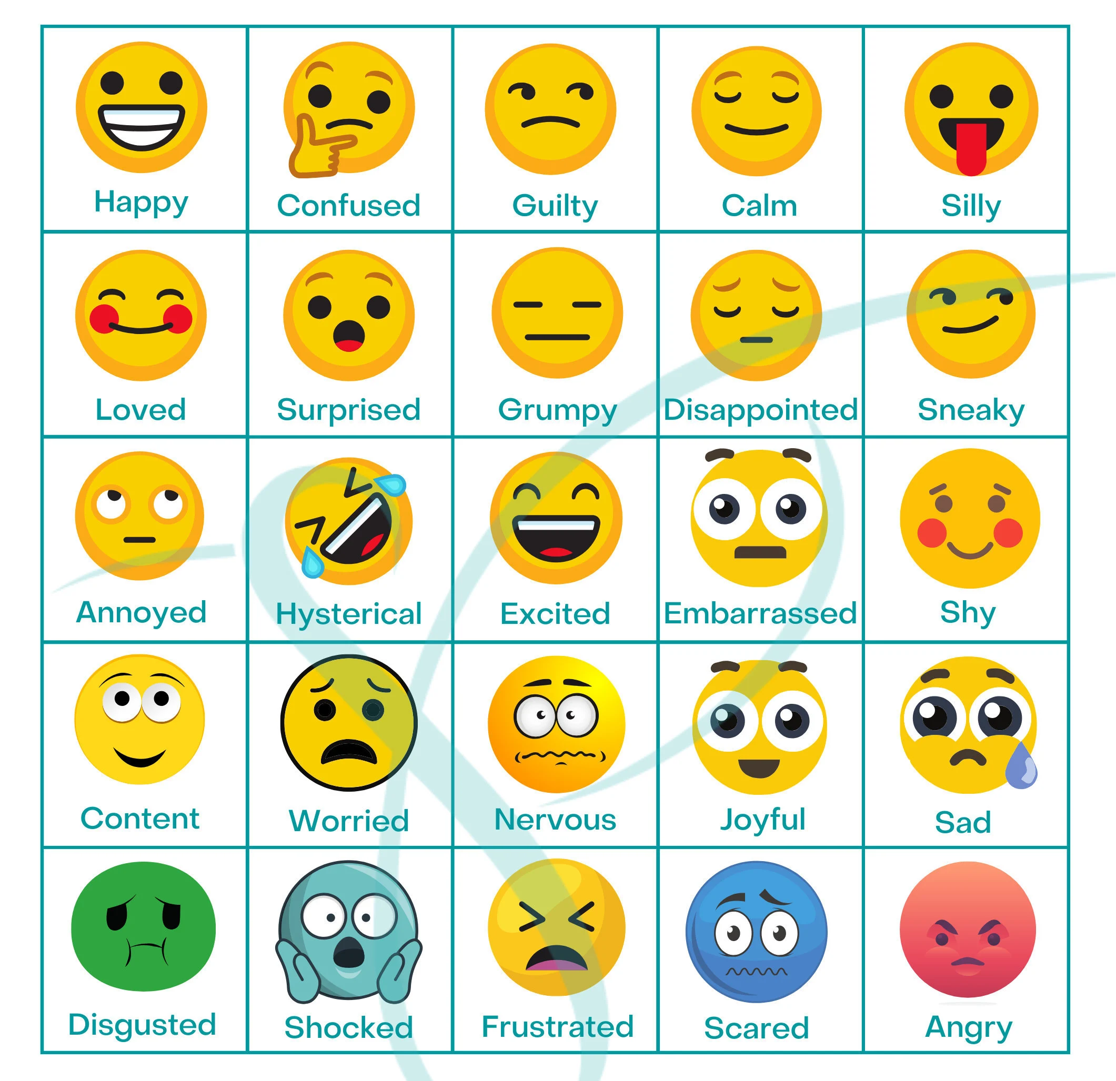
How did this poem make you feel?
What words or phrase struck you the most in this poem?

Slide 4
At one end of the classroom is a sign that says ‘Bullying’. At the other end, there is a sign that says ‘Not bullying’. Listen to your teacher as they read out the scenarios to you.
You will then need to decide which end of the room to stand. Make up your own mind, don’t follow your friend’s opinion.

Slide 5
Ismail spits into a glass of water and says he will make Ahmed drink it.
Anna accuses Marie of taking her skipping rope. The two girls have a fight in the corridor on the way out to play.
Jemma has a disability which means she can’t control her movements and causes her to jerk her hands up. A group of girls laugh at her when this happens and mimic her actions.

Slide 6
Maddie and Amy won’t let Jasmin play with them.
Jake and Ryan have had an argument. Jake kicks Ryan’s coat across the corridor.
Jodie tells Marcus each day that if he doesn’t give her his dinner money, she will beat him up.

Slide 7
Before we do the activity with the scenarios that we have just listened to, we need to be clear on the following:
Bullying is:
A deliberate act of hurting someone, it is done on purpose and it’s not accidental.
It doesn’t just happen once; it goes on over time and happens again and again.
It is unfair: the person doing the bullying is older, stronger and more powerful (or there are more of them) and even if the bully is enjoying it, the person being bullied is not.

Slide 8
You will now be given the scenarios we have just discussed to arrange and stick in your book.
Make two piles using the scenarios, one pile will be where bullying is taking place and the other pile will be where bullying is not taking place.
DO NOT STICK IN YET!

Slide 9
Activity
Choose one of the scenarios from the list that show bullying and answer the following questions. Make sure that you answer in full sentences and with lots of detail.
1. What might be the reasons for the person/people using bullying behaviours?
2. How did these behaviours make the recipient of them feel and what could they do to manage these feelings e.g. calming techniques, talking to someone.
3. How could the recipient deal with/manage the situation?

