Slide 1
Year 1 Maths
Term 4 Week 1 Thursday
Compare Mass

Slide 2
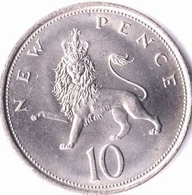
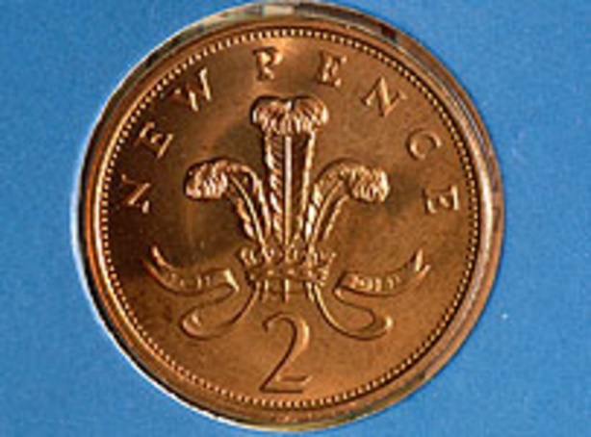
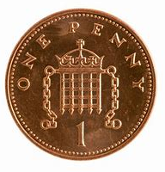
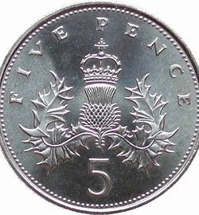
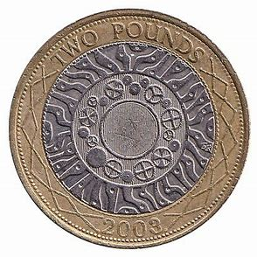
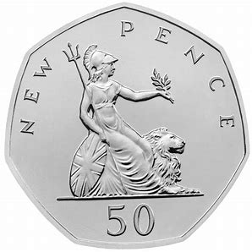
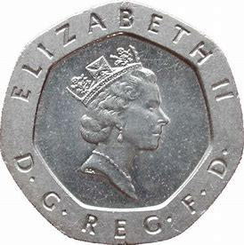
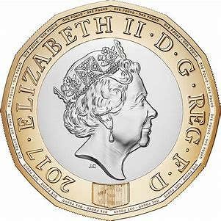
Warm up
Coin recognition

Slide 3
How many different ways can you make?
5p
10p
20p
50p

Slide 4
25.02.2021 LI: To Compare mass.
Steps to Success:
I can use words such as: more than, less than, heavier, lighter.
I can explain how I know something is heavier or lighter.
If two objects weigh the same I understand the scales will be balanced.
I can use scales to weigh everyday objects.

Slide 5
What are Weight and Mass?
The weight of an object is how hard gravity pulls down on it.
The mass of an object is how much stuff is inside something.
We can place a scale on the moon and weigh an object there. The weight will be different because the strength of gravity is different. But the mass will be the same.
We use them to discover how heavy/light objects are.

Slide 6
25.02.2021 LI: To compare mass.
Steps to Success:
I can use words such as: more than, less than, heavier, lighter.
I can explain how I know something is heavier or lighter.
If two objects weigh the same I understand the scales will be balanced.
I can use scales to weigh everyday objects.
Activity Time

Slide 12
Investigate!
Choose an object from around the room to weigh. Find one object that is heavier and one object that is lighter.

