Slide 1
Year 2 Maths
Term 4 Week 1 Tuesday
Multiplication and Division – Divide by 2

Slide 2
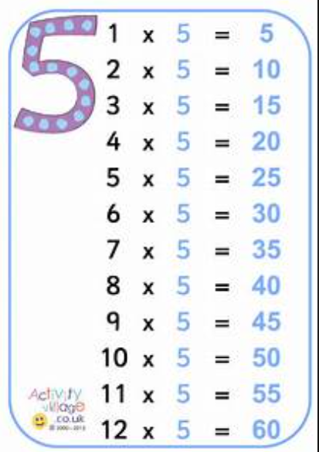
Warm Up – Do you know your 5 x Table?

Slide 3
23.02.2021 LI: divide by 2
Steps to Success:
I check each group is equal (the same).
I use what I know about counting in 2’s to help me.
I understand that by sharing into groups I am dividing ÷
I understand that ÷ is the inverse of X.

Slide 4
Click on the Picture for the Video Link

Slide 5
23.02.2021 LI: divide by 2
Steps to Success:
I check each group is equal (the same).
I use what I know about counting in 2’s to help me.
I understand that by sharing into groups I am dividing ÷
I understand that ÷ is the inverse of X.
Activity Time

