Slide 1
Book Week
Wednesday 10th March 2021

Slide 2
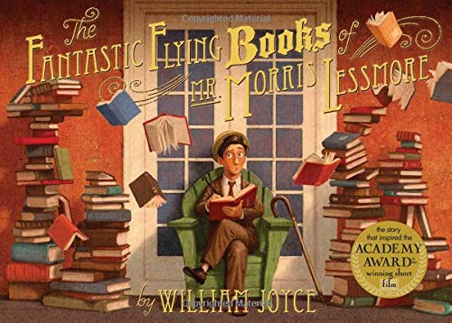

Slide 3
The Fantastic Flying Books of Mr Morris Lessmore
LI: To make predictions
Steps to Success:
I can enjoy and understand a story, that I can’t yet read myself by hearing them read and talking about them with others (Band 1 Sp&L)
I can name the letters of the alphabet in order. (Band 1)
I can name the letters of the alphabet using the letter names to tell the difference between different graphemes with the same sound. (Band 1)
I can use what I have already read or heard, or the information a teacher has given me, to help me understand what I am reading. (Band 2 Comp)

Slide 4
The Fantastic Flying Books of Morris Lessmore.
Think about the story so far. What happened to Morris Lessmore? [Next slide]

Slide 5
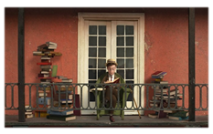
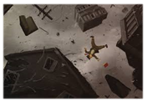
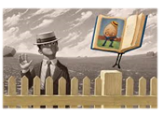
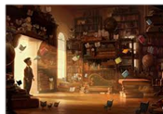
The Fantastic Flying Books of Morris Lessmore.
?

Slide 6
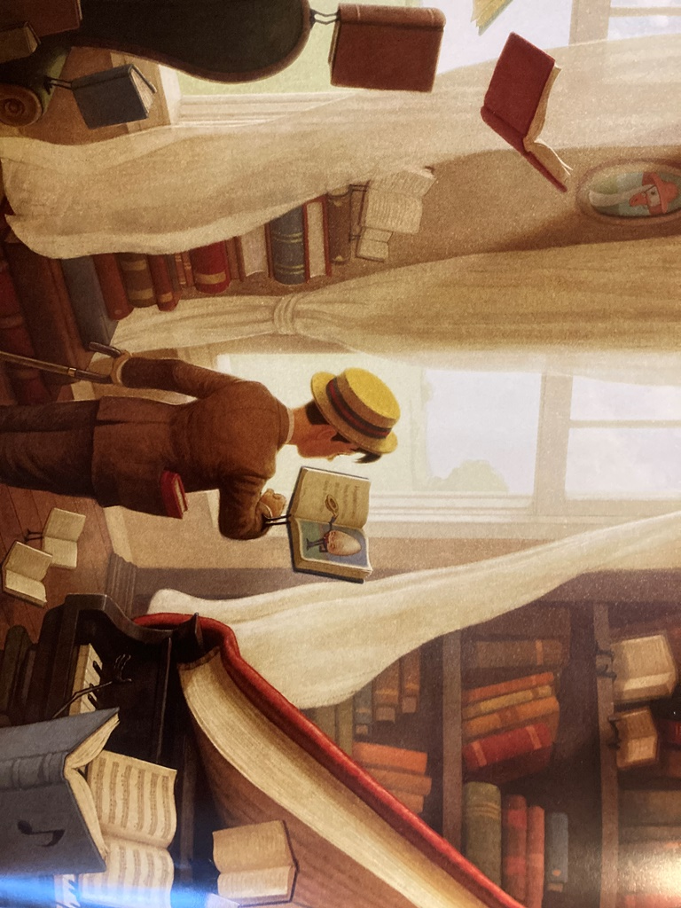
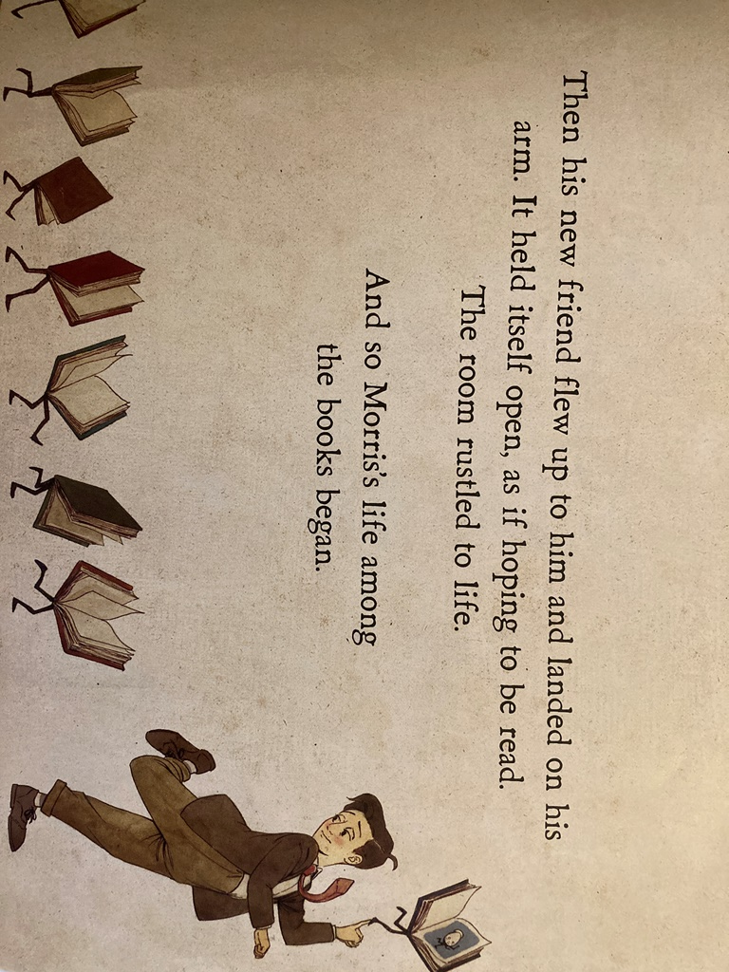

Slide 8
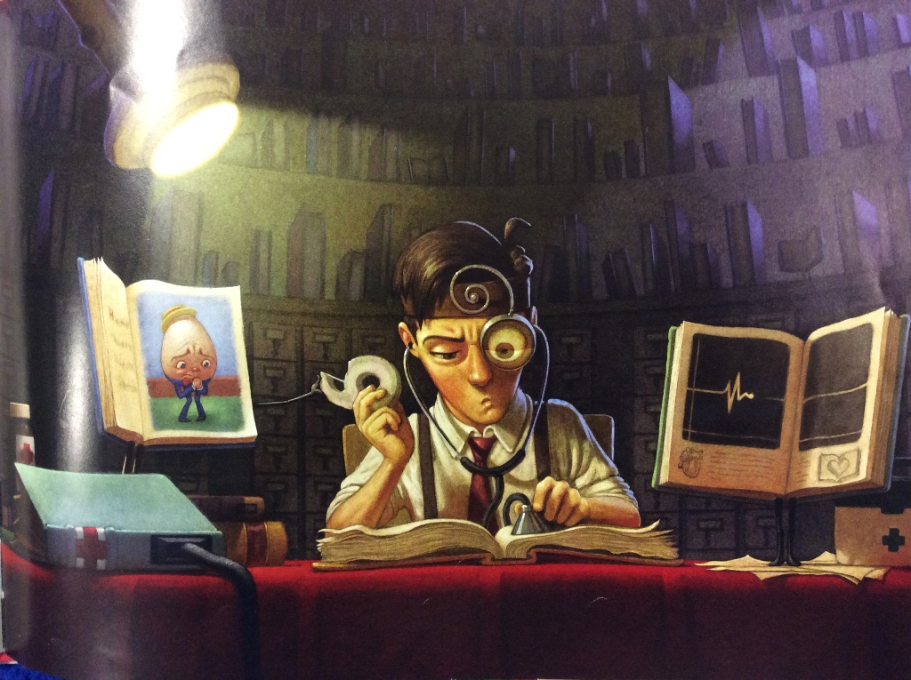

Slide 9
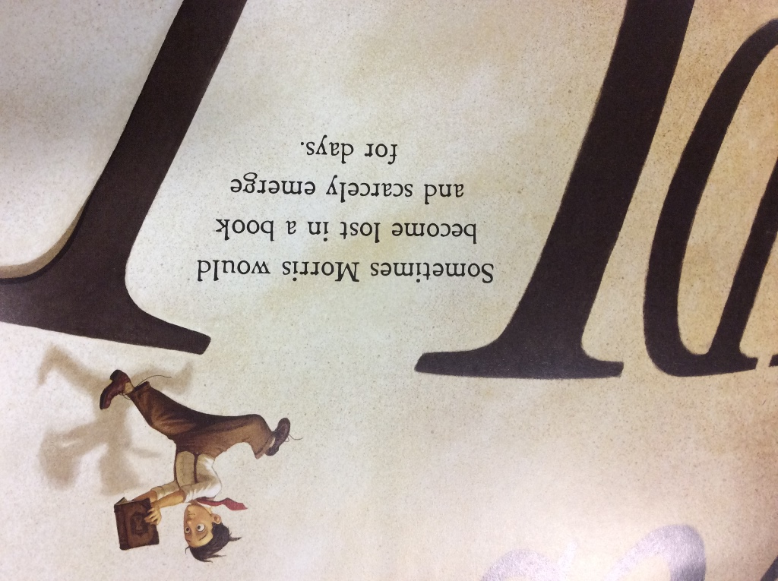
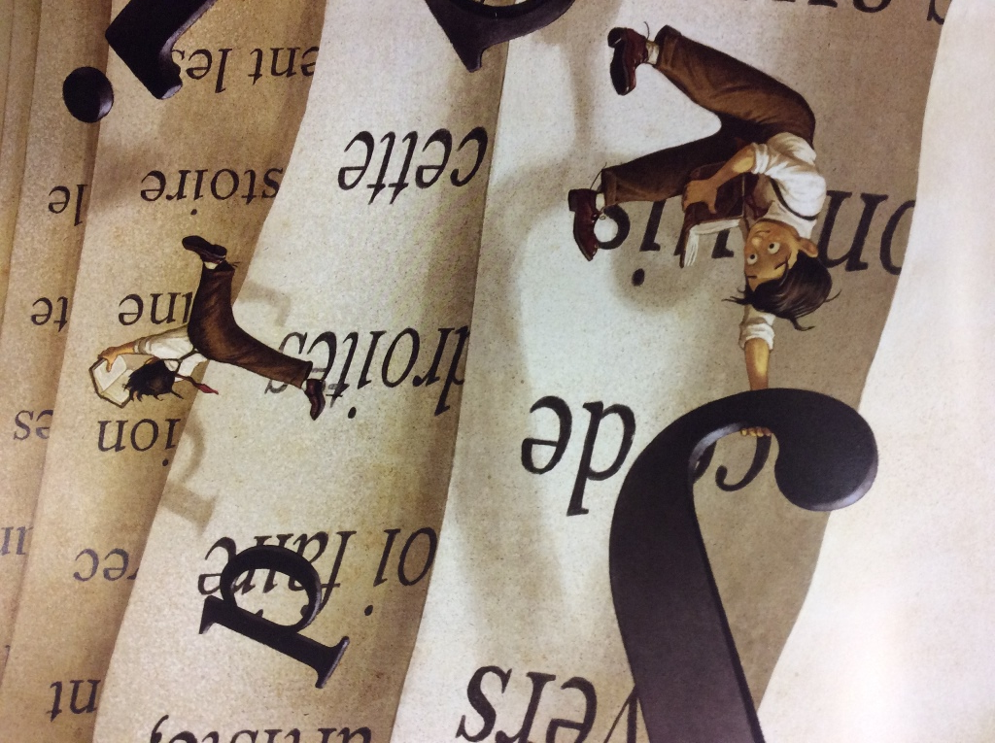

Slide 10
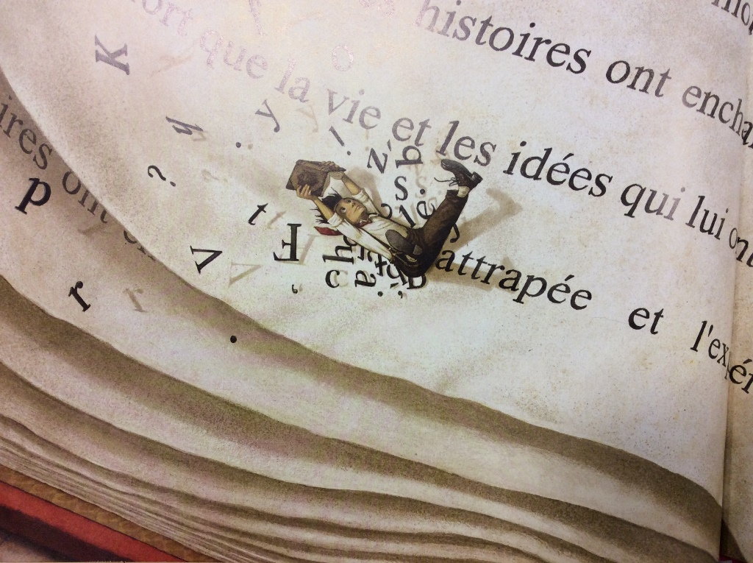
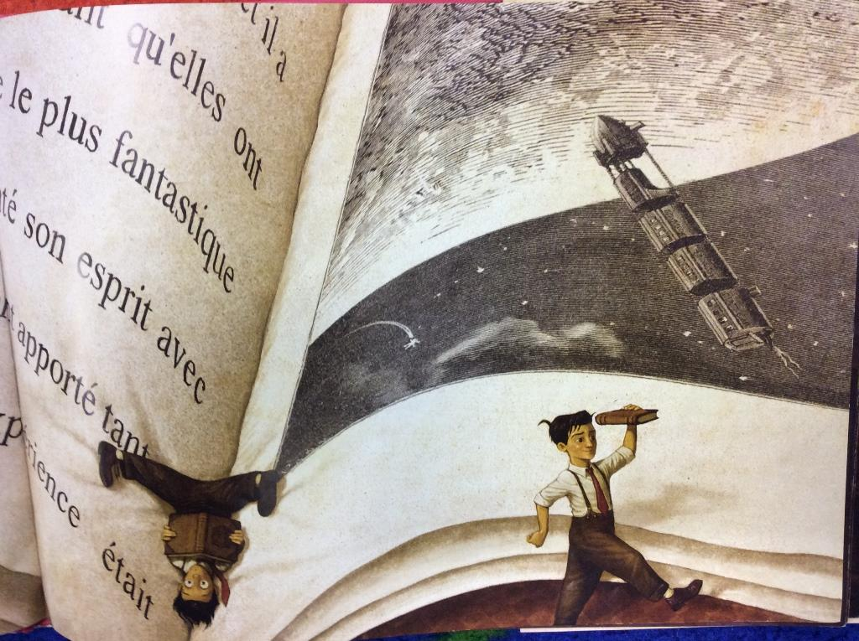

Slide 11
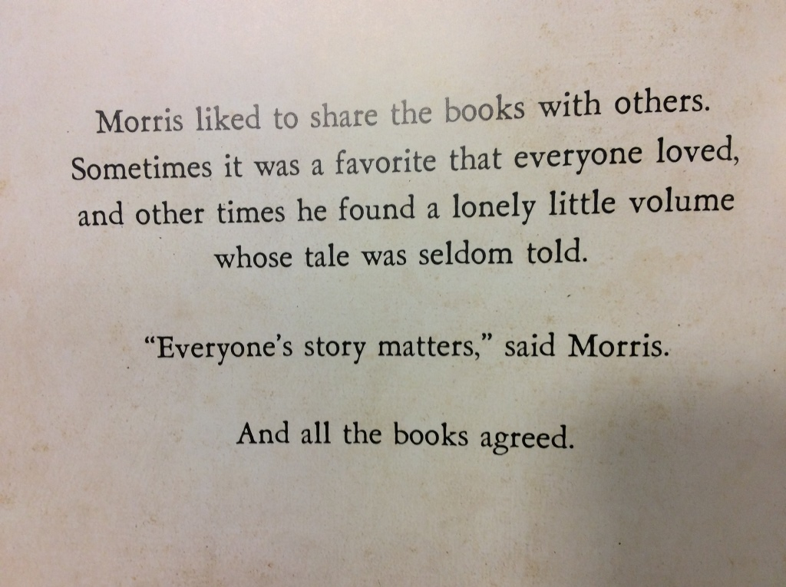
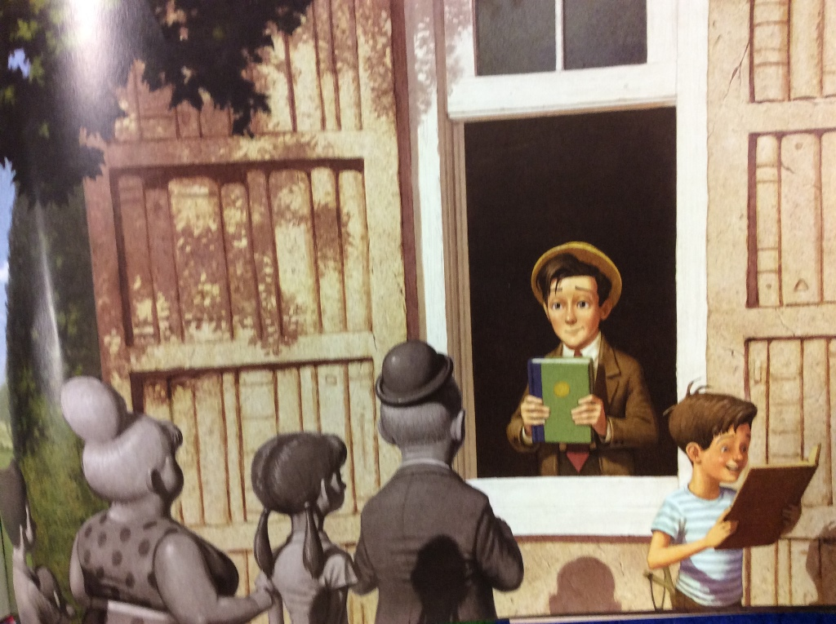

Slide 12
