Slide 1
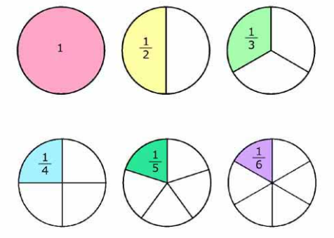
Wednesday Term 5 Week 1
Fractions

Slide 2
L.I. to understand and use fractions
PKS – Begin to recognise a half as one of two equal parts.
Band 1 – Recognise, find and name a half as one of two equal parts of an object, shape or quantity.
Band 2 – Recognise, find, name and write fractions 1/2, 1/3, 1/4, 2/4 and 3/4 of a length, shape, set of objects or quantity and demonstrate understanding that all parts must be equal parts of the whole.

Slide 3
Can you remember what a fraction is?
A fraction represents a part of a whole or, more generally, any number of equal parts. They are useful whenever we need to split things up.
A fraction has three parts. They are:
The numerator – the number above the bar.
The denominator – the number below the bar.
The vinculum – the bar separating the two numbers.

Slide 4
Yesterday we looked at half 1/2 – What can you remember?
What shapes have been cut in half? How do you know?

Slide 5
Are shapes the only things that can be split in half?
What else can you think of?
Today we are going to find half of a set of objects. T to demo with a set of 8 pencils finding half.
What will we do first? Count Why?
How will we find half? Share into two equal groups
How will we know that we have found half?

Slide 8
Activity
Looking at different sets of objects and finding half. T to take photos.
Find half of a set of objects worksheet.
Extension – Finding half of a quantity challenge.

Slide 9
Plenary
What do you know about finding half?
Was it easier for you to find half of a shape or half of a set of objects? Why?
Why is it useful to know what half looks like?
If halves are two equal parts, what do you think quarters are?

