Slide 1
Electricity
LI: Can I investigate why a bulb won’t work and how to increase the strength?

Slide 2
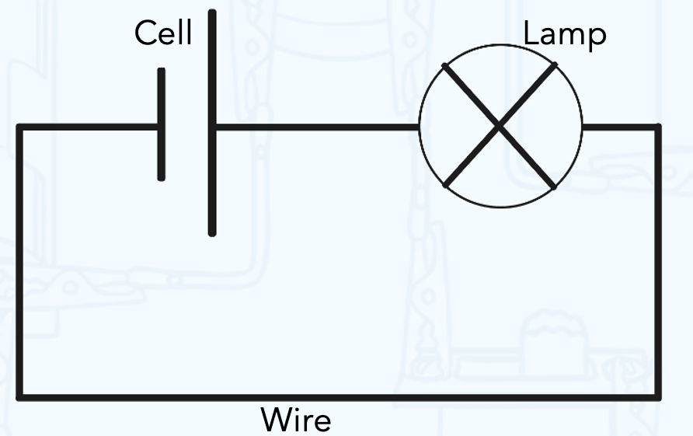
Let’s recap on our learning…
What do we know about the images show here?
What are they showing us?

Slide 3
How does a circuit work?
Let’s watch this video (to 2:00):
https://youtu.be/HOFp8bHTN30
Task 1
Thinking about what we just learned, why do you think the bulb in this circuit won’t work?
The bulb isn’t working because…

Slide 4
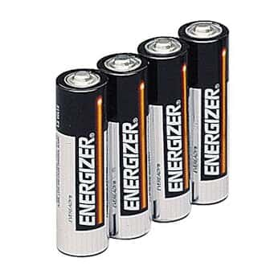
How can we increase a bulb’s brightness?
We use ‘volts’ to measure the power of a battery. The more volts a battery has the more powerful it will be.
When we want to increase the brightness of a light bulb, we need to increase the power it is receiving.

Slide 5
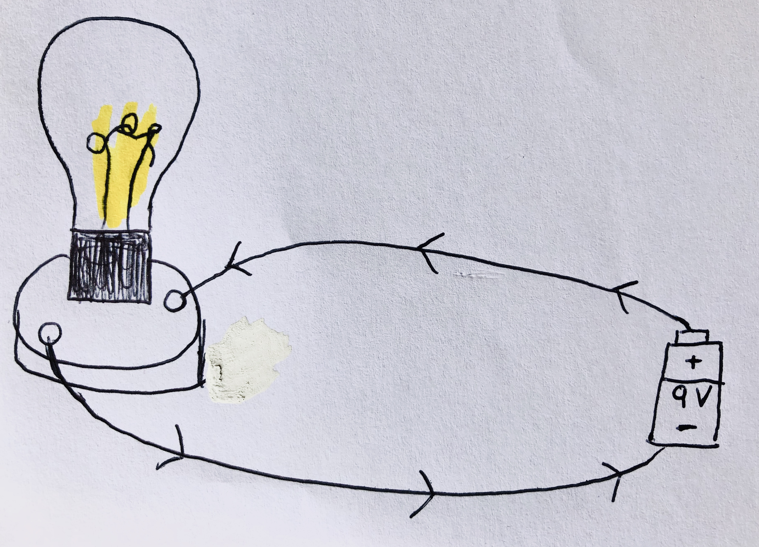
How can we increase a bulb’s brightness?
Task 2
Draw the diagram into your books.
The light from our bulb is dull and we need to find a way to increase the brightness.
How do you think we could increase the power the bulb is receiving?
Draw a diagram showing this.

Slide 6
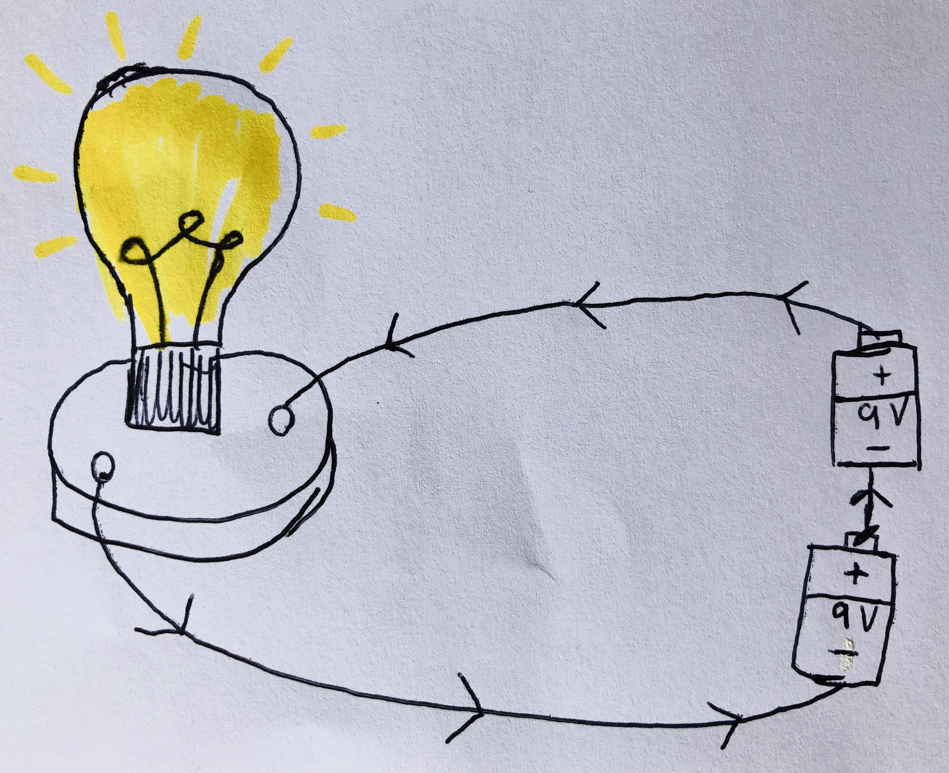
How can we increase a bulb’s brightness?
Task 2
Draw the diagram into your books.
The light from our bulb is dull and we need to find a way to increase the brightness.
How do you think we could increase the power the bulb is receiving?
Draw a diagram showing this.
Can we write an explanation of what we did to increase the brightness of the bulb?

