Slide 1
Can I compare numbers?

Slide 2
Wednesday 23.9.20

Slide 3
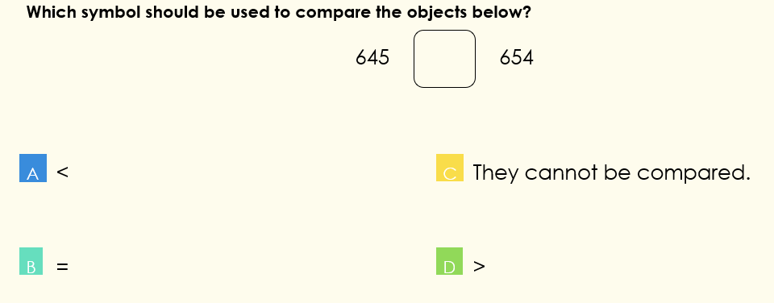
Focus task
Year 3
Year 4

Slide 4
Fluency – do and talk
Year 3: Find the greatest number in each pair
Year 4: Find the smallest amount in each pair

Slide 5
Fluency – do and talk
What strategy did you use to compare the numbers?
What materials would be useful to help you compare the numbers?
How did you know which one was the smallest / greatest?
Which column do you start comparing from? Why?

Slide 6
Fluency - variation
Year 3
Using the digits
0, 2, 3, 3, 5, 8, 8
once each time. Make as many statements as you can for
_______ < _______
(use 3-digit numbers)
Year 4
Using the digits
0, 1, 1, 4, 6, 8, 8, 9
once each time. Make as many statements as you can for
_______ > ________ (use 4-digit numbers)

Slide 7
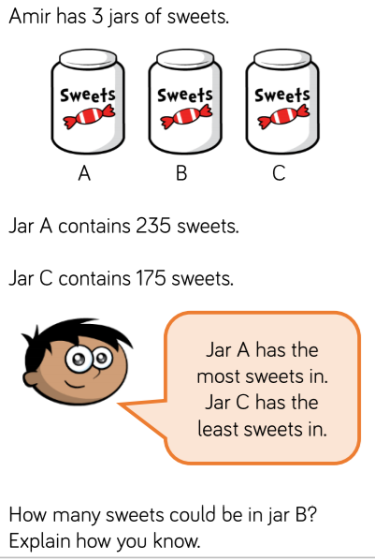
Reasoning
Year 3
Year 4
Find the mistakes and correct it. Explain what went wrong.

Slide 8
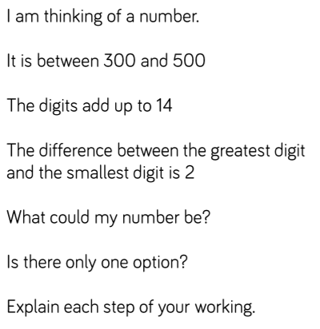
Lightbulb challenge
There are two possibilities

