Slide 1
Year 3: Can I add and subtract multiples of 100? Year 4: Can I count back through zero using negative numbers?

Slide 2
6.10.20

Slide 3
In Focus complete these in your books
Year 3
900
600 300
Can you write all the fact families for the bar model?
Year 4
Can you write all the fact families for the bar model?
1400
300
1100

Slide 4
Year 4 – Fill in your number line. Year 3 – fluency: do and talk
Complete each box for 500 + 400

Slide 5
Year 3 – Work on your independent task Year 4 – do and talk
What is a negative number?
How do we represent a negative number?
How would I write…
Negative 4?
Negative 13?
Negative 22?

Slide 6
Year 3 – Work on your independent task Year 4 – do and talk
Order these numbers from smallest to largest using inequality symbols:
-1, - 4, 0, -8, 10
8, -7, -12, 3, 7

Slide 7
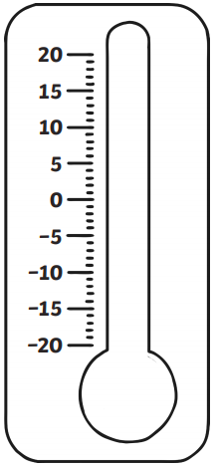
Year 4 – fluency: do and talk
Which is the warmer temperature in each pair?
5ºC and 2ºC
4ºC and - 8ºC
-12ºC and 1ºC
-3ºC and 0ºC

Slide 8
Lightbulb challenge
Year 3
There are 700 children in the school.
There are 100 more boys than girls.
How many girls are in the school?
Draw a barmodel.
Year 4
Teddy counted down in 3s until he reached -18.
The first number he said was 21, what was the tenth number he said?

