Slide 1
Can I plan an investigation?
I can decide what to change
I can decide what to measure
I can predict what will happen

Slide 2
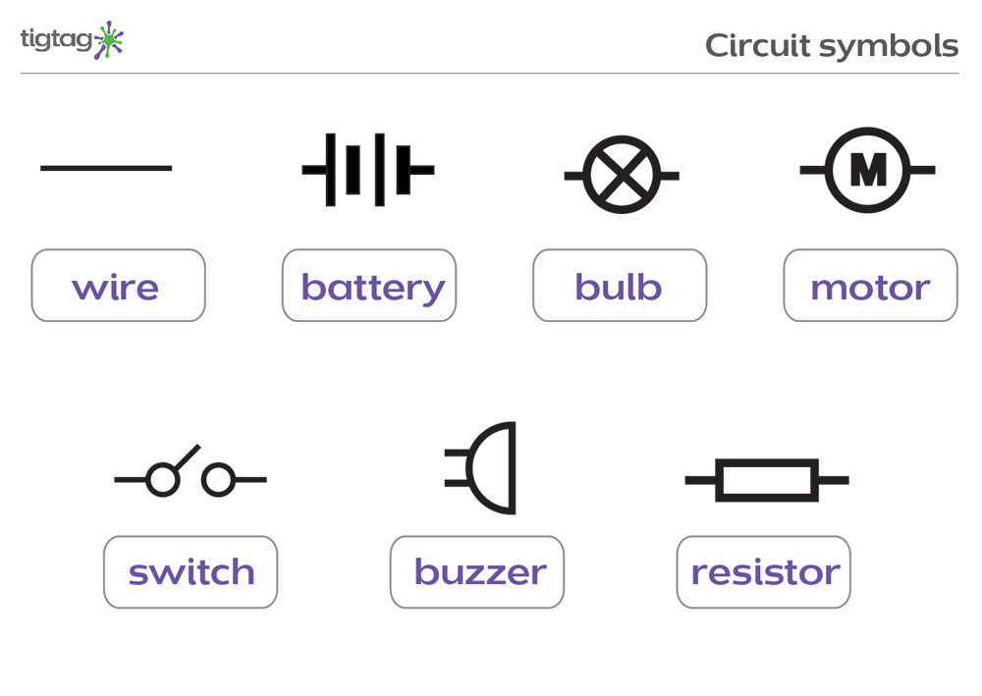
REcap:
An electrical circuit is like a circle with all components connected
Batteries (voltage) affect the brightness of a bulb
A switch opens and closes a circuit, turning a bulb, motor or buzzer on and off.

Slide 3
Plan an investigation
How does number of batteries affect the number of lego bricks picked up by a motor in a circuit?
First, we are going to gather some ideas.

Slide 4
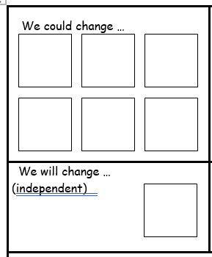
Plan an investigation
When you do an investigation there is one component you need to change each time.
With your partner, discuss what you can change in your investigation.
Write it on a post-it note

Slide 5
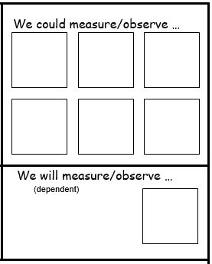
Plan an investigation
When you do an investigation there is there is something we will need to measure.
With your partner, discuss what you will measure and observe in your investigation.
Write it on a post-it note

Slide 6
Plan an investigation
When you do an investigation you need to make sure it is fair. That means you need a lot of things that stay the same each time.
With your partner, discuss what you will keep the same in your investigation.
Write it on a post-it note

Slide 7
Plan an investigation
When you do an investigation you also need to make a prediction.
What do you and your partner think will happen? Explain why.
Write it on a post-it note

Slide 8
Write up your plan
Now you have thought about your investigation and made a choice from all the options, you can complete the planning sheet.

