Slide 1
RE Day

Slide 2
Title of unit: Sukkot Journey/Covenant
Key learning:
Can I explain what the Torah is?
Can I understand the concept of the Covenant?
Can I link Sukkot to Harvest Festival?
Can I explain why Sukkot is important and why is it celebrated now?

Slide 3
What do you know about Judaism?
Have you got a religion?
What is it?

Slide 4
The Torah
Does anybody know what a Torah is?
Let’s have a look at a real one!

Slide 5
The Torah
https://www.bbc.co.uk/teach/class-clips-video/religious-studies-ks2-the-torah/zhs2t39
Watch the video.
Discuss something you have learnt from the video.

Slide 6
The Torah
We are going to create our own Torah scroll.
First, let’s watch this video of a Jewish family visiting a synagogue to observe Shabbat. If you watch carefully, you will see a Torah being taken out from the Ark, then a Rabbi reads from it in Hebrew before the scrolls are carefully put away again https://www.bbc.co.uk/bitesize/clips/zcfgkqt
In Hebrew, letters are formed and written from right to left.
Does anybody else in here speak a different language?
Jewish children sometimes make small scrolls to take to a special service at the synagogue to give thanks to God.
You are going to make small scrolls and use letters from the Hebrew alphabet as decoration. The text will be one rule for living that we can come up with together.
Extension: Can you decorate the cover and make it look special like a Torah?

Slide 7
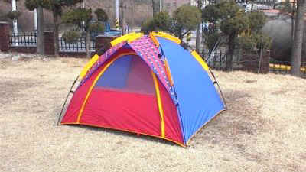
Sukkot
What is it?
Who might live in a tent and why?
Why might they use a tent?
What are the differences between a tent and a home?

Slide 8
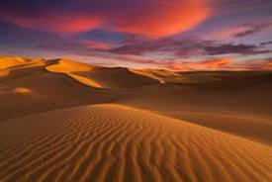
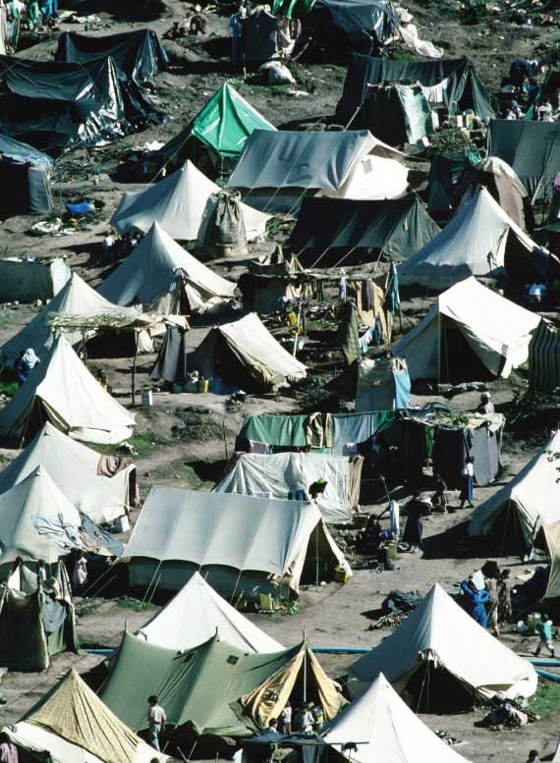
Sukkot
This picture shows refugees living in tents.
Consider what life might be like if you did not have homes and had to live in tents all of the time.
The Jewish festival of Sukkot is a time when Jews remember how their ancestors, when escaping from the Egyptiants, travelled through the desert and did not have permanent homes.
What would you use to build a shelter if you were living in a desert?
The Israelites did not have permanent homes and they called the shelters ‘booths’. Sometimes Sukkot is called the ‘Festival of the Booths’.

Slide 9
God gave Moses the commandment to remember the journey that the Israelites made.
‘ You shall live in booths seven days…in order that future generations may know that I made the children of Israel to dwell in booths when I brought them out of the land of Egypt’
Many years ago the festival was celebrated when the years’ crops were harvested before the winter. it was called the Festival of the ‘in-gathering’ to remember this.
The festival lasts for 7 days and as God commanded each family will build a sukkah. Building a sukkah is a commandment from God.
What might this mean? Another word for ’commandment’ is ‘Mitzvah’ and there are 613 in Judaism. These are very special rules as Jews believe that they were given to Moses from God and they should be followed.

Slide 10
A sukkah is a dwelling where the roof is open to the sky.
Jewish families live in or use a sukkah for the period of the festival.
Today, Jewish families might eat meals, study or socialize in the booths.
Some families sleep in the booths (especially children)!

Slide 11
We are going to build a Sukkah!
There are special rules for building a sukkah.
The Roof: must grow from the earth (the plants). Must provide more shade than sunlight. Must allow the rain in and be open to the stars. No opening must exceed 11 inches.
The Walls: there are no restrictions on the material used. There should be three walls. The fourth can be left open. Minimum height 35 inches, maximum height 35’3”.
A sukkah can be built for one person or a family.
The roof and walls can be decorated with fruit and nuts.
The sukkah should have 4 special species (Arba’at haminim) to symbolise the fertility of the land( Leviticus 23:40
Lulav—a young shoot from a palm tree.
Arravot—a branch of a willow which grows near water.
Hadassim—branches of myrtle bush.
Etrog—a citron—a fruit that looks like but is bigger that a lemon.
(Remember these plants are common in the Middle East).

Slide 12
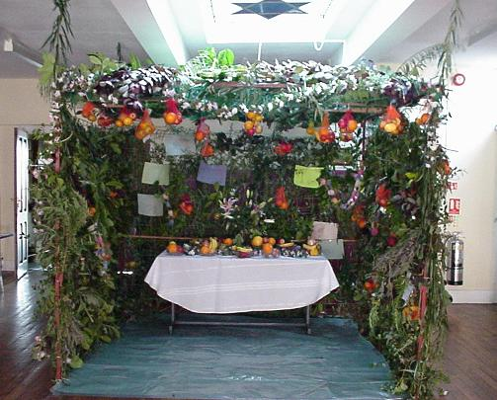
Sukkah
Consdier how you might build one in the classroom, what plants and fruits might you use?
We are going to build a sukkah and decorate it.
Then, we are going to bless it in 6 directions. N,S,E,W, up and down.
A fruit tower is often built as a centre piece for the table during Sukkot.
Use your Sukkah to have a special celebration.

