Slide 1
Biographies
Monday 19th October 2020

Slide 2
Legacy
On Friday we discussed the impression you have left on me.
Today we are going to write about how we remember Florence. Her legacy.
We are going to use conjunctions to write excellent sentences.

Slide 3
Gathering phrases
Let’s gather some thoughts about Florence Joyner.
Chot some words and phrases that describe Florence’s achievements.
Kind calling out

Slide 4
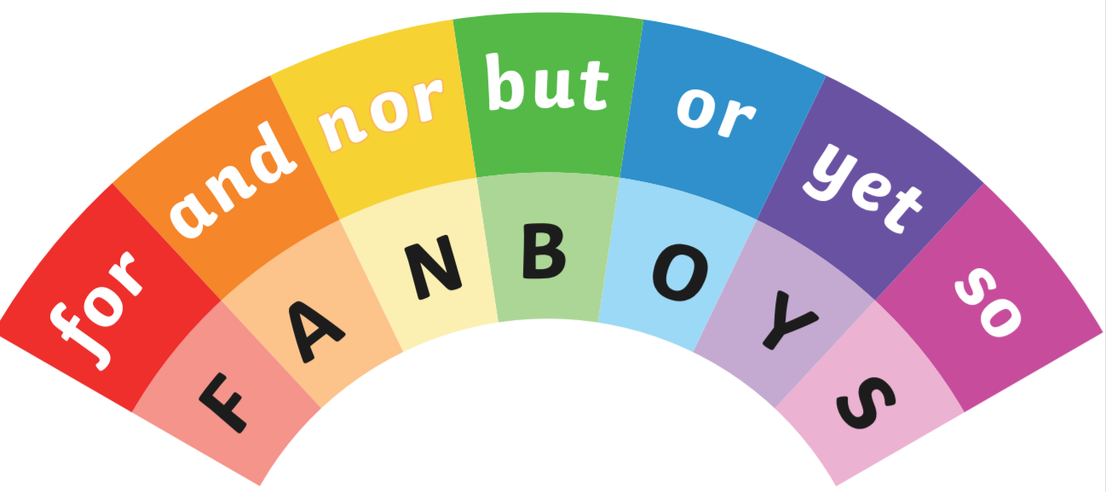
Subordinating conjunctions
Tell your partner what conjunctions are and when we use them

Slide 5
Legacy
I’m going to combine our chotted phrases about Florence using subordinating conjunctions.
Florence’s legacy that she left behind for other children to develop their athletic talents was a youth foundation. She would have liked to be remembered for her record breaking speed and dedication, but also for her fashion sense.
model
Your turn

Slide 6
Message for life
Let’s play: Relevant or not relevant
I am going to give you a message. I need you to decide with your partner if this is relevant to Florence or not relevant to Florence.

Slide 7
Message for life
model
Her message we can feel through how she lived her life is, do not be afraid to be different.
Write a sentence about what you have learned from Florence.
Your turn

Slide 8
Power of three
Think back about the positive impressions you all have left on me.
Chot positive characteristics (adjectives) about Florence. I’ll start: dedicated…
Kind calling out

Slide 9
Power of three
model
I am going to choose three and list these with a comma.
She showed grit, determination and strength.
Use three positive adjectives to describe Florence.
Your turn

