Slide 1
Biographies
Wednesday 21st October 2020

Slide 2
William the Conqueror
(1028 - 1087)
King of England

Slide 3
Independent writing
Today, you are going to plan your writing.
Using the planning grid and your notes from yesterday you are going to write your lens sentences.
First, we are going to look at William’s story plan.

Slide 4
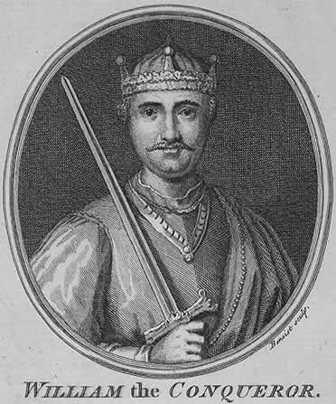
William the Conqueror
King of England
Domesday book
Castles
Feudal system
French
Soldier King
Was promised the throne of England
Parents were not married
Became a Duke age 7

Slide 5
Planning William’s biography
Look at the planning table
We are going to write the lens sentences today.
Let’s discuss your steps to success for writing William’s biography.

Slide 6
Shape | Lens | Lens sentence
 |  | Imagine what life was like for young William
 |  | Use a fronted adverbial to write a sentence about (when, where or when) William was promised he could be King.
 |  | Use conjunctions in a sentence describing how William won the Battle of Hastings and became King of England.
 |  | Use good quality verbs to list William’s legacy as King of England
 |  | William was called the Soldier King. State what he would have valued?
 |  | Write three interesting facts about William, using good adjectives, nouns, adverbs and verbs.

