Slide 1
Can I explain what a feudal system is?
- Explain the difference between a serf and a lord.
- Take part in a class discussion and give examples for my opinions.

Slide 2
Watch this video about the Feudal System.
https://www.bbc.co.uk/bitesize/guides/zdvdmp3/video

Slide 3
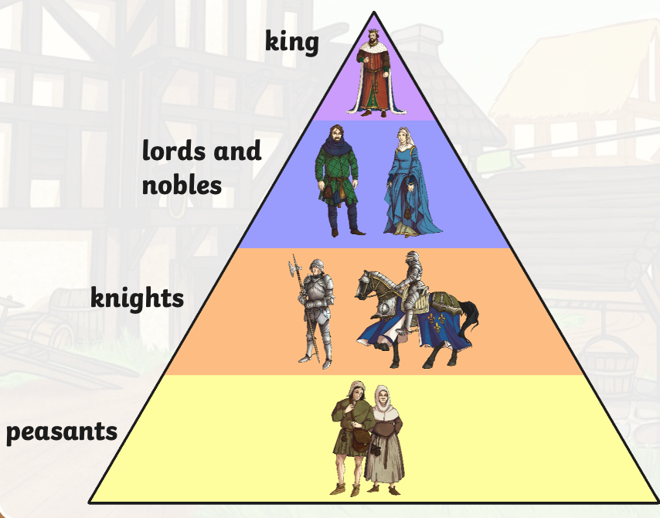
The Feudal System​
These groups were ordered into a social hierarchy, known as the Feudal System. It had the king at the top with all of the control, and the peasants at the bottom doing all of the work.
The feudal system provided order and stability. Everyone knew their place and what they had to do.
The manorial system provided for an economy that was based on farming and being self-sufficient on the manor.
serfs

Slide 4
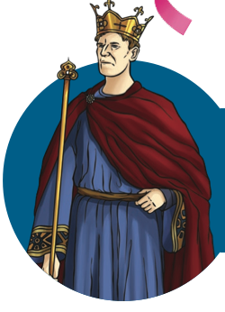
A new form of the Feudal System was introduced in England by William the Conqueror in 1066.
It was a way of him ensuring loyalty from his subjects, keeping hold of power and giving away some of his responsibilities to others to do for him.

Slide 5
Serfs and Lords
A lord is someone who owns the land.
A serf is someone who does agricultural labour for that land. If the ownership of the land is transferred, then the serf remains with the land.
This is what makes them different to slaves as slaves are owned by a person.
Would you rather be a Lord or a Serf?
I would rather be a _______ because ________ .

