Slide 1
Can I subtract 2-digit from 3-digit, regrouping tens? (Y3) Can I subtract 4-digit from 4-digit, regrouping tens? (Y4)

Slide 2
22.10.20

Slide 3
In focus task Complete these in your books using column subtraction. Year 3 134 – 32 = 134 – 31 = 256 – 51 = 384 – 12 = 334 – 14 = 825 – 15 = Year 4 3134 – 1111 = 4256 – 1140 = 6384 – 2211 = 7384 – 1122 = 2825 – 1215 =

Slide 4
Regrouping Whole class https://www.harcourtschool.com/activity/elab2004/gr3/4.html We are going to practice subtracting with regrouping tens. I will model column subtraction number sentences on the flipchart and practice drawing it out pictorially.

Slide 5
Independent/talk partners Year 3s: Your activity is to subtract 2-digits from 3-digits regrouping tens. Year 4s: Your activity is to subtract 4-digits from 4-digits regrouping tens.

Slide 6
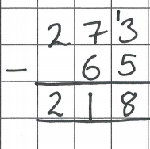
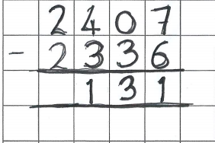
Light bulb challenge
Year 3
Spot the mistake
Year 4
Spot the mistake

