Slide 1
21/10/20

Slide 2
In focus task
How many tens and ones are in these numbers?
10 = ____ ten.
11 = ____ ten and ____ ones.
12 =
13 =
14 =
15 =
16 =
17 =
18 =
19 =

Slide 3
Regrouping
https://www.harcourtschool.com/activity/elab2004/gr3/4.html
Practice subtracting 1-digit from 2-digit with regrouping ones (Year 3).
Practice subtracting 1-digit from 3-digit with regrouping ones (Year 4).

Slide 4
Independent/Talk partners
At your tables, make each column subtraction using the manipulatives in front of you. Use the place value boxes to help you.
Make sure that you regroup when needed.
Challenge 1: Explain how you did it.
Challenge 2: Explain why you do it that way.
Challenge 3: Can you draw them pictorially too?

Slide 5
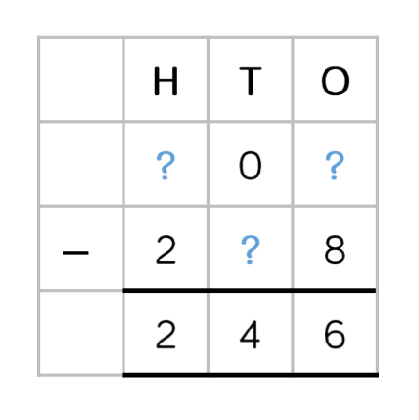
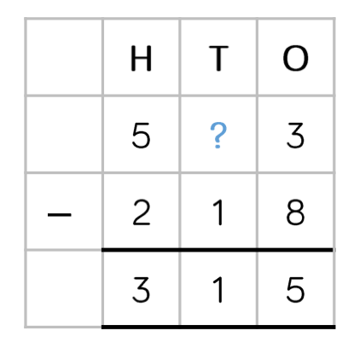
Light bulb challenge.
Year 3
Year 4
1
-
1
What are the missing digits?

