Slide 1
LI: Can I explore the 5 and 10 times tables?

Slide 2
Focus task
Year 3
Count in 5s to 50.
Count in 10s to 100.
What do you notice?
Year 4
2 x 5 = 10
2 x 10 = 20
What do you notice?

Slide 3
5 times table

Slide 4
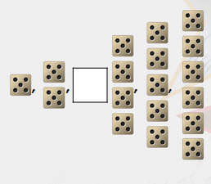
Complete the sequence below.

Slide 5
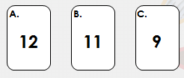
How many 5s are in 55?

Slide 6
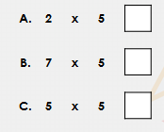
Tick the calculation that is equal to 25.

Slide 7
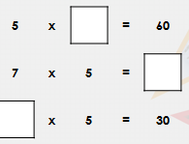
Complete the calculations below.

Slide 8
10 times table.

Slide 9
True or false?
If I multiply 9 by 10 the answer will be 90.

Slide 10
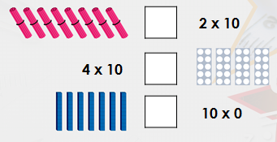
USE <, > or = to complete the statements below.

Slide 11
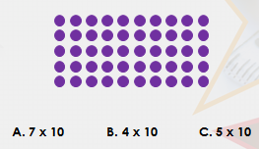
Circle the correct calculation to match the array below.

Slide 12
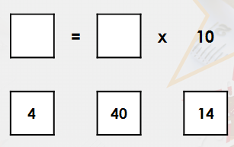
Choose the correct numbers to complete the number sentence.

Slide 13
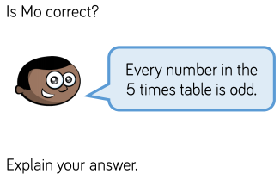
Lightbulb challenge
Year 4​
Year 3

