Slide 1
Design Technology
Can I design my own Chariot?
Can I plan how I am going to make the Chariot?

Slide 2
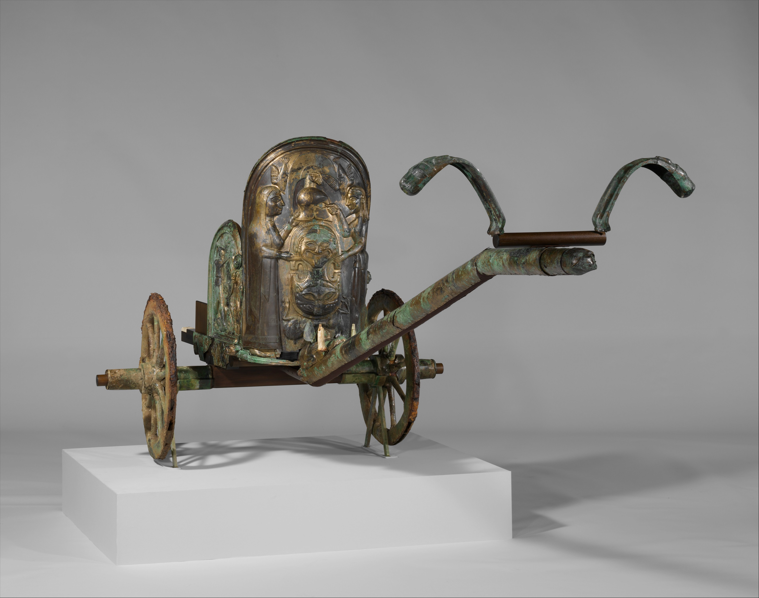
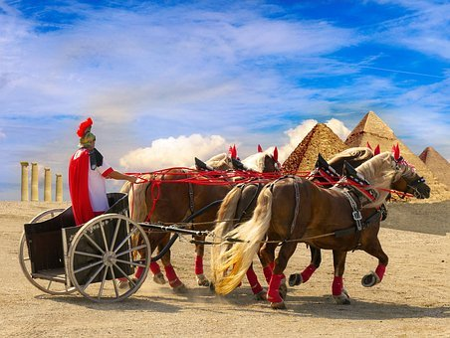
Roman chariots
Last week, you learned about Roman chariots and how they used axles and wheels.

Slide 3
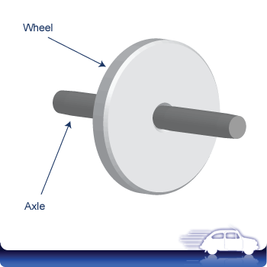
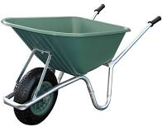
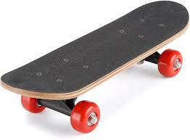
Recap Axles
An axle is a rod shaft which passes through a wheel.

Slide 4
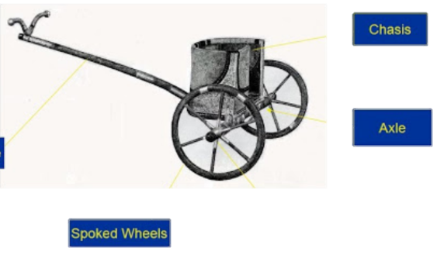
Chariots
For your own design, you need to include all of the main parts:
Carriage
Wheels
Axles
Shaft
Carriage
Pole

Slide 5
Think about
Could I change the shape of the carriage?
Could I add more detail?
What about changing the size of the wheels?
How can I make my chariot better?
A roof? A seat?

Slide 6
Task 1
Draw your design neatly and carefully.
Label all the parts.
Tell us how you have improved it and about any special features or details.
Look at the examples on the last page to give you some ideas.

Slide 7
Task 2
Ask your grown-ups to help you make a list of all the things you may need to make the Chariot next week.
Try and think of things you already have at home you can re-use (cereal box, straws or skewers, bottle lids for the wheels, paper).

Slide 8
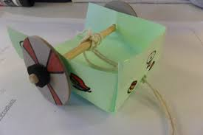
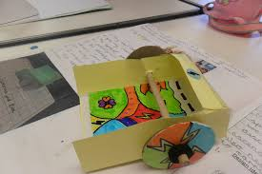
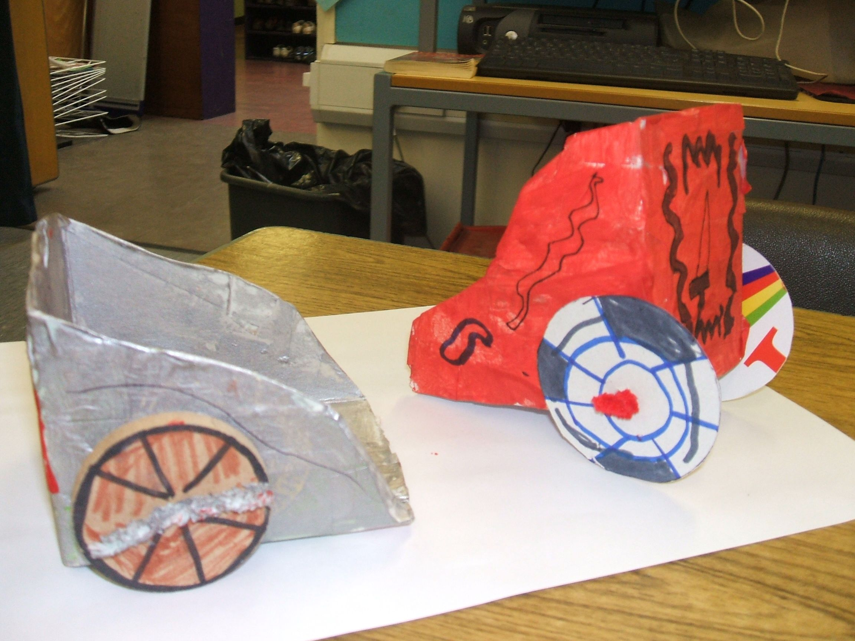
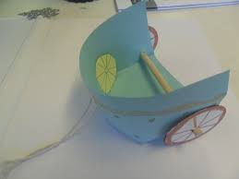
Examples to give you ideas

