Slide 1
What is perimeter? Activity
Year 3 Friday 5th^{th} February 2021

Slide 2
Watch the video
https://vimeo.com/507042543
Now complete the activity
There is some 1cm by 1cm squared paper for you to print off, if you would like to, on the next slide.

Slide 3
1cm x 1cm squares

Slide 4
ANSWER sheets
Please check your answers using the answer sheets on the next slide.
If you have made a mistake, can you explain what you did wrong and what you should have done instead?

Slide 5
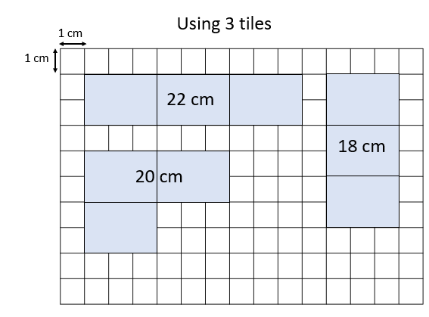

Slide 6
