Slide 1
Can I order lengths in metres (m) and centimetres (cm)?
Years 3 and 4 alternative provision
Monday 1st February 2021
Recap lesson

Slide 2
Watch the video
https://vimeo.com/405439587
Now complete the questions on the next slides

Slide 4
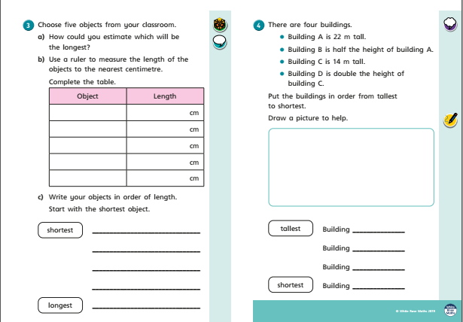

Slide 6
ANSWER sheets
Please check your answers using the answer sheets on the next slide.
If you have made a mistake, can you explain what you did wrong and what you should have done instead?

Slide 8
