Slide 1
Can I compare lengths?
Year 3 Tuesday 2nd February 2021

Slide 2
Watch the video
https://vimeo.com/425555865
Now complete the questions on the next slides

Slide 3
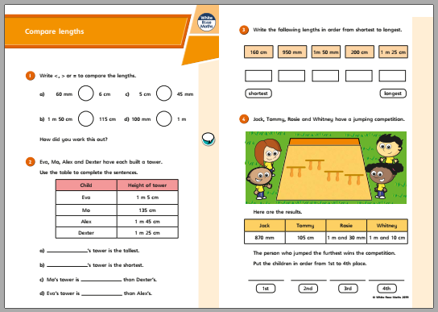

Slide 4
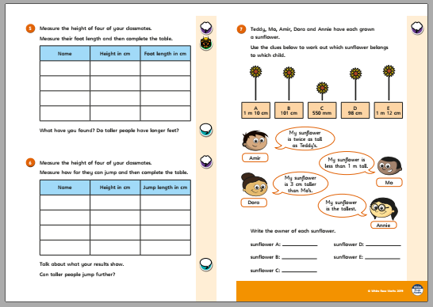

Slide 6
ANSWER sheets
Please check your answers using the answer sheets on the next slide.
If you have made a mistake, can you explain what you did wrong and what you should have done instead?

Slide 8
