Slide 1
Can I measure length in cm?
Years 3 and 4 alternative provision
Wednesday 3rd February 2021

Slide 2
Go through the powerpoint presentation
Complete the questions on the slides

Slide 3
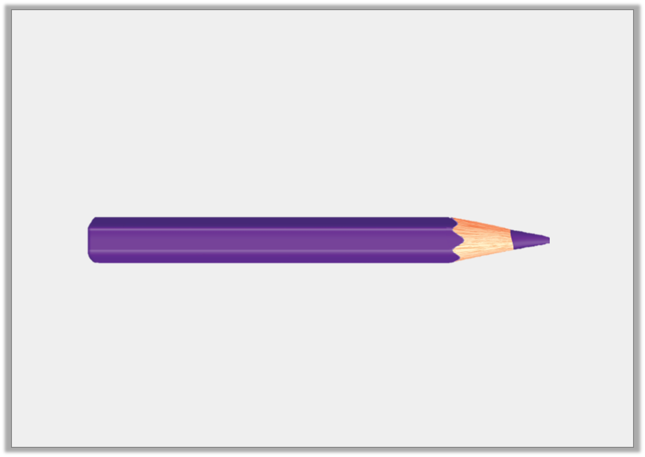
Introduction
What would you use to measure a pencil?

Slide 4
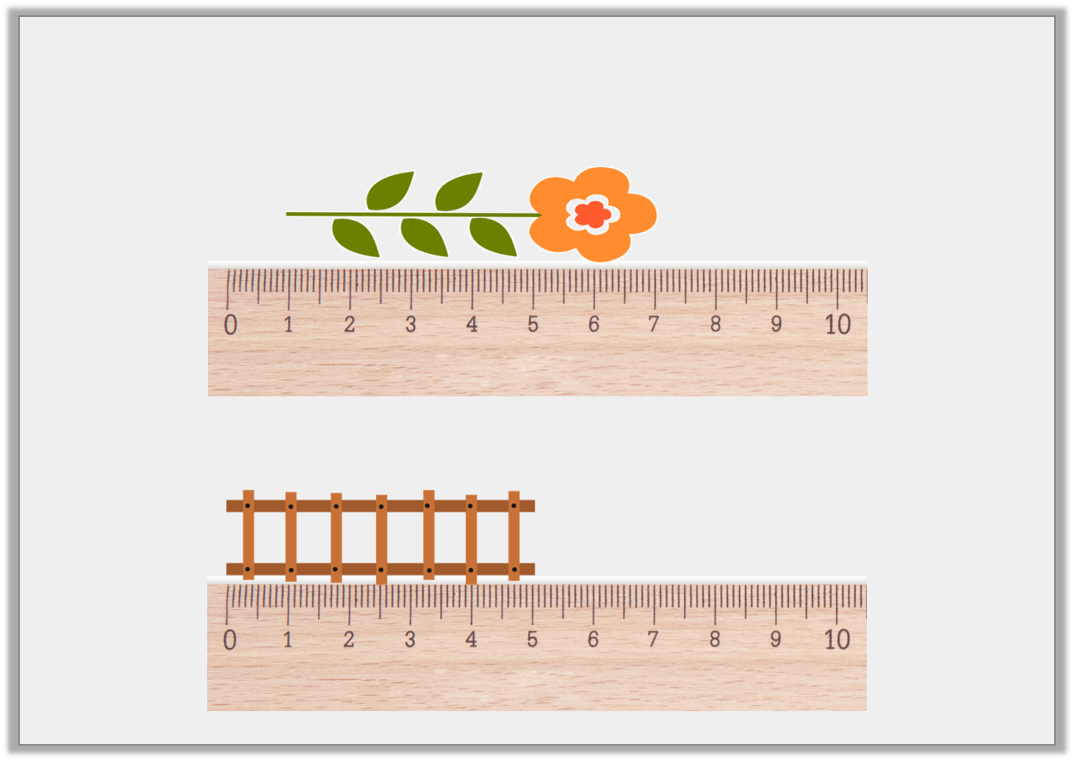
Varied Fluency 1
How long are these objects in centimetres?
A
B

Slide 5
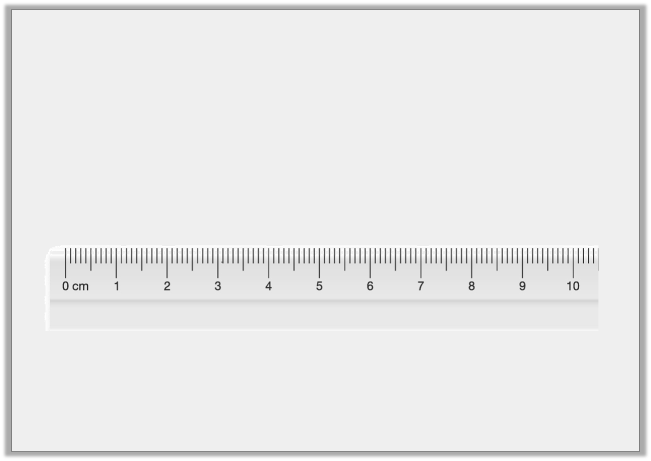
Varied Fluency 2
Matthew draws a 2cm line. He starts at the arrow.
What number will he finish at?

Slide 6
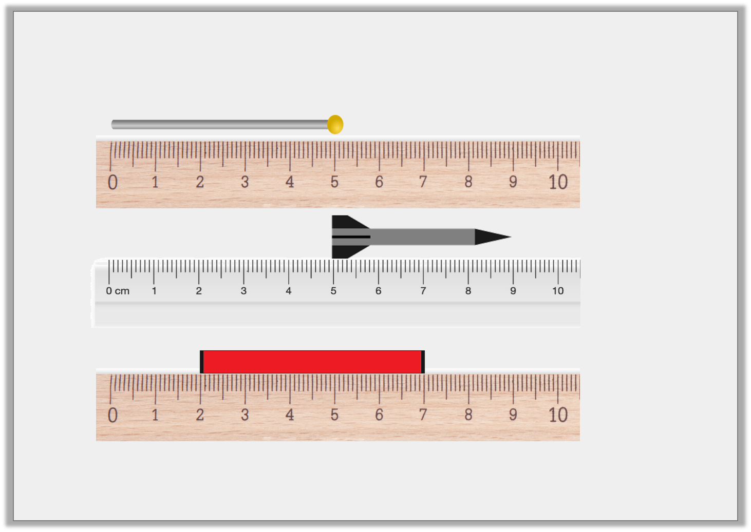
Reasoning 1
Which is the odd one out?
A.
B.
C.

Slide 7
Reasoning 1
Which is the odd one out?
A.
B.
C.
B is the odd one out because…

Slide 8
Reasoning 2
James and Laura are measuring the length of a train.
James says,
The train is 5cm long.
Laura says,
The train is 6cm long.
Who is correct? Explain your answer.

Slide 9
Reasoning 2
James and Laura are measuring the length of a train.
James says,
The train is 5cm long.
Laura says,
The train is 6cm long.
Who is correct? Explain your answer.
Laura is correct because…

Slide 10
Problem Solving 1
Harry’s flag measures between 7cm and 12cm in length.
What are the possible lengths his flag could be?

Slide 11
ANSWER sheets
Please check your answers using the answer sheets on the next slide.
If you have made a mistake, can you explain what you did wrong and what you should have done instead?

Slide 12
Introduction
What would you use to measure a pencil?
A ruler or a tape measure.

Slide 13
Varied Fluency 1
How long are these objects in centimetres?
6cm
A
B
5cm

Slide 14
Varied Fluency 2
Matthew draws a 2cm line. He starts at the arrow.
What number will he finish at?
6cm

Slide 15
Reasoning 1
Which is the odd one out?
A.
B.
C.
B is the odd one out because it is 4cm. The other two are 5cm long.

Slide 16
Reasoning 2
James and Laura are measuring the length of a train.
James says,
The train is 5cm long.
Laura says,
The train is 6cm long.
Laura is correct because she has taken into account that the object is measured from 1cm and not 0cm.

Slide 17
Problem Solving 1
Harry’s flag measures between 7cm and 12cm in length.
What are the possible lengths his flag could be?
Various answers, for example: 8cm, 9cm, 10cm and 11cm.

