Slide 1
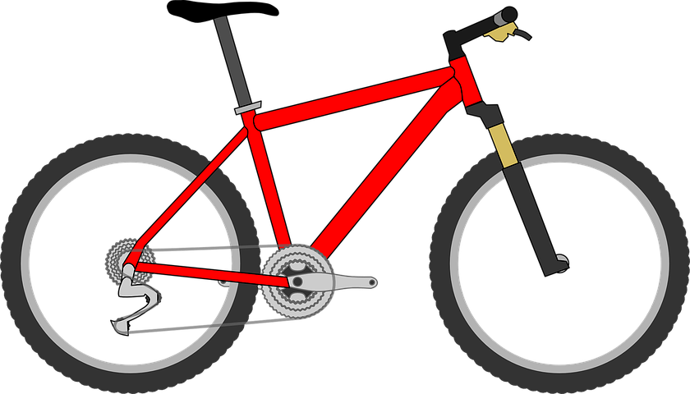
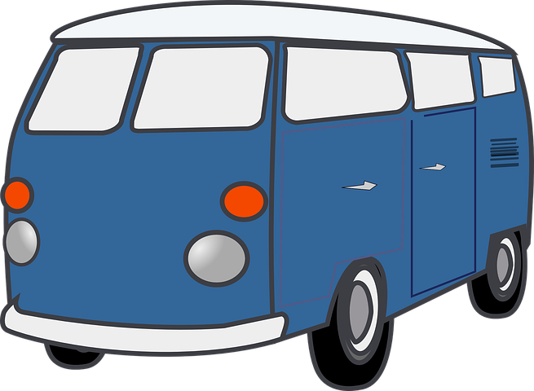
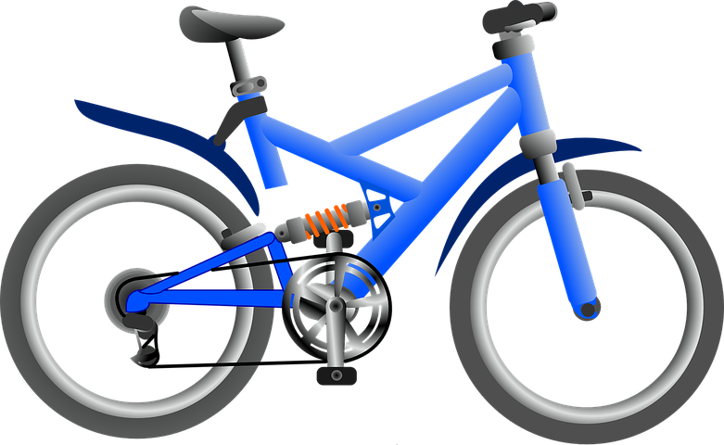
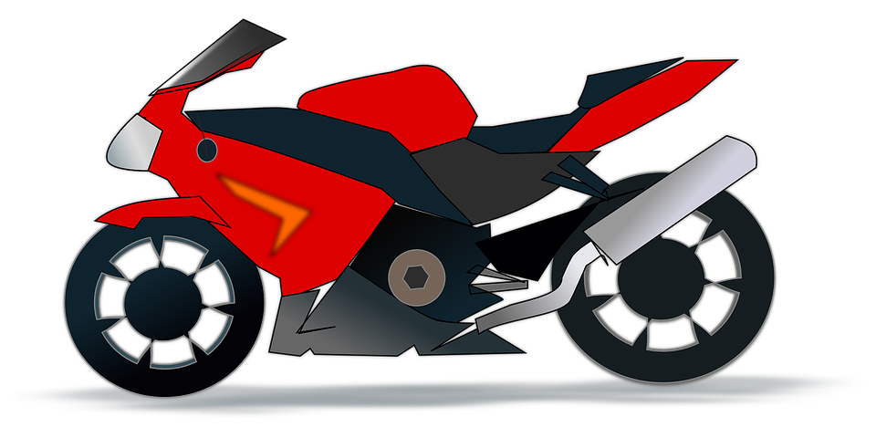
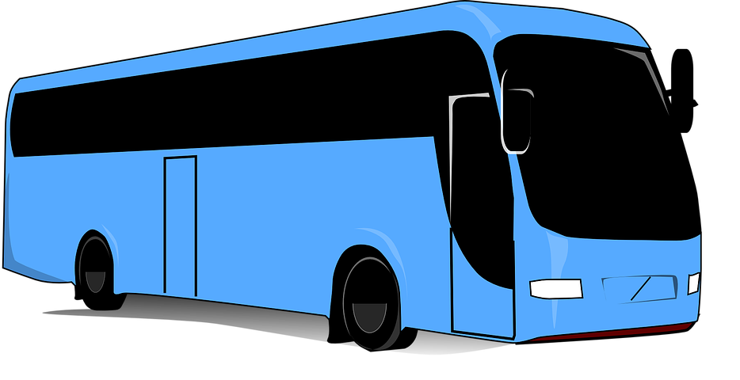
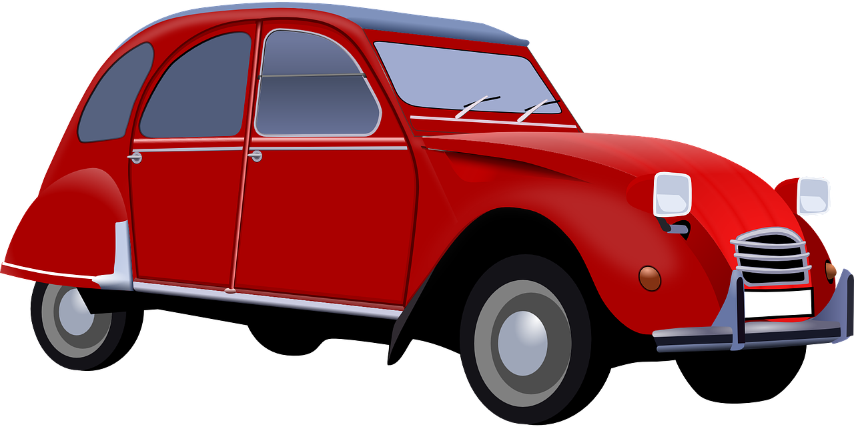
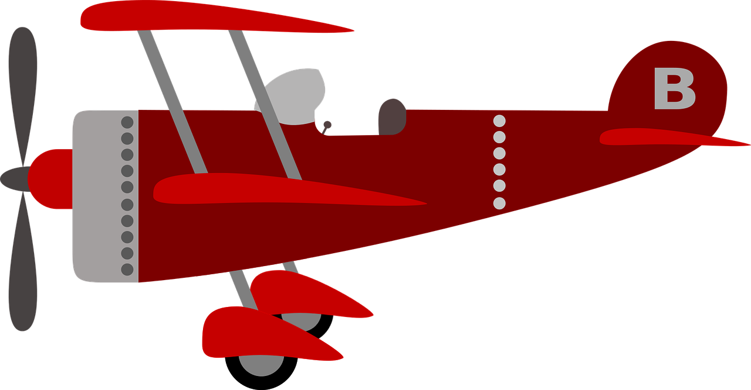
Year 3 – Branching databases Lesson 1 – Yes or no questions | Learner worksheet Save a copy
Asking questions
Write at least two questions that have a yes or no answer. The answer should sort the pictures into two groups that are roughly the same size.
Question |  |  |  |  |  |  |  | Total ‘Yes’ | Total ‘No’
Example: Does it have handlebars? | √ | X | √ | √ | X | X | X | 3 | 4
This resource is available online at ncce.io/dat3-1-a3-w. Resources are updated regularly — please check that you are using the latest version.
This resource is licensed under the Open Government Licence, version 3. For more information on this licence, see ncce.io/ogl.
Notes:
Last updated: 01-07-20
Red plane: https://pixabay.com/illustrations/children-s-plane-red-kids-plane-1789559/
Red bicycle: https://pixabay.com/vectors/bicycle-red-bike-cycle-cycling-311656/
Red car: https://pixabay.com/vectors/car-vintage-red-old-automobile-33633/
Blue bicycle: https://pixabay.com/vectors/bicycle-blue-vehicle-transportation-26558/
Blue coach: https://pixabay.com/vectors/bus-travel-transport-vehicle-road-312564/
Camper van: https://pixabay.com/vectors/van-camping-automobile-automotive-150081/
Red motorbike: https://pixabay.com/vectors/motor-cycle-motorbike-motorcycle-42422/

