Slide 1
Lesson 1: Yes or no questions
Save a copy
Data and information – Branching databases
Notes:
Last updated: 01-07-20
This resource is available online at ncce.io/dat3-1-s. Resources are updated regularly — please check that you are using the latest version.
This resource is licensed under the Open Government Licence, version 3. For more information on this licence, see ncce.io/ogl.

Slide 2
Objectives
L.I. Can I create questions with yes/no answers?
Steps to success:
I can investigate questions with yes/no answers
I can make up a yes/no question about a collection of objects
I can create two groups of objects separated by one attribute

Slide 3
Different questions
Introduction
When do you eat breakfast?
How do you get to school each morning?
Is it raining?
What is your favourite food?
Is a parrot a bird?
Are the walls in the classroom pink?
?
Notes:
Pair the learners and have them take turns in asking each other the questions provided. Encourage them to think carefully about the answers that each question elicits.
Green dinosaur: https://pixabay.com/vectors/dino-dragon-dinosaur-animal-2026962/

Slide 4
Different questions
Introduction
Think:
What is different about the answers you gave?
Would everyone give the same answers to these questions?
Questions can need different types of answers.
Notes:
Allow the learners time to discuss the question. Click and explain to the learners that some questions require different types of answers.
Question mark: https://pixabay.com/illustrations/question-mark-why-icon-blue-usa-1332062/

Slide 5
Open-ended questions
Introduction
Some answers are open-ended. You can give an opinion or add more detail.
What is your favourite food?
I really like salad with lots of leaves.
Notes:
Green dinosaur: https://pixabay.com/vectors/dino-dragon-dinosaur-animal-2026962/
Purple dinosaur: https://pixabay.com/vectors/dinosaur-cartoon-purple-cute-312094/

Slide 6
Yes or no questions
Introduction
Other answers are factual and can only be answered yes or no.
Is it raining?
No.
Notes:
Green dinosaur: https://pixabay.com/vectors/dino-dragon-dinosaur-animal-2026962/
Purple dinosaur: https://pixabay.com/vectors/dinosaur-cartoon-purple-cute-312094/

Slide 7
Yes or no questions
Introduction
Think:
Why can a yes or no answer be useful?
Notes:
Take suggestions from the learners and click to animate the following reasons:
Quicker to give
Easier to understand
Clearer

Slide 8
Yes or no questions
Introduction
Think:
Why can a yes or no answer be useful?
Quicker to give
Easier to understand
Clearer
Notes:
Take suggestions from the learners and click to animate the following reasons:
Quicker to give
Easier to understand
Clearer

Slide 9
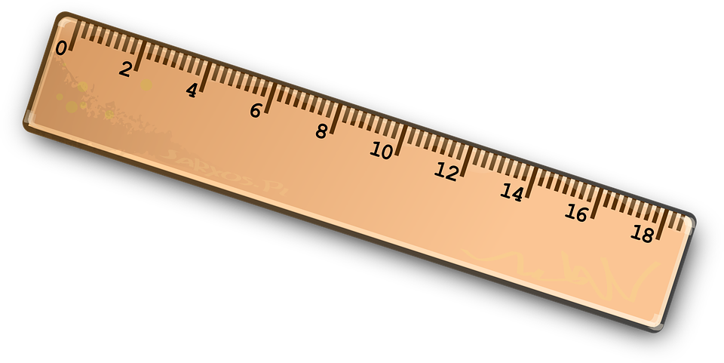
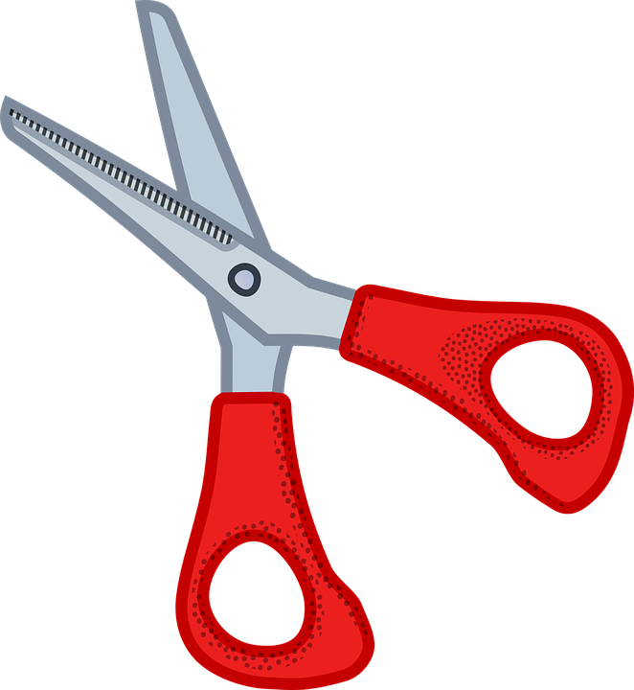
Can you ask questions to guess which object is chosen?
Activity 1
Play this game with someone at home. You can play more than once.
One of you chooses a picture from this slide
The other asks questions to find out which object was chose – what questions could you ask?
You can only ask questions with yes and no answers!
Notes:
Explain that you have chosen an object (notepad). The learners must think of questions with clear yes or no answers to ask you to identify it.
Note: Learners may have experience of playing games such as Guess Who?. Tell them that this game will be similar.
If needed, provide the learners with an example question (“Does it have red on it?”). Drag the ‘crosses’ to the objects that do not. Ask the learners to continue discussing what questions they could ask to find the object.
Take suggested questions from the learners and cross off those that don’t apply. For example, “Is it sharp?”, “no” – cross off the scissors and the red coloured pencil. If a learner poses a question that doesn't have a yes or no answer, give an ambiguous answer and explain that you can’t cross things off if the question isn’t yes or no. Possible questions may include:
Is it sharp?
Is it made of ____?
Is it smooth?
Pencil: https://pixabay.com/vectors/school-pencil-pen-write-sketch-153561/
Eraser: https://pixabay.com/vectors/eraser-school-supplies-office-23659/
Notepad: https://pixabay.com/vectors/school-exercise-book-study-learn-161701/
Scissors: https://pixabay.com/vectors/cut-scissors-tool-1295044/
Ruler: https://pixabay.com/vectors/ruler-straight-edge-tool-geometry-145940/
Red pen: https://pixabay.com/illustrations/marker-sharpie-office-pen-paint-4643862/
Red coloured pencil: https://pixabay.com/vectors/pencils-colored-pen-write-pencil-161141/
Sharpener: https://pixabay.com/vectors/sharpener-stationery-school-pencil-4704862/
Glue: https://pixabay.com/vectors/glue-bottle-orange-blue-fluid-306757/
Cross adapted from: https://pixabay.com/vectors/cross-delete-remove-cancel-abort-296507/

Slide 10
Think: How have these objects been grouped?
Activity 2
Notes:
Bring the learners back together.
Answer: Some red and no red. Take suggestions from the learners and click to animate the group labels. Explain that none of the objects are completely red but some have red on them, so the labels reflect this.
Pencil: https://pixabay.com/vectors/school-pencil-pen-write-sketch-153561/
Eraser: https://pixabay.com/vectors/eraser-school-supplies-office-23659/
Notepad: https://pixabay.com/vectors/school-exercise-book-study-learn-161701/
Scissors: https://pixabay.com/vectors/cut-scissors-tool-1295044/
Ruler: https://pixabay.com/vectors/ruler-straight-edge-tool-geometry-145940/
Red pen: https://pixabay.com/illustrations/marker-sharpie-office-pen-paint-4643862/
Red coloured pencil: https://pixabay.com/vectors/pencils-colored-pen-write-pencil-161141/
Sharpener: https://pixabay.com/vectors/sharpener-stationery-school-pencil-4704862/
Glue: https://pixabay.com/vectors/glue-bottle-orange-blue-fluid-306757/

Slide 11
Think: How have these objects been grouped?
Activity 2
Some red
No red
Notes:
Bring the learners back together.
Answer: Some red and no red. Take suggestions from the learners and click to animate the group labels. Explain that none of the objects are completely red but some have red on them, so the labels reflect this.
Pencil: https://pixabay.com/vectors/school-pencil-pen-write-sketch-153561/
Eraser: https://pixabay.com/vectors/eraser-school-supplies-office-23659/
Notepad: https://pixabay.com/vectors/school-exercise-book-study-learn-161701/
Scissors: https://pixabay.com/vectors/cut-scissors-tool-1295044/
Ruler: https://pixabay.com/vectors/ruler-straight-edge-tool-geometry-145940/
Red pen: https://pixabay.com/illustrations/marker-sharpie-office-pen-paint-4643862/
Red coloured pencil: https://pixabay.com/vectors/pencils-colored-pen-write-pencil-161141/
Sharpener: https://pixabay.com/vectors/sharpener-stationery-school-pencil-4704862/
Glue: https://pixabay.com/vectors/glue-bottle-orange-blue-fluid-306757/

Slide 12
Think: How have these objects been grouped?
Activity 2
Notes:
Answer: Not sharp and sharp.
Pencil: https://pixabay.com/vectors/school-pencil-pen-write-sketch-153561/
Eraser: https://pixabay.com/vectors/eraser-school-supplies-office-23659/
Notepad: https://pixabay.com/vectors/school-exercise-book-study-learn-161701/
Scissors: https://pixabay.com/vectors/cut-scissors-tool-1295044/
Ruler: https://pixabay.com/vectors/ruler-straight-edge-tool-geometry-145940/
Red pen: https://pixabay.com/illustrations/marker-sharpie-office-pen-paint-4643862/
Red coloured pencil: https://pixabay.com/vectors/pencils-colored-pen-write-pencil-161141/
Sharpener: https://pixabay.com/vectors/sharpener-stationery-school-pencil-4704862/
Glue: https://pixabay.com/vectors/glue-bottle-orange-blue-fluid-306757/

Slide 13
Think: How have these objects been grouped?
Activity 2
Not sharp
Sharp
Notes:
Answer: Not sharp and sharp.
Pencil: https://pixabay.com/vectors/school-pencil-pen-write-sketch-153561/
Eraser: https://pixabay.com/vectors/eraser-school-supplies-office-23659/
Notepad: https://pixabay.com/vectors/school-exercise-book-study-learn-161701/
Scissors: https://pixabay.com/vectors/cut-scissors-tool-1295044/
Ruler: https://pixabay.com/vectors/ruler-straight-edge-tool-geometry-145940/
Red pen: https://pixabay.com/illustrations/marker-sharpie-office-pen-paint-4643862/
Red coloured pencil: https://pixabay.com/vectors/pencils-colored-pen-write-pencil-161141/
Sharpener: https://pixabay.com/vectors/sharpener-stationery-school-pencil-4704862/
Glue: https://pixabay.com/vectors/glue-bottle-orange-blue-fluid-306757/

Slide 14
Can you think of other ways to group the objects?
Activity 2
Notes:
Note: This slide requires the teacher to drag objects to different places on the slide. In order to complete this activity, the slides should be temporarily shown out of ‘present’ mode.
Encourage the learners to think of different ways to group the objects, rather than solely using colour. Drag the objects into the spaces provided. Possible answers may include:
Has metal; doesn’t have metal
Made of wood; isn’t made of wood
Can draw with; can’t draw with
Pencil: https://pixabay.com/vectors/school-pencil-pen-write-sketch-153561/
Eraser: https://pixabay.com/vectors/eraser-school-supplies-office-23659/
Notepad: https://pixabay.com/vectors/school-exercise-book-study-learn-161701/
Scissors: https://pixabay.com/vectors/cut-scissors-tool-1295044/
Ruler: https://pixabay.com/vectors/ruler-straight-edge-tool-geometry-145940/
Red pen: https://pixabay.com/illustrations/marker-sharpie-office-pen-paint-4643862/
Red coloured pencil: https://pixabay.com/vectors/pencils-colored-pen-write-pencil-161141/
Sharpener: https://pixabay.com/vectors/sharpener-stationery-school-pencil-4704862/
Glue: https://pixabay.com/vectors/glue-bottle-orange-blue-fluid-306757/

Slide 15
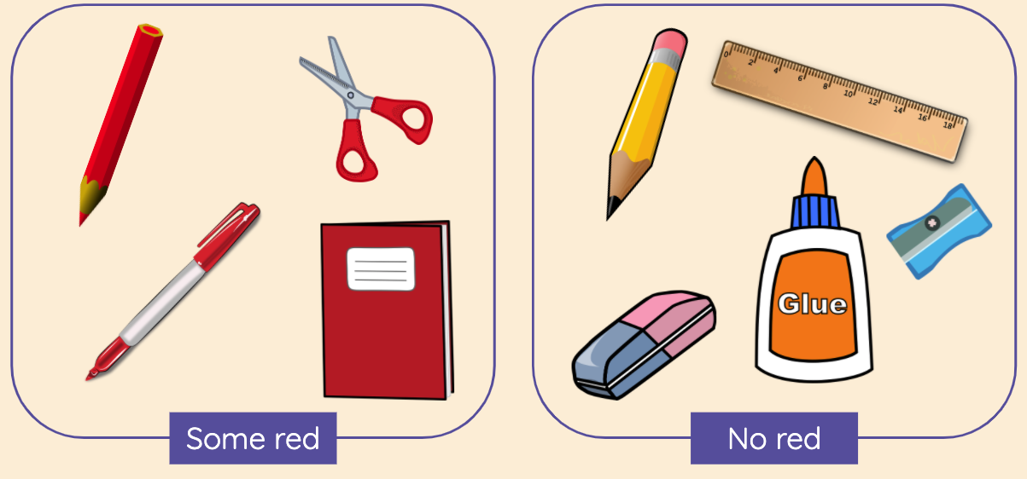
You have been grouping objects by their attributes
Activity 2
Colour
Is it red?
Does it have any metal?
Material
Attribute is another way to say property
Notes:
Explain to the learners that they have been using attributes to group the objects. Click to animate the attributes (colour, material), and the explanation of an attribute and share with the learners.
Pencil: https://pixabay.com/vectors/school-pencil-pen-write-sketch-153561/
Eraser: https://pixabay.com/vectors/eraser-school-supplies-office-23659/
Notepad: https://pixabay.com/vectors/school-exercise-book-study-learn-161701/
Scissors: https://pixabay.com/vectors/cut-scissors-tool-1295044/
Ruler: https://pixabay.com/vectors/ruler-straight-edge-tool-geometry-145940/
Red pen: https://pixabay.com/illustrations/marker-sharpie-office-pen-paint-4643862/
Red coloured pencil: https://pixabay.com/vectors/pencils-colored-pen-write-pencil-161141/
Sharpener: https://pixabay.com/vectors/sharpener-stationery-school-pencil-4704862/
Glue: https://pixabay.com/vectors/glue-bottle-orange-blue-fluid-306757/

Slide 16
Answer...
Activity 3
Does your school teach computing?
Is it raining?
Is it morning?
Does your school start at 9am?
Notes:
Tell the learners to ask and answer the questions with their elbow partner.
Ask the learners, “What do you notice about the questions?”. Click to share the bullet points, explaining:
All of the questions can be answered with yes or no
All of the questions start with is or does
The answers are facts, so all of the learners should have the same answer
Encourage the learners to use this information when they are thinking of their own questions.

Slide 17
Tell your partner the answer...
Activity 3
Does your school teach computing?
Is it raining?
Is it morning?
Does your school start at 9am?
Each answer is either yes or no
The questions start with is or does
Everyone has the same answers because they are facts
Notes:
Tell the learners to ask and answer the questions with their elbow partner.
Ask the learners, “What do you notice about the questions?”. Click to share the bullet points, explaining:
All of the questions can be answered with yes or no
All of the questions start with is or does
The answers are facts, so all of the learners should have the same answer
Encourage the learners to use this information when they are thinking of their own questions.

Slide 18
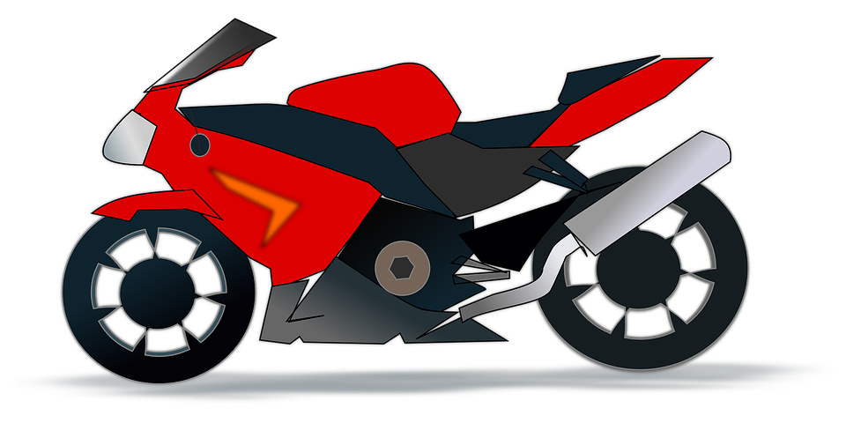
Think: Think of three questions you could ask about this motorbike
Activity 3
Is it...
Is it...
Does it...
Remember: The answer must only be yes or no!
Notes:
Tell the learners that two questions must begin with “Is it…” and one must start with “Does it…”. Remind the learners to ensure that the questions all have clear yes or no answers.
Note: If learners suggest questions that are related to weight or size, discuss that weight and size can be subjective. You would need to compare it to something else to answer the question.
As learners are suggesting questions, ask, “What attribute is that question about?” For example, the question “Is it red”, the attribute would be colour.
Red motorbike: https://pixabay.com/vectors/motor-cycle-motorbike-motorcycle-42422/

Slide 19
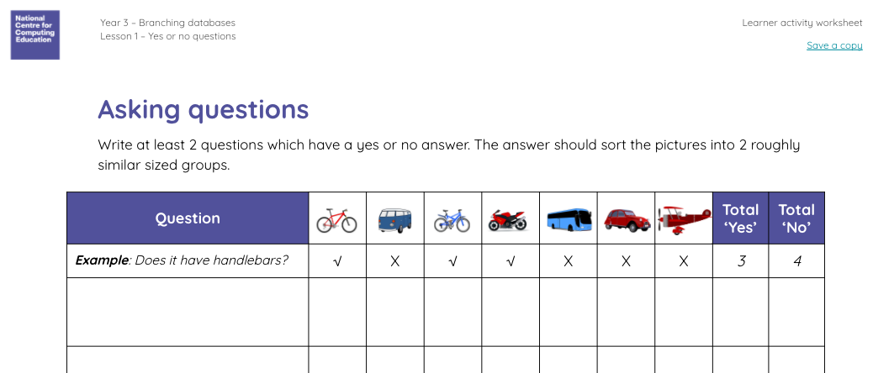
Can you write questions to group the objects?
Activity 3
Use the activity sheet to complete this task
Notes:
Provide each learner with the ‘Asking questions’ worksheet. Explain that they need to record at least two questions that will separate the collection of objects on the next slide into two similar sized groups. Reference the example row to demonstrate the activity.
Red plane: https://pixabay.com/illustrations/children-s-plane-red-kids-plane-1789559/
Red bicycle: https://pixabay.com/vectors/bicycle-red-bike-cycle-cycling-311656/
Red car: https://pixabay.com/vectors/car-vintage-red-old-automobile-33633/
Blue bicycle: https://pixabay.com/vectors/bicycle-blue-vehicle-transportation-26558/
Blue coach: https://pixabay.com/vectors/bus-travel-transport-vehicle-road-312564/
Camper van: https://pixabay.com/vectors/van-camping-automobile-automotive-150081/
Red motorbike: https://pixabay.com/vectors/motor-cycle-motorbike-motorcycle-42422/

Slide 20
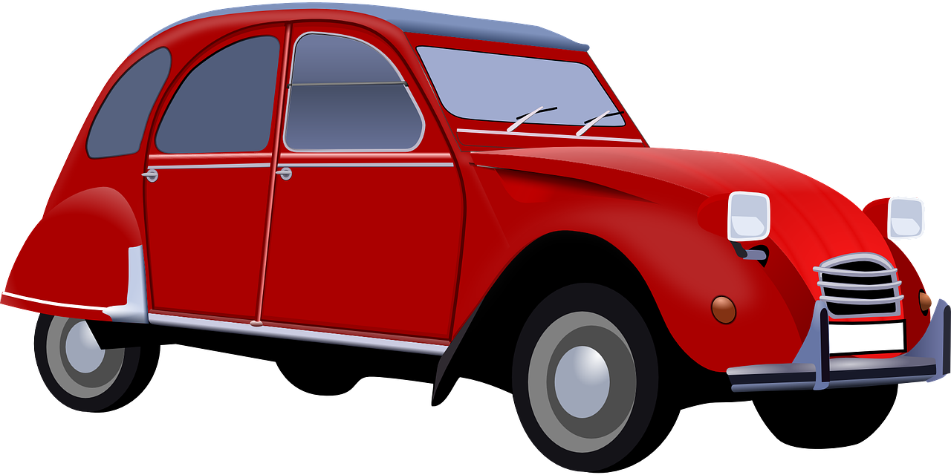
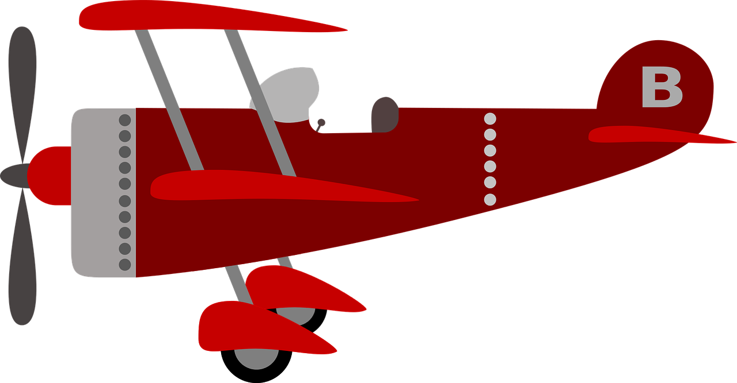
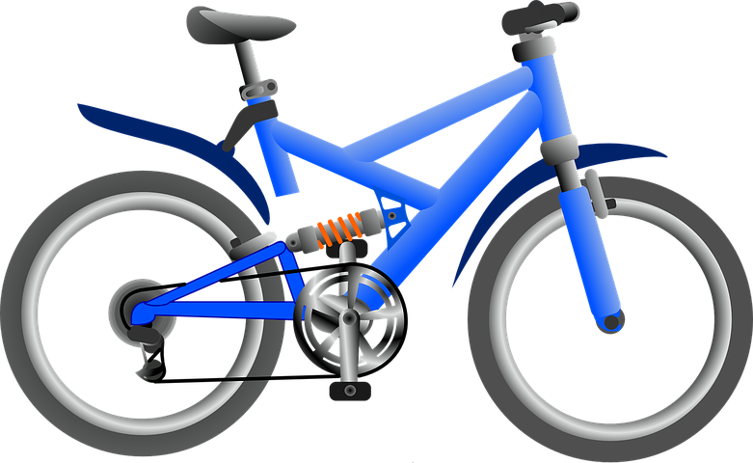
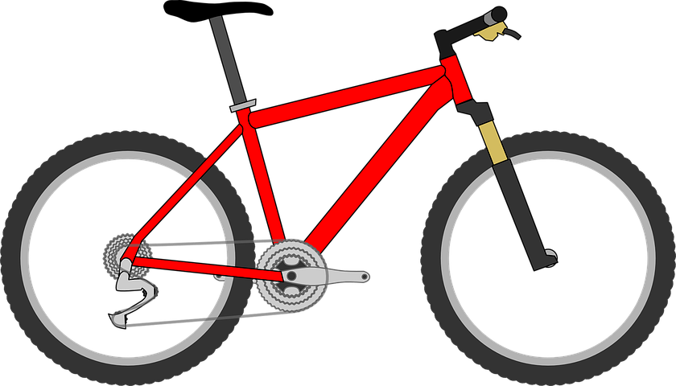
Activity 3
What questions could you ask to make two similar sized groups?
Notes:
Red plane: https://pixabay.com/illustrations/children-s-plane-red-kids-plane-1789559/
Red bicycle: https://pixabay.com/vectors/bicycle-red-bike-cycle-cycling-311656/
Red car: https://pixabay.com/vectors/car-vintage-red-old-automobile-33633/
Blue bicycle: https://pixabay.com/vectors/bicycle-blue-vehicle-transportation-26558/
Blue coach: https://pixabay.com/vectors/bus-travel-transport-vehicle-road-312564/
Camper van: https://pixabay.com/vectors/van-camping-automobile-automotive-150081/
Red motorbike: https://pixabay.com/vectors/motor-cycle-motorbike-motorcycle-42422/

Slide 21
Yes/no questions describe an object’s attributes
Plenary
Yes/no question | Attribute
Is it big? | Size
Is it made of metal? | Material
Is it heavy? | Weight
Is it grey? | Colour
Think: What question could be used for the attribute, ‘material’?
Notes:
Explain that the learners will be helping to fill in the gaps. Discuss the first row of the table and discuss how the questions describe the object’s attributes.
Think, pair, share: “What question could be used for the attribute, ‘material’?”. There are many possible answers for this question (“Is it made of wood?”, “Is it made of metal?”, etc.) as the answer in relation to the object is not relevant. Click to animate ‘Is it made of metal?’.
Read through the next two questions. Ask the learners, “What is the attribute for each question?” (weight, colour). Click to animate each.

Slide 22
Next lesson
Summary
In this lesson, you...
Thought of questions about objects that had yes or no answers
Linked questions to attributes and separated objects into even groups
Next lesson, you will…
Learn what a branching database is
Arrange a set of objects into a tree structure

