Slide 1
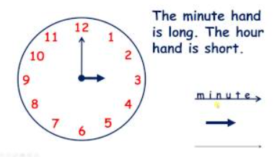
Can I tell the time to O’ Clock and half past? (Recap)
Year 3 Monday 22nd February 2021

Slide 2
Watch the video
https://vimeo.com/434770979
Now complete the questions on the next slides
Date your work for me please and if you did the work on your own with no help write an I at the top and if you had help please write AS at the top
Don’t forget to write your answers including your working out.

Slide 3
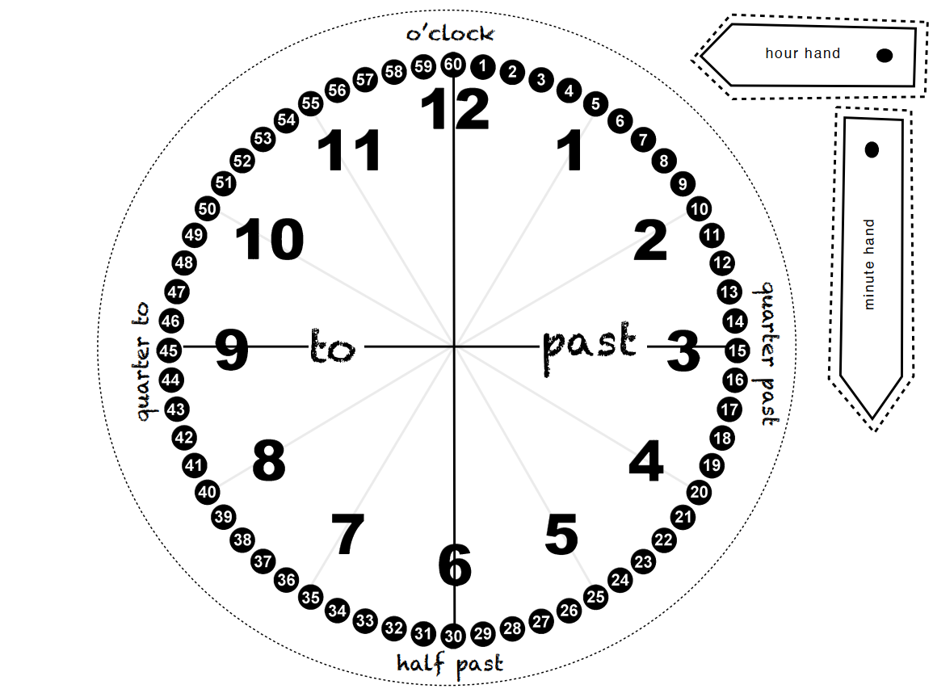
You may like to make this on card to help with your maths this week
Colour in the ‘past’ side a different colour to the ‘to’ side
Use a split pin to attach the hands.

Slide 4
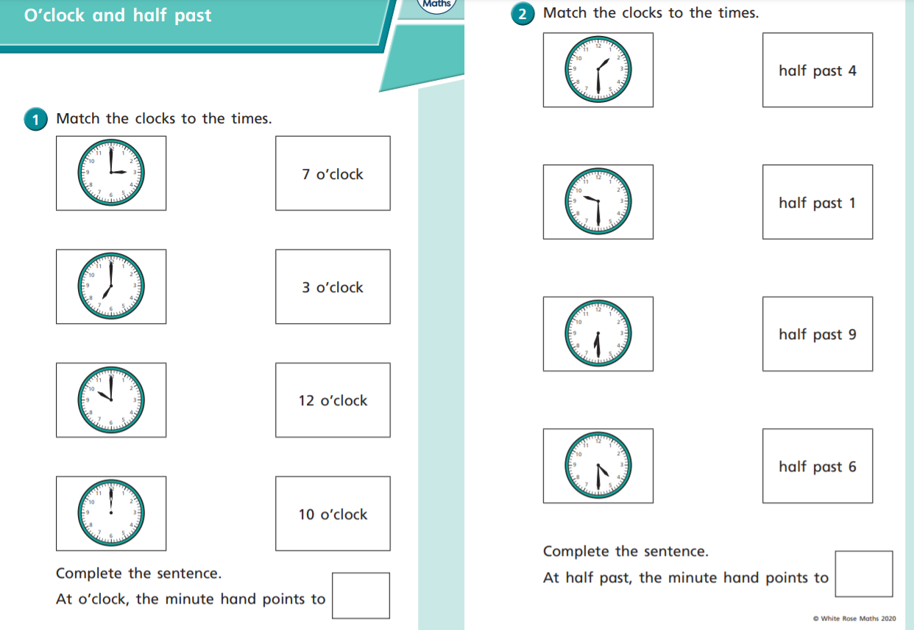

Slide 5
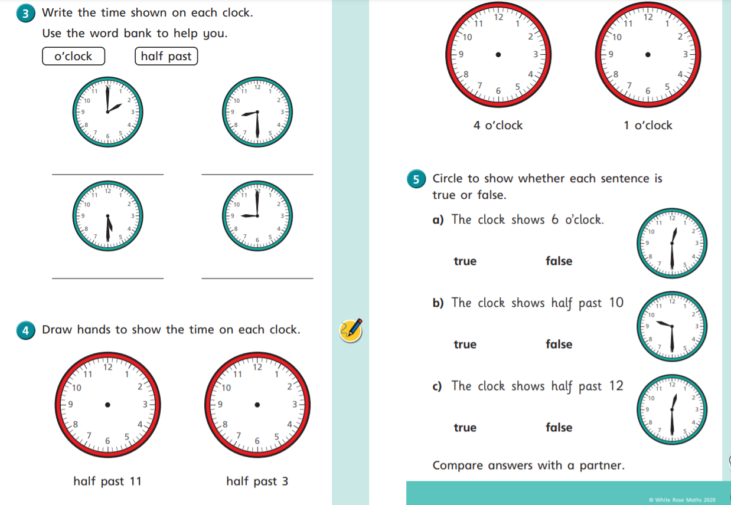

Slide 6
Use your ACE answer
Answer: True or False
Calculation: Check the correct time
Explain: because

Slide 7
ANSWER sheets
Please check your answers using the answer sheets on the next slide.
If you have made a mistake, can you explain what you did wrong and what you should have done instead?

Slide 8
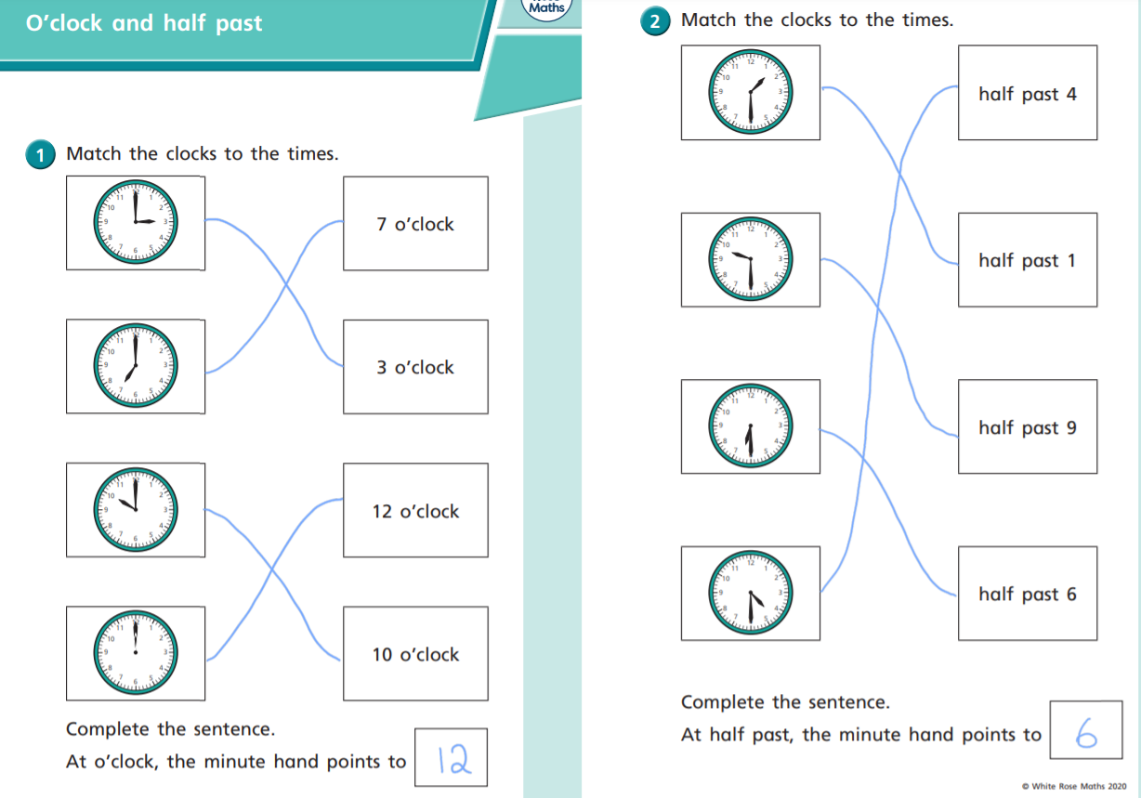

Slide 9
