Slide 1
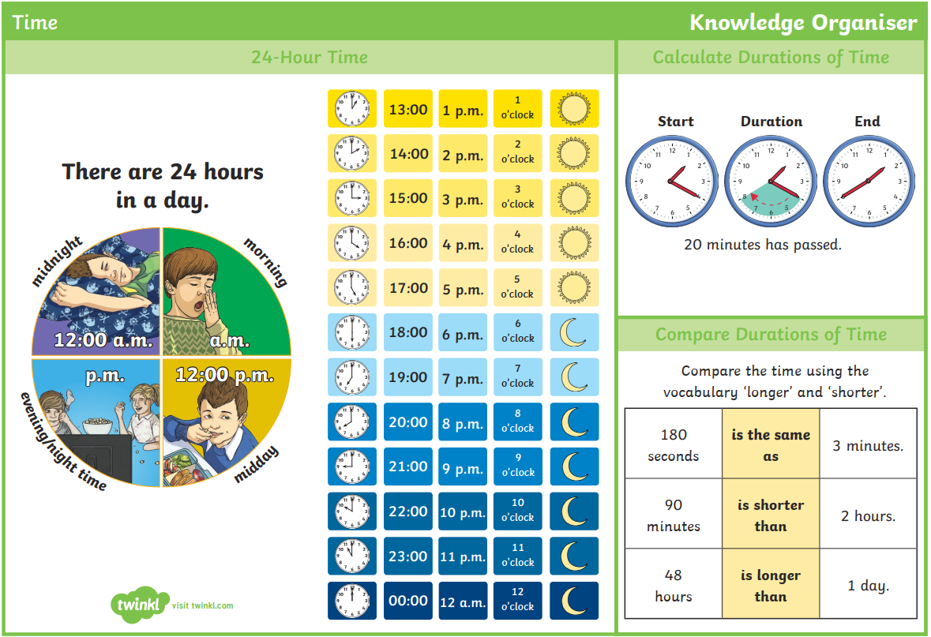
Can I tell the time to the minute?
Year 3 Wednesday 24th February 2021

Slide 2
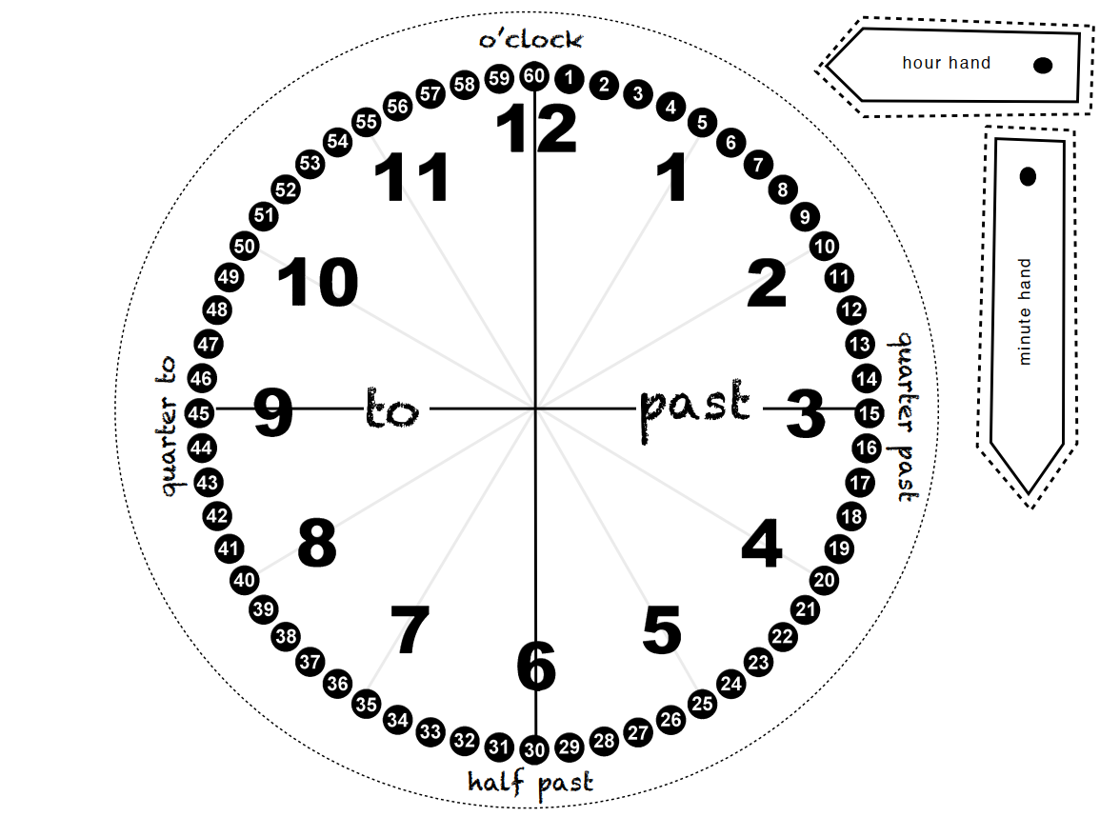
Use this to help with telling the time to the minute

Slide 3
Watch the video
https://www.youtube.com/watch?v=ohgPN0jOcf4
Now complete the questions on the next slides
Date your work for me please and if you did the work on your own with no help write an I at the top and if you had help please write AS at the top
Don’t forget to write your answers including your working out.

Slide 6
Use your ACE answer
Answer: True or False
Calculation: Draw the correct time
Explain: because

Slide 7
ANSWER sheets
Please check your answers using the answer sheets on the next slide.
If you have made a mistake, can you explain what you did wrong and what you should have done instead?

Slide 9
