Slide 1
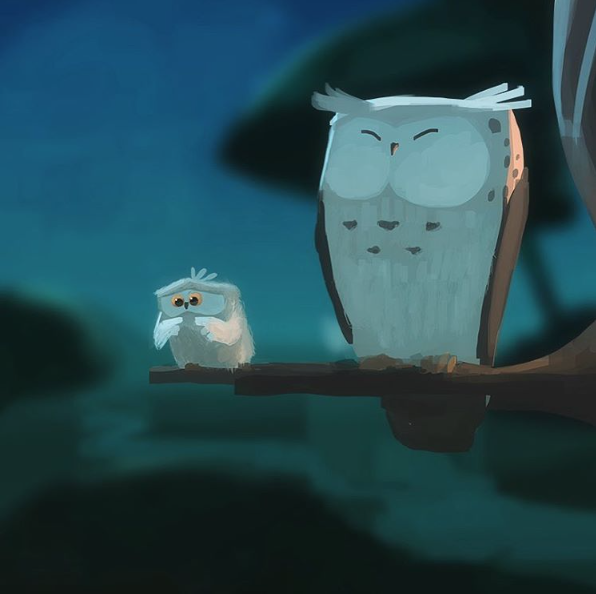
Look at the picture and answer the questions
First Flight
How are the owls related?
Which owl is about to take its first flight? How do you know?
How does the young owl feel about flying?
What might it be thinking? Add a thought bubble to the picture.
Is the older owl worried?
What advice might the older owl give to the younger one? Write it in a speech bubble.

