Slide 1
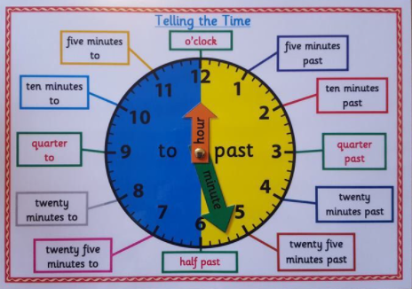
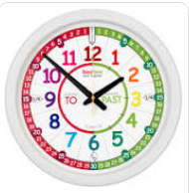
Can I convert from analogue to digital?
Year 4 Monday 1st March 2021

Slide 2
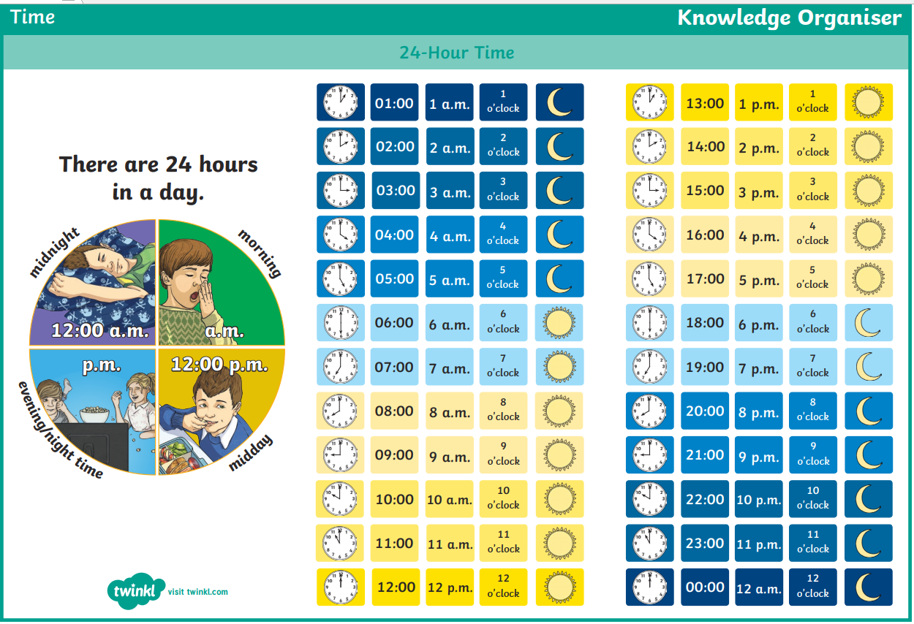

Slide 3
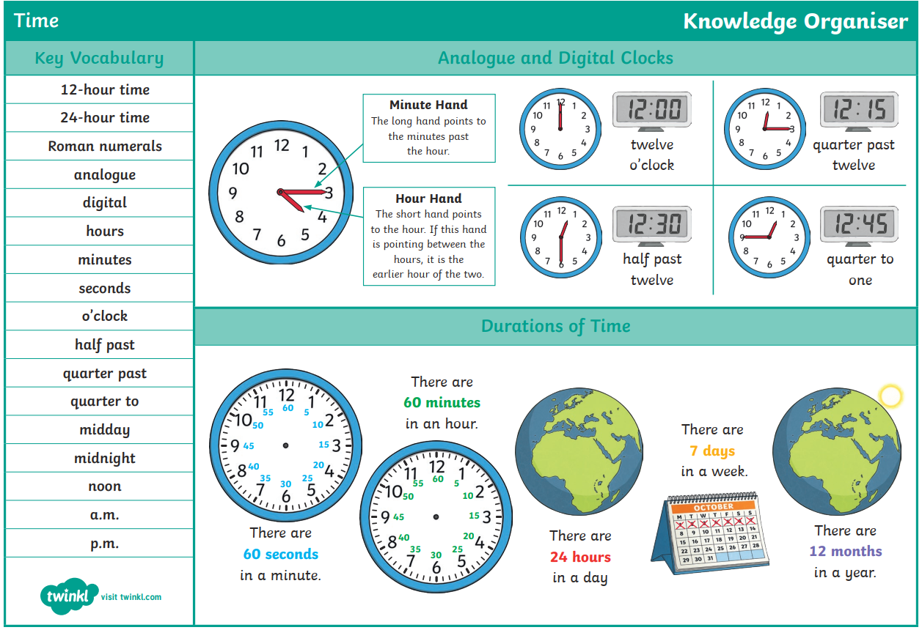

Slide 4
Play the game
https://mathsframe.co.uk/en/resources/resource/116/telling-the-time
Now complete the questions on the next slides
Date your work for me please and if you did the work on your own with no help write an I at the top and if you had help please write AS at the top
Don’t forget to write your answers including your working out.
Example: 110 seconds is longer than 3 minutes
First work out how many seconds in 3 minutes =
60 x 3 = 120 seconds. Now you can see which amount of time is longer
Answer: False because 120 seconds is longer than 110 seconds.
Write out all your calculations

Slide 5
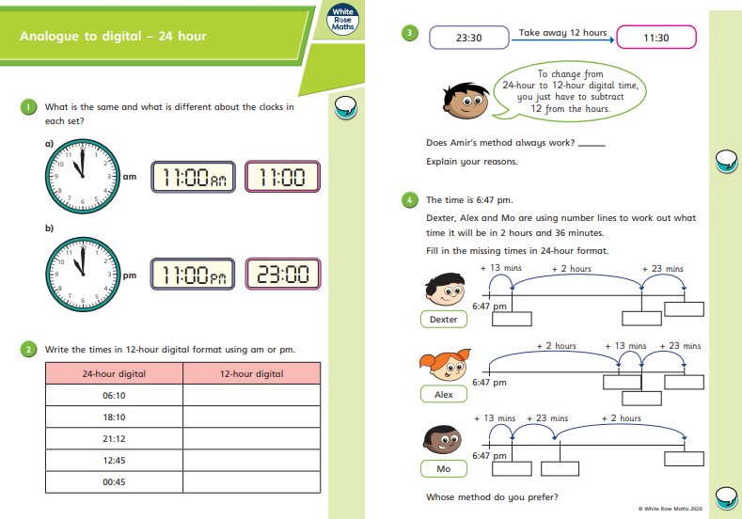

Slide 6
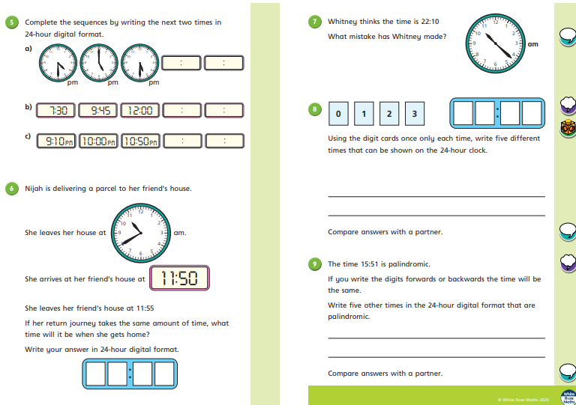

Slide 7
Use your ACE answer
Answer: True or False
Explain: because

Slide 8
ANSWER sheets
Please check your answers using the answer sheets on the next slide.
If you have made a mistake, can you explain what you did wrong and what you should have done instead?

Slide 9
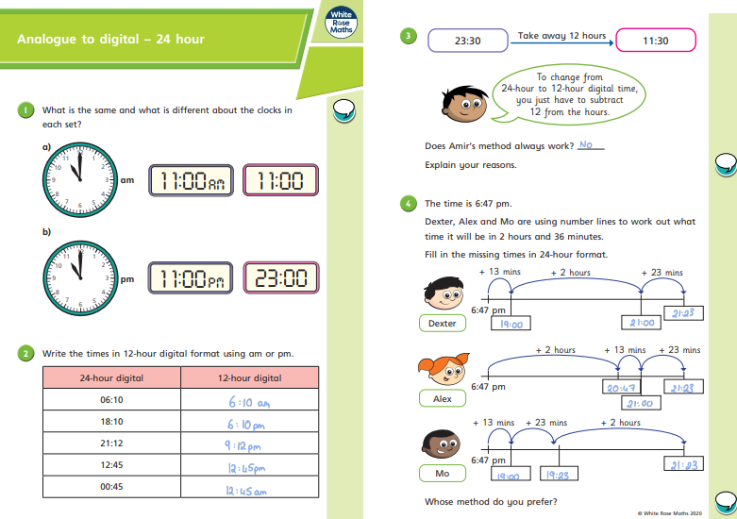

Slide 10
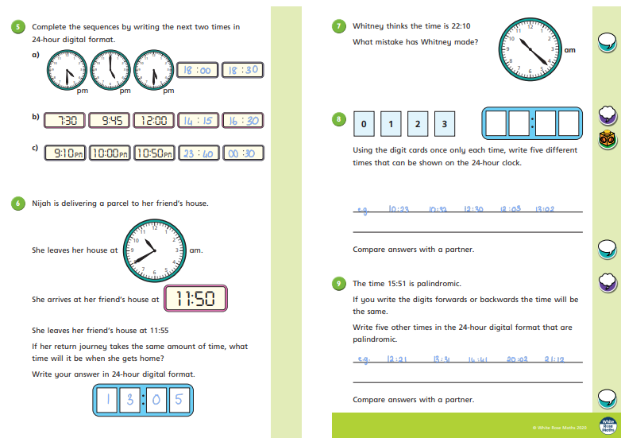

Slide 11
because

