Slide 1
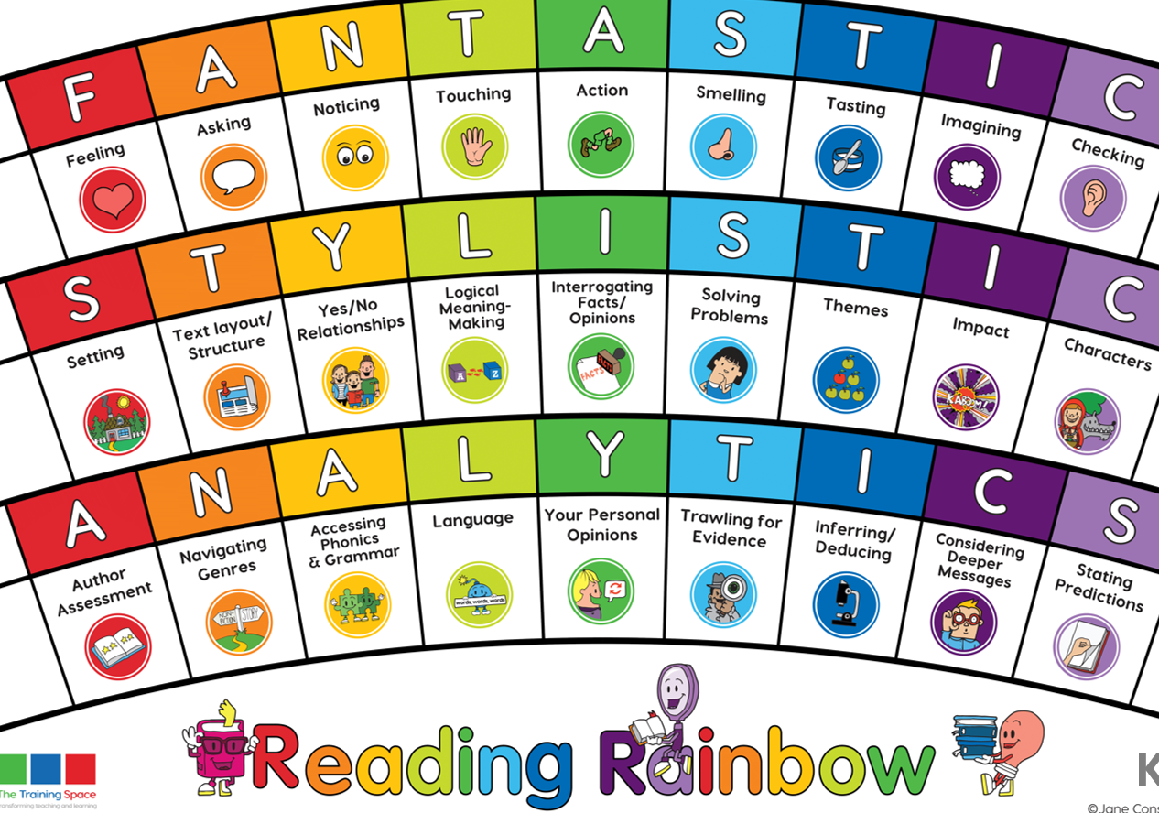
Our LI’s for the week: Skim and scan to find key words Read with an awareness of the audience
Lesson 1:
Initiate

Slide 2
Lenses:
Feeling
Logical meaning makers
Sentence Starters:
Feeling:
An overriding feeling in this part of the story is…
Logical meaning makers:
In summary, the chronological order of events is…

Slide 3
Lesson 2:
MODEL
please write this in the margin.

Slide 4
Feeling
In the final part of the story, what is the overriding feeling? Why do you get this impression?
Together: scan for emotive language and chot down the evidence.

Slide 5
Logical meaning makers
In summary, the chronological order of events is…
Together: read through the text again. Chot down each event that has happened in order.

Slide 6
Lesson 3:
ENABLE please write this in the margin.

Slide 7
Session 3 – Enable (Independent comprehension)
The overriding feeling of Hiccup in the final part is ‘brave’. Find and copy words and phrases that show Hiccup feeling brave.
2) Put these events in chronological order:
- A mighty wind pick up the ship and threw it fifty miles - Flying fish and leaping dolphins followed Hiccup - The Vikings turned a pretty green - Stoick the Vast thinks they are lost - Stoick sings the Viking song
Bonus question: Year 3
4) Find and copy two examples of similes used in the text.
Bonus question: Year 4
4) Find and copy examples of personification used in the text.

