Slide 1
Year 3
L.I – Can I multiply 2-digit by 1-digit numbers?
Steps to success
I can use multiplication facts or a multiplication grid
I can use place value to partition numbers
I can use an efficient method to add numbers
Challenge: Convince me
Year 4
L.I. – Can I identify hundredths?
Steps to success
I know how to write one hundredth as a fraction
I can compare hundredths and tenths
I can make one whole using hundredths and tenths
Challenge: True or false

Slide 2
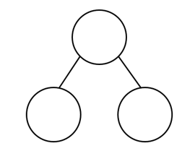
In Focus Task
How many ways can you partition 62?
62
62
62
True or false: I can partition 62 into 14 and 47. Use an ACE answer.

Slide 3
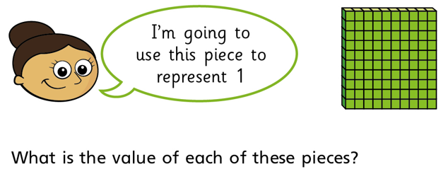
New Learning
Year 3
Write these multiplication facts.
What do you notice?
Year 4
Can you write your answer as a fraction?

Slide 4
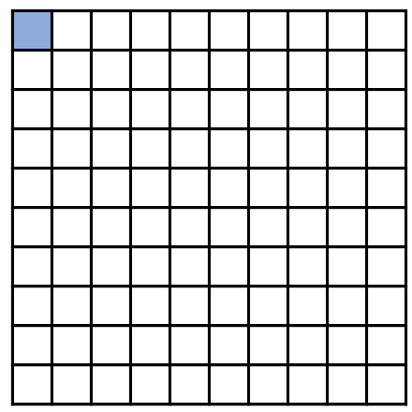
New Learning
Year 3
Write these multiplication facts.
What do you notice?
Year 4
Stem sentence:
One hundredth is one out of one hundred.
There are 10 hundredths in one tenth.

Slide 5
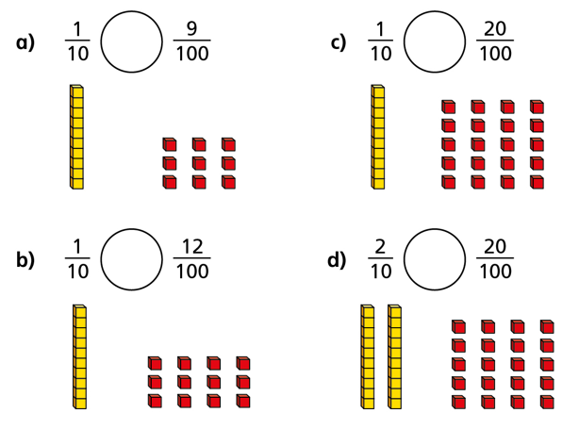
Talk Task
Year 3
Year 4
Explain to your partner how you would work out
20 x 6
Are there different ways of doing this?
Which symbol would you use to compare these fractions? =, > or <

Slide 6
Develop Learning
Year 3
Year 4
I can use a grid to calculate 42 x 5
Use the dienes to work out these equivalent fractions.
x
5
40
200
2
10
answer
210
How did I work out the answer?

Slide 7
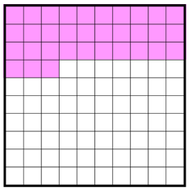
Develop Learning
Year 4
Year 3
- How many hundredths have been shaded?
- Rewrite it as tenths and hundredths.
Use this grid to work out 36 x 4.
x
4
30
6
answer
How many more to make a whole?

Slide 8
Develop Learning
Year 4
Year 3
Use the dienes to help you work out how to partition these fractions.
Use the grid to work out 27 x 3
1
x
3
2
answer

Slide 9
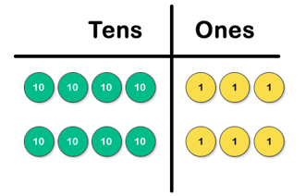
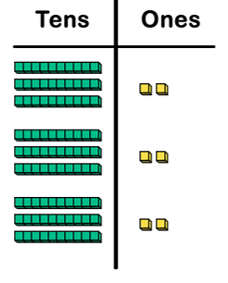
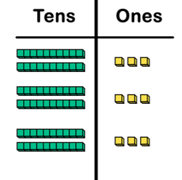
Independent Task
Year 3
32 x 3 =
23 x 3 =
43 x 2 =
x
Use a grid to work out:
45 x 4 =
58 x 3 =
36 x 4 =
56 x 4 =
answer

Slide 10
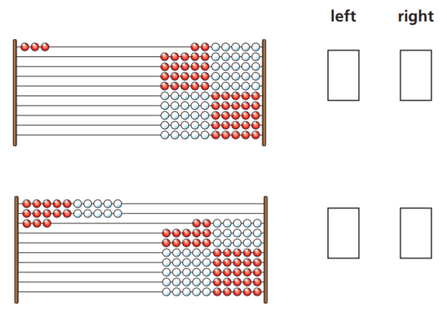
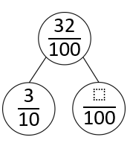
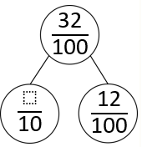
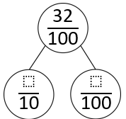
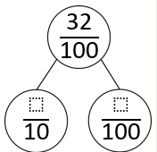
Independent Task
Year 4
1
Use the correct symbol < or >.
3
Write down the fractions represented on the left and right of the reken reks.
2
Show different ways to partition 32 hundredths

Slide 11
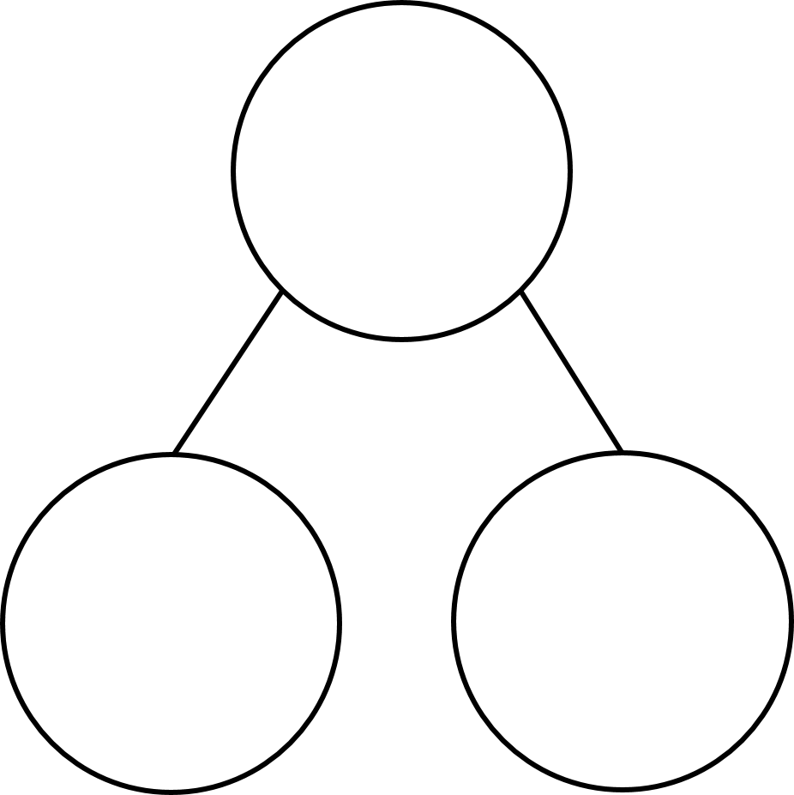












$\frac{\text{32}}{\text{10}\text{0}}$
$\frac{\text{32}}{\text{10}\text{0}}$
$\frac{\text{3}}{\text{10}}$
$\frac{}{\text{10}\text{0}}$
$\frac{}{\text{10}}$
$\frac{\text{12}}{\text{10}\text{0}}$
$\frac{\text{32}}{\text{10}\text{0}}$
$\frac{\text{32}}{\text{10}\text{0}}$
$\frac{}{\text{10}}$
$\frac{}{\text{10}\text{0}}$
$\frac{}{\text{10}}$
$\frac{}{\text{10}\text{0}}$

Slide 12
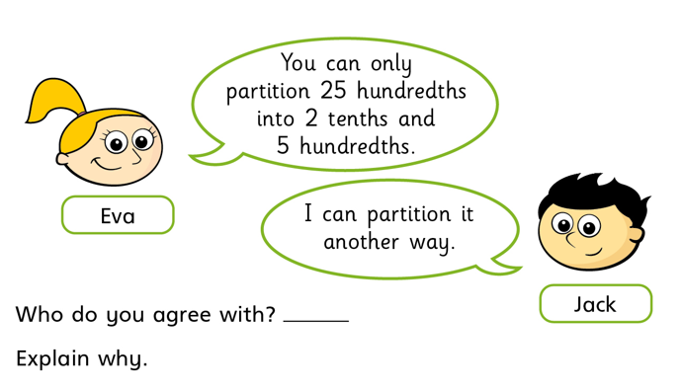
Independent Task
Year 3
Doug says: To find the answer to 23 x 4, split 23 into 2 and 3 and find the answers to 2 x 4 and 3 x 4, then combine them.
Is he correct? Explain.
Year 4

Slide 13
Plenary
Year 3
Year 4
Convince me:
“If I know 6x4=24 then I also know that 60x4=240.”
What do you think?
Convince me!

