Slide 1
Flotsam
Stories with dilemmas
Monday 5th July 2021

Slide 2
LI: Can I write a story with a dilemma?
Stories with a dilemma
Steps to success:
I can write a setting description;
I can use the adverbial lens and prepositions;
I can use adjectives.

Slide 3
Flotsam
Flotsam is the story of a boy, who goes to the beach with his parents and finds something interesting. A piece of flotsam.
He doesn’t really know what it is or what to do with it.
When you do not know what to do, which action to take, we say you have a dilemma.
The boy will have to face several dilemmas in this story that we are going to write together.

Slide 4
Setting description
Our story is set in the summer. Gather words for shining.
1.

Slide 5
Setting description
Here are some of my ideas:
bright
brilliant
dazzling
amazing
stunning
spectacular
splendid
superb
marvelous
1.

Slide 6
Setting description
It is a hot day, but hot is a bit boring, so find better words for hot.
2.

Slide 7
Setting description
Here are some of my ideas:
Boiling
Warm
Scorching
Blistering
Baking
Sweltering
Sizzling
roasting
2.

Slide 8
Model sentence
It was a dazzling, sweltering summer day at the beach.
Your task:
Write a sentence to open our story telling the reader how hot a bright it is.
Challenge: deepen the moment using alliteration.

Slide 9
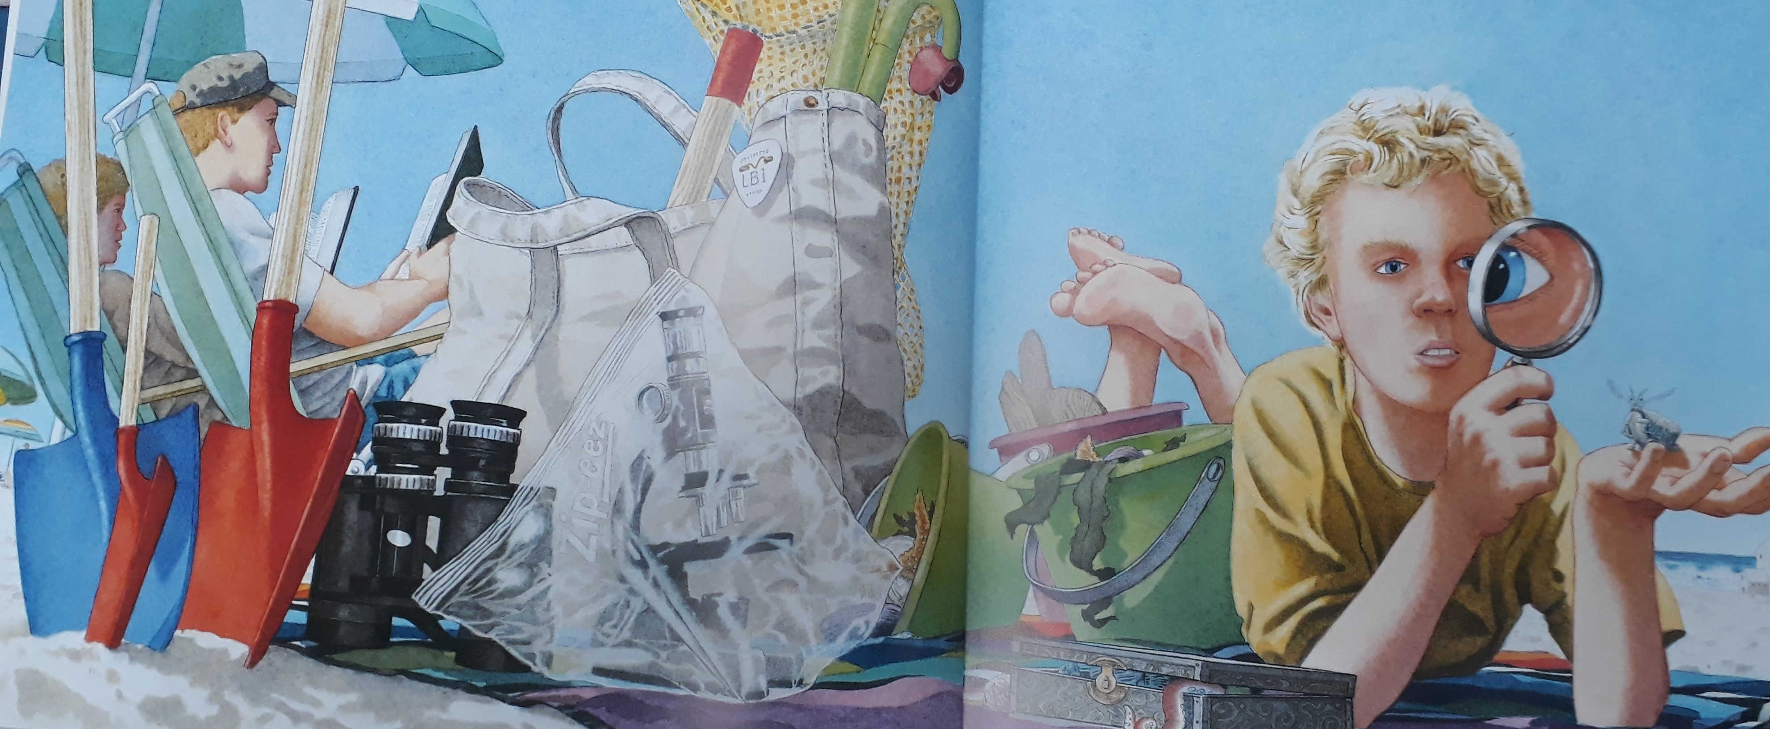
Setting description
What is the setting of this picture?
What can you see in this picture?
Use good adjectives and chot what you see. Write it in the third box.
3.

Slide 10
Setting description
Here are some of my ideas:
Sturdy microscope wrapped in transparent plastic.
Two large spades, one small fire-engine red one.
Several plastic buckets filled with seaweed.
A blonde haired boy wearing a yellow top.
Black binoculars.
A stripy umbrella.

Slide 11
Setting description
Prepositions tell us where things are. For example, on the towel. At the beach. Write interesting phrases with prepositions in the fourth box.
4.

Slide 12
Model sentence
David was lying close by his parents on top a colourful towel. He was curiously studying an insect sitting on his hand, with his magnifying glass.
Your task:
Write a descriptive sentence giving the reader information about the setting.
Challenge: deepen the moment by adding more detail about the setting.

Slide 13
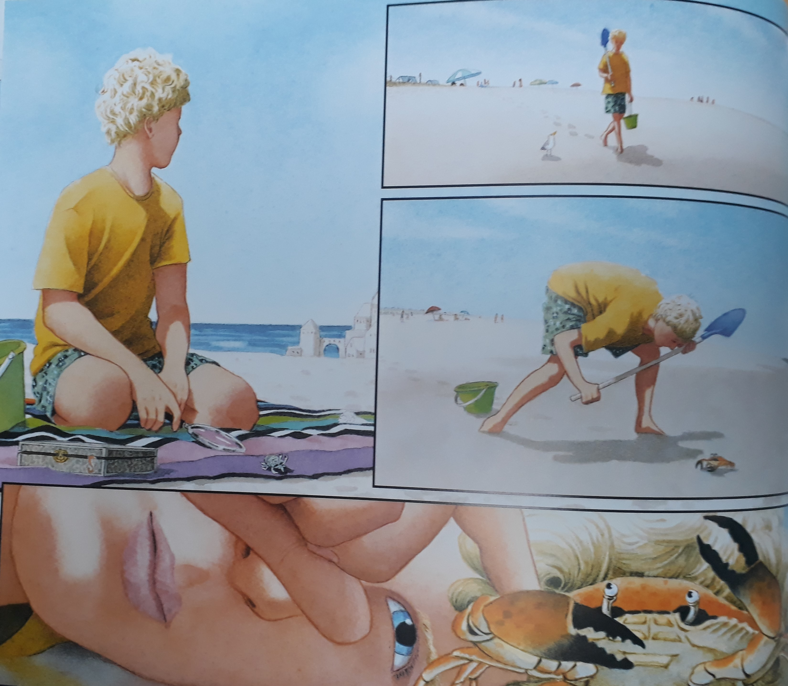
Setting description
+
How is David walking?
Let’s gather different words for walking using the shadometer.
_
5.

Slide 14
Setting description
+
wandered
strolled
walked
meandered
ambled
sauntered
_
5.

Slide 15
Model sentence
David wandered along the shimmering shore. This part of the beach was deserted.
Your task:
Use precise verbs, a preposition and adjective to write about what David is doing.
Challenge: deepen the moment by adding more description or use the imagining lens to write what he might be thinking.

Slide 16
Share and feedback
Share your work
What sentence are your proud of?
What does the class think of the work?
How could we make it even better?

