Slide 1
Year 4
L.I – Can I understand what symmetry is?
Steps to success
- I know that both sides of the line of symmetry have to be equal.
- I can identify lines of symmetry.
- I can create a line of symmetry.
Challenge: True or false

Slide 2
In Focus Task
Draw a horizontal line.
Draw a vertical line.
Draw a diagonal line.

Slide 3
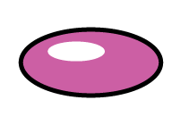
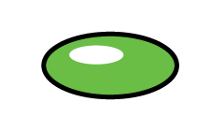
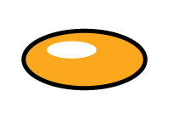
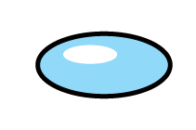
Talk Task
Which images are reflections? Which images are not?

Slide 4
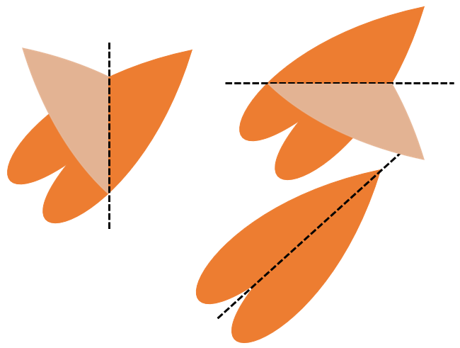
New Learning
A line of symmetry requires both sides to be equal.

Slide 5
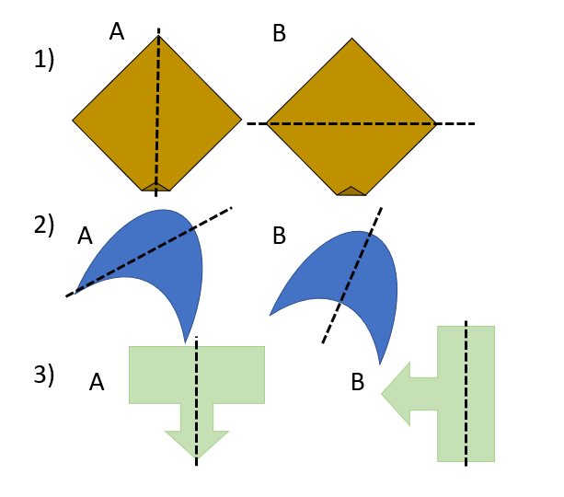
New Learning
Which shapes show accurate lines of symmetry?

Slide 6
Develop Learning
What do you notice about all of these shapes?

Slide 7
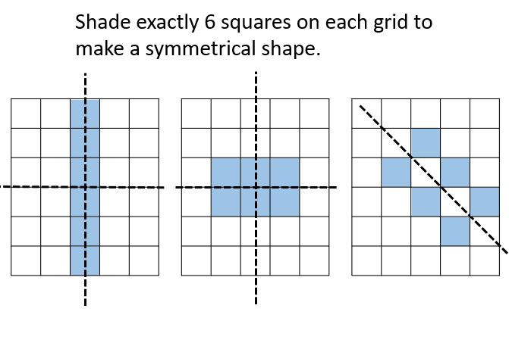
Develop Learning

Slide 8
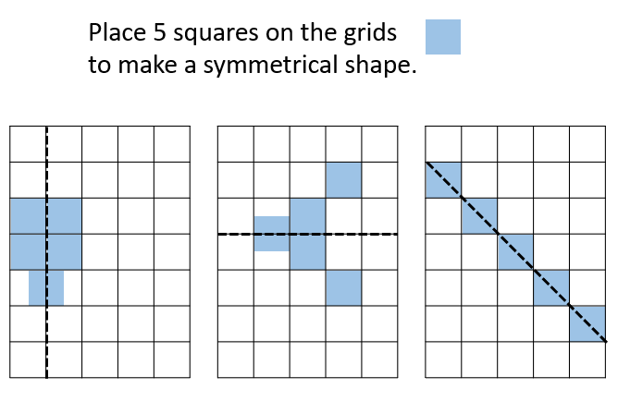
Develop Learning

Slide 9
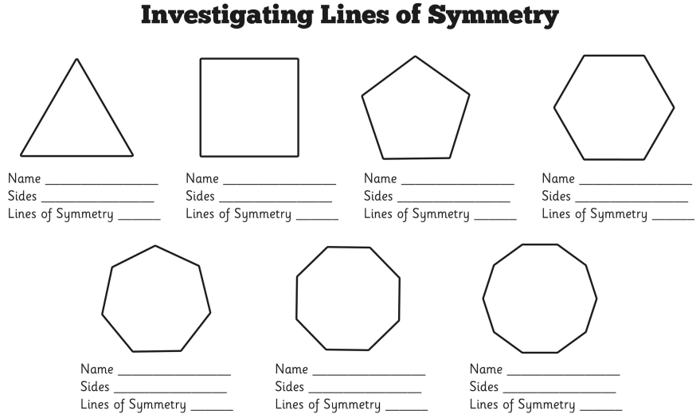
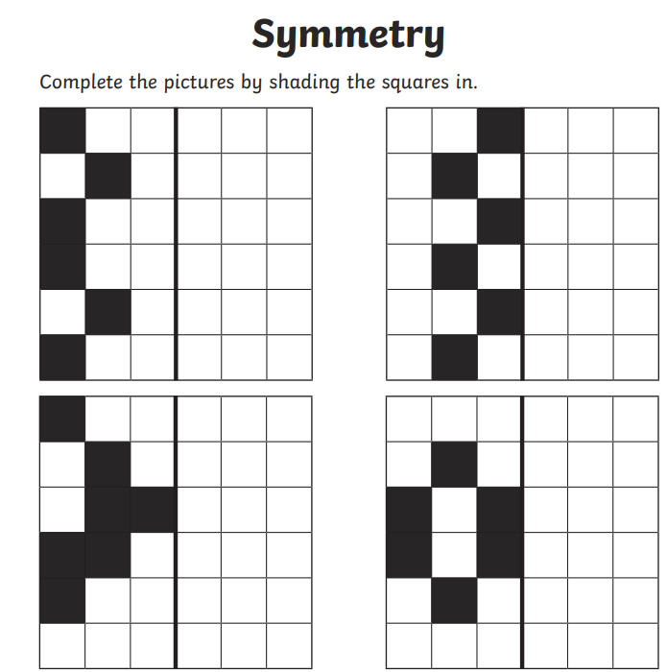
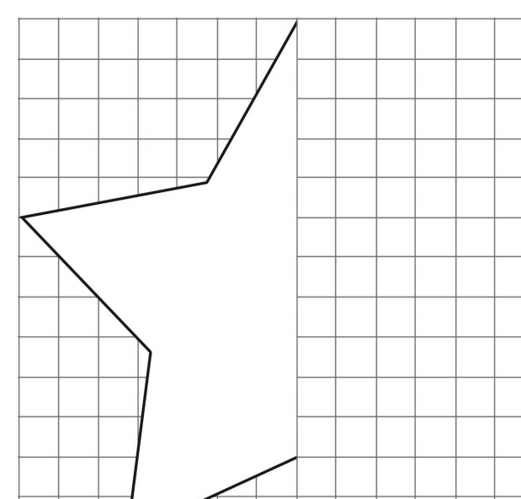
Independent Task

Slide 10
Plenary

