Slide 1
Year 4
L.I – Can I describe position?
Steps to success
- I understand positional vocabulary.
- I understand coordinates.
- I can describe the coordinates.
Challenge: True or false

Slide 2
In Focus Task

Slide 3
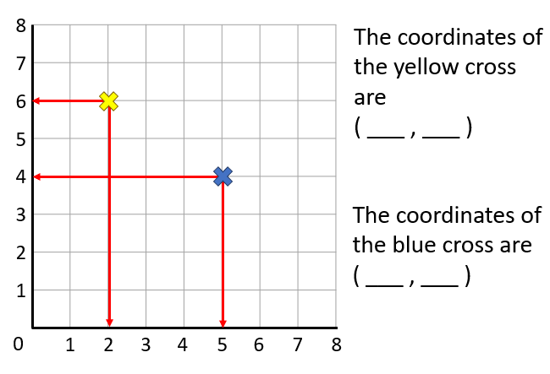
Talk Task
y
x
Remember: Go along the corridor (x) and then up the stairs (y)!

Slide 4
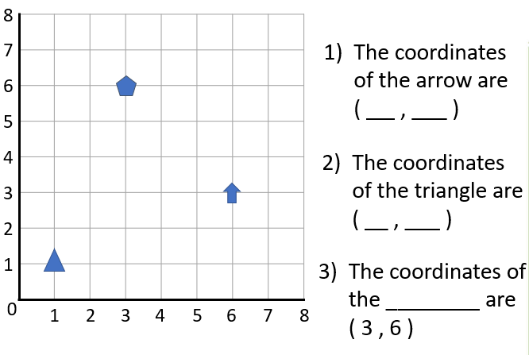
New Learning

Slide 5
New Learning

Slide 6
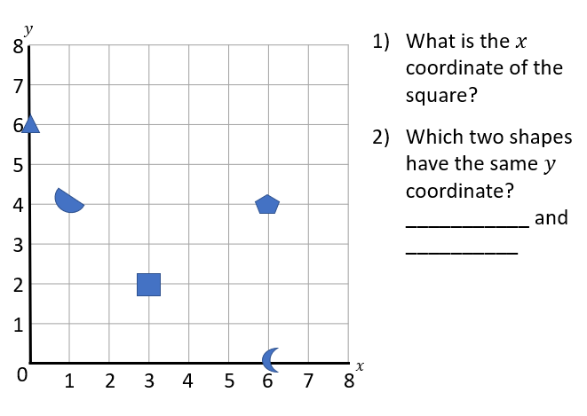
Develop Learning

Slide 7
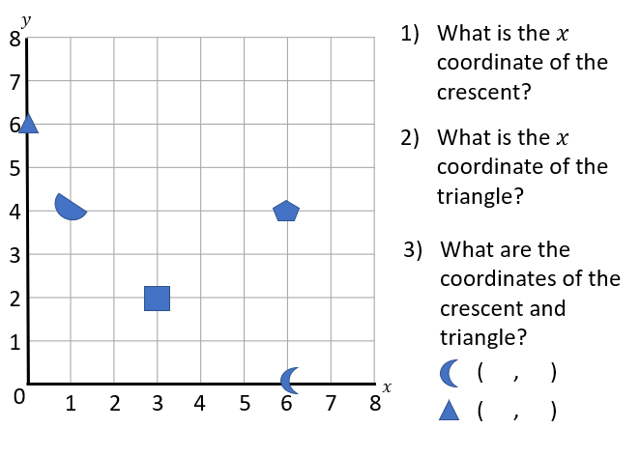
Develop Learning

Slide 8
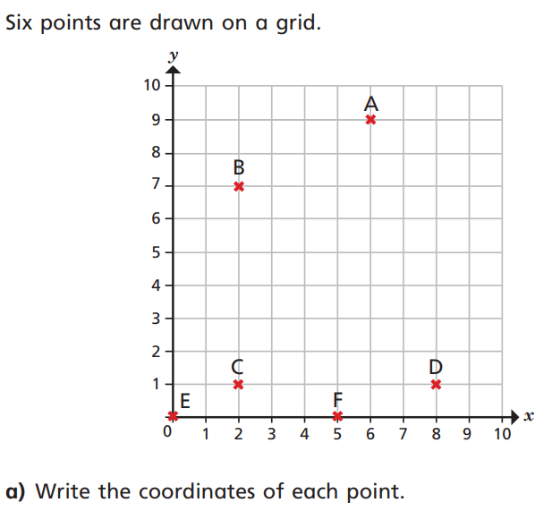
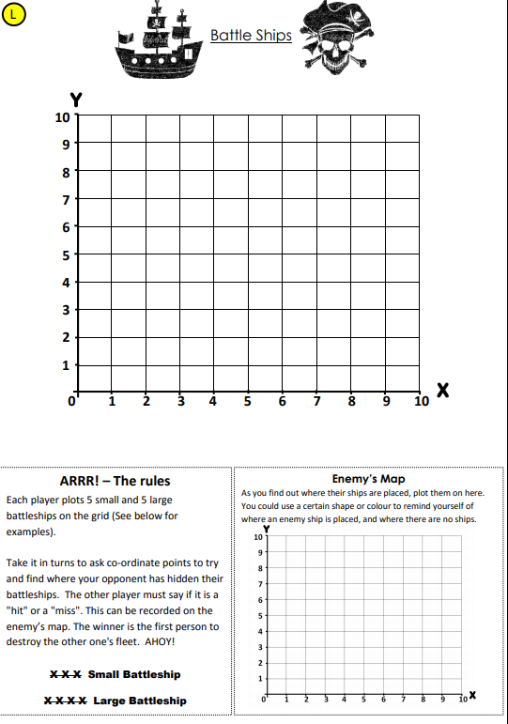
Independent Task

Slide 9
Plenary

