Slide 1
Year 2/3 – Spring Block 4 – Length, Height and Perimeter – Step 7
About This Resource:
This PowerPoint has been designed to support your teaching of this small step from the Mixed Age planning. It includes a starter activity suitable for each year group and an example of each question from the Varied Fluency and Reasoning and Problem Solving resources also provided in this pack (separate for each year group). Each slide has the year group identified in the bottom right-hand corner. We recommend that you look through this PowerPoint in advance and decide whether to work through all examples provided or a selection of them depending on the needs of your class.
National Curriculum Objectives:
Mathematics Year 3: (3M1a) Compare lengths (m/cm/mm)
More Year 2 and Year 3 Length, Height and Perimeter resources.
Did you like this resource? Don’t forget to review it on our website.
© Classroom Secrets Limited 2019

Slide 2
Year 2/3 – Spring Block 4 – Length, Height and Perimeter
Step 7
Year 3: Subtract Length
© Classroom Secrets Limited 2019

Slide 3
Introduction
Complete the part whole models.
?
?
2m
70cm
30cm
55
cm
100 cm
75cm
?
Y3
© Classroom Secrets Limited 2019

Slide 4
Introduction
Complete the part whole models.
1m
1m 55cm
2m
70cm
30cm
55
cm
100 cm
75cm
1m 25cm
Y3
© Classroom Secrets Limited 2019

Slide 5
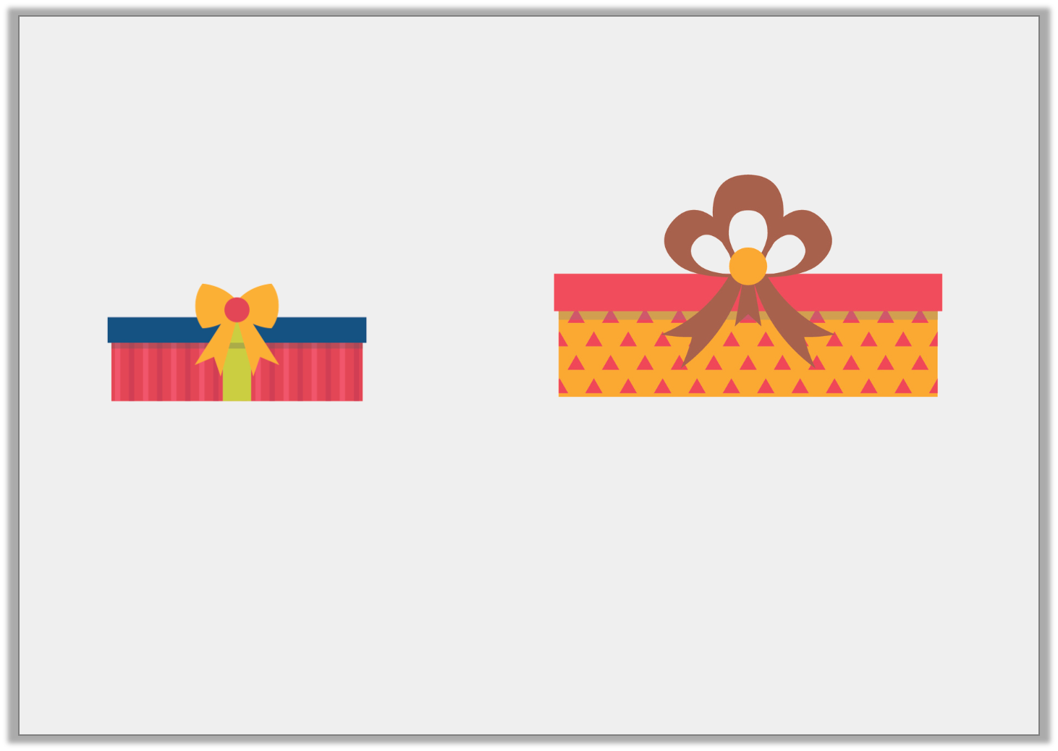
Varied Fluency 1
What is the difference in length of the following items?
Not to scale
43cm
100cm
A. 47cm | B. 57cm | C. 47mm
Y3
© Classroom Secrets Limited 2019

Slide 6
Varied Fluency 1
What is the difference in length of the following items?
Not to scale
43cm
100cm
A. 47cm | B. 57cm | C. 47mm
Y3
© Classroom Secrets Limited 2019

Slide 7
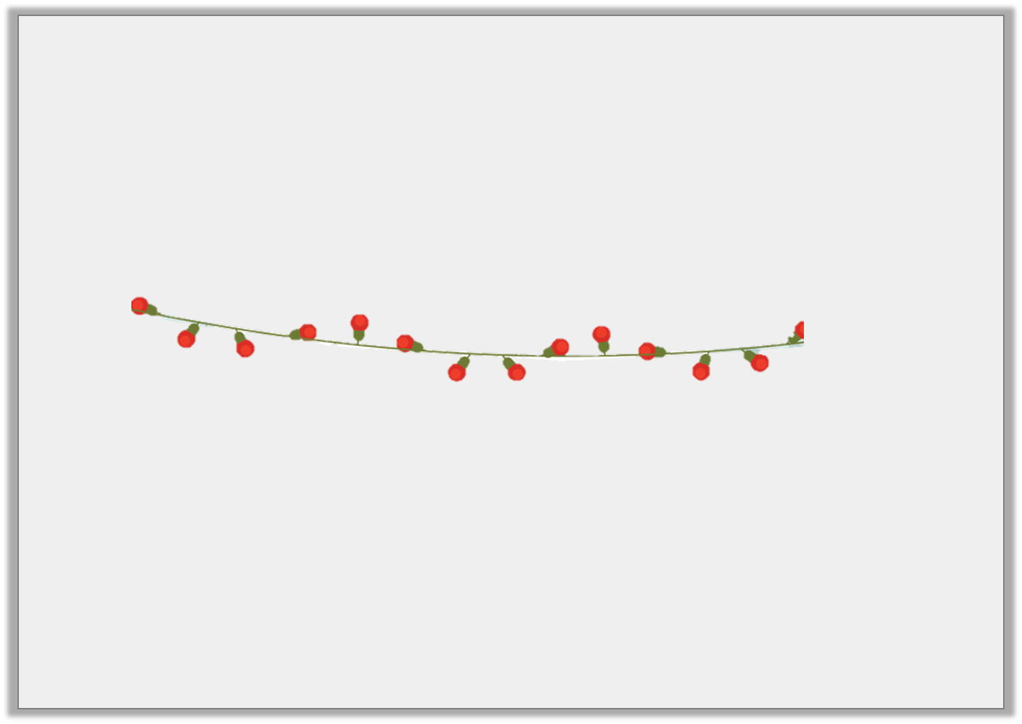
Varied Fluency 2
Mollie and Jacob are hanging a string of lights on Mollie’s wall.
The wall is 1m 65cm long, the lights are 95cm long.
They will need more lights to reach the end of the wall.
True or false?
Y3
© Classroom Secrets Limited 2019

Slide 8
Varied Fluency 2
Mollie and Jacob are hanging a string of lights on Mollie’s wall.
The wall is 1m 65cm long, the lights are 95cm long.
They will need more lights to reach the end of the wall.
True or false?
True. They will need another 70cm of lights to reach the end of the wall.
Y3
© Classroom Secrets Limited 2019

Slide 9
Varied Fluency 3
Complete the part whole model.
378cm
80cm
?
180cm
Y3
© Classroom Secrets Limited 2019

Slide 10
Varied Fluency 3
Complete the part whole model.
378cm
80cm
118cm
180cm
Y3
© Classroom Secrets Limited 2019

Slide 11
Varied Fluency 4
Add <, > or = to make the statement correct.
5m 72cm – 98cm |  | 480cm – 6cm
Y3
© Classroom Secrets Limited 2019

Slide 12
Varied Fluency 4
Add <, > or = to make the statement correct.
5m 72cm – 98cm | = | 480cm – 6cm
Y3
© Classroom Secrets Limited 2019

Slide 13
Reasoning 1
Tom has completed his homework.
Find and explain his mistake.
A. | 4m 40cm – 340cm = 100cm
B. | 350cm = 7m – 350cm
C. | 1m – 90cm = 10m
Y3
© Classroom Secrets Limited 2019

Slide 14
Reasoning 1
Tom has completed his homework.
Find and explain his mistake.
Statement C is incorrect because…
A. | 4m 40cm – 340cm = 100cm
B. | 350cm = 7m – 350cm
C. | 1m – 90cm = 10m
Y3
© Classroom Secrets Limited 2019

Slide 15
Reasoning 1
Tom has completed his homework.
Find and explain his mistake.
Statement C is incorrect because Tom has written the answer using the wrong unit of measurement; 1m – 90cm = 10cm.
A. | 4m 40cm – 340cm = 100cm
B. | 350cm = 7m – 350cm
C. | 1m – 90cm = 10m
Y3
© Classroom Secrets Limited 2019

Slide 16
Problem Solving 1
Some Year 3 children are setting up the school fayre tables.
The length of the hall is 5m 85cm which is enough for two stalls.
The craft stall needs 238cm. The snack stall needs 3m 43cm. How much space is left between the tables?
School Fayre
TODAY!
Y3
© Classroom Secrets Limited 2019

Slide 17
Problem Solving 1
Some Year 3 children are setting up the school fayre tables.
The length of the hall is 5m 85cm which is enough for two stalls.
The craft stall needs 238cm. The snack stall needs 3m 43cm. How much space is left between the tables?
238cm + 343cm = 581cm
585cm – 581cm = 4cm
There will be 4cm spare.
School Fayre
TODAY!
Y3
© Classroom Secrets Limited 2019

Slide 18
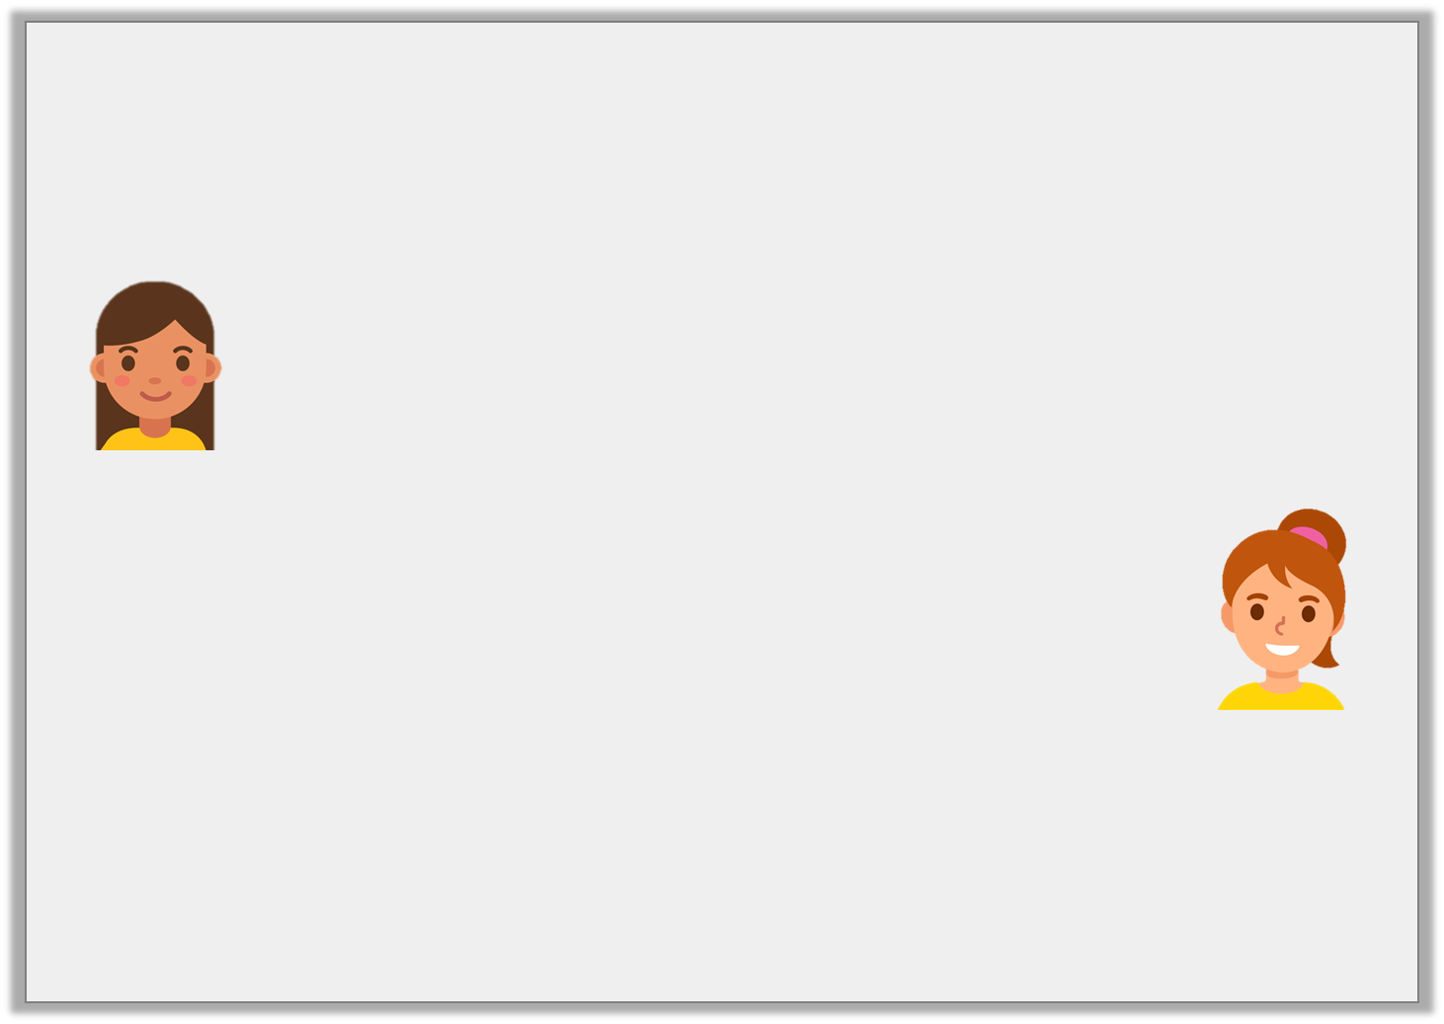
Reasoning 2
Tia and Heather are discussing how to subtract 1cm 9mm from 20cm.
Who is correct? Explain why.
I converted both lengths to mm.
200mm – 19mm = 181mm
Tia
I converted both lengths to cm.
20cm – 19cm = 1cm
Heather
Y3
© Classroom Secrets Limited 2019

Slide 19
Reasoning 2
Tia and Heather are discussing how to subtract 1cm 9mm from 20cm.
Who is correct? Explain why.
Tia is correct because…
I converted both lengths to mm.
200mm – 19mm = 181mm
Tia
I converted both lengths to cm.
20cm – 19cm = 1cm
Heather
Y3
© Classroom Secrets Limited 2019

Slide 20
Reasoning 2
Tia and Heather are discussing how to subtract 1cm 9mm from 20cm.
Who is correct? Explain why.
Tia is correct because 20cm is the same 200mm and 1cm 9mm is the same as 19mm. Heather has made a mistake when converting.
I converted both lengths to mm.
200mm – 19mm = 181mm
Tia
I converted both lengths to cm.
20cm – 19cm = 1cm
Heather
Y3
© Classroom Secrets Limited 2019

