Slide 1
Year 2/3 – Spring Block 4 – Length, Height and Perimeter – Step 3
About This Resource:
This PowerPoint has been designed to support your teaching of this small step from the Mixed Age planning. It includes a starter activity suitable for each year group and an example of each question from the Varied Fluency and Reasoning and Problem Solving resources also provided in this pack (separate for each year group). Each slide has the year group identified in the bottom right-hand corner. We recommend that you look through this PowerPoint in advance and decide whether to work through all examples provided or a selection of them depending on the needs of your class.
National Curriculum Objectives:
Mathematics Year 3:(3M1a) Compare lengths (m/cm/mm)
Mathematics Year 3:(3M2a) Measure lengths (m/cm/mm)
More Year 2 and Year 3 Length, Height and Perimeter Resources.
Did you like this resource? Don’t forget to review it on our website.
© Classroom Secrets Limited 2019

Slide 2
Year 2/3 – Spring Block 4 – Length, Height and Perimeter
Step 3
Year 3: Equivalent Lengths-mm and cm
© Classroom Secrets Limited 2019

Slide 3
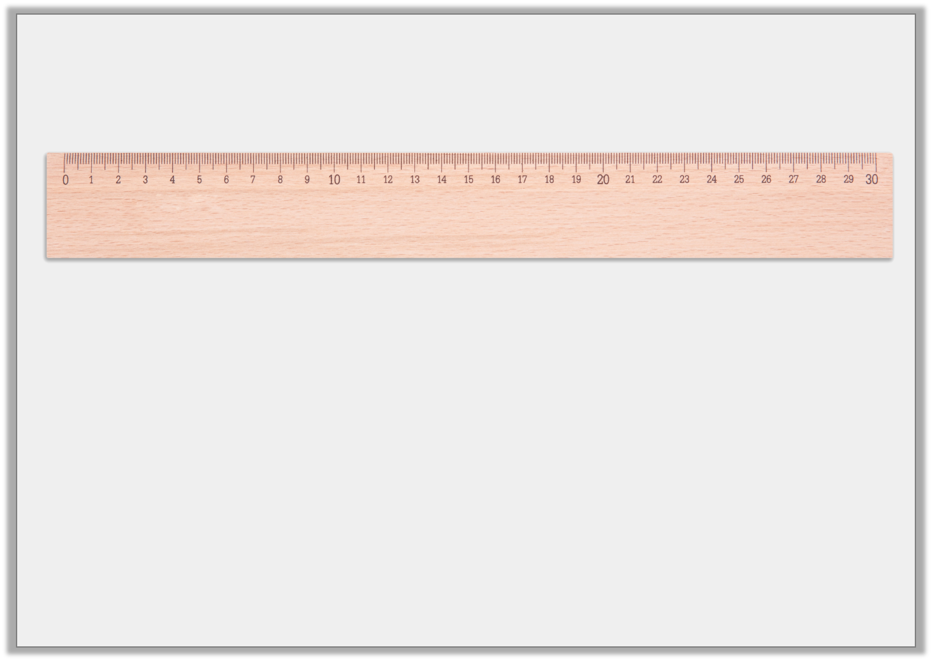
Introduction
1cm is equal to 10mm.
Use this information to complete these conversions.
20mm = cm
mm = 4cm
300mm = cm
Y3
© Classroom Secrets Limited 2019

Slide 4
Introduction
1cm is equal to 10mm.
Use this information to complete these conversions.
20mm = cm
mm = 4cm
300mm = cm
2
40
30
Y3
© Classroom Secrets Limited 2019

Slide 5
Varied Fluency 1
Complete the bar model:
83mm
cm | mm
Y3
© Classroom Secrets Limited 2019

Slide 6
Varied Fluency 1
Complete the bar model:
Various possible answers, including:
8cm 3mm
7cm 13mm
6cm 23mm
83mm
cm | mm
Y3
© Classroom Secrets Limited 2019

Slide 7
Varied Fluency 2
Join the equivalent lengths:
48mm |  | 93mm
56mm |  | 4cm 8mm
721mm |  | 6mm 5cm
9cm 3mm |  | 72cm 1mm
Y3
© Classroom Secrets Limited 2019

Slide 8
Varied Fluency 2
Join the equivalent lengths:
48mm |  | 93mm
56mm |  | 4cm 8mm
721mm |  | 6mm 5cm
9cm 3mm |  | 72cm 1mm
Y3
© Classroom Secrets Limited 2019

Slide 9
Varied Fluency 3
Circle the longest length:
7cm 4mm |  | 733mm
8cm 13mm |  | 9cm 0mm
Y3
© Classroom Secrets Limited 2019

Slide 10
Varied Fluency 3
Circle the longest length:
7cm 4mm |  | 733mm
8cm 13mm |  | 9cm 0mm
Y3
© Classroom Secrets Limited 2019

Slide 11
Varied Fluency 4
Tick the fish that are the same length as the one below:
98mm
 | 9cm 18mm
 | 9cm 8mm
 | 8cm 18mm
Y3
© Classroom Secrets Limited 2019

Slide 12
Varied Fluency 4
Tick the fish that are the same length as the one below:
98mm
 | 9cm 18mm
 | 9cm 8mm | ✓
 | 8cm 18mm | ✓
Y3
© Classroom Secrets Limited 2019

Slide 13
Reasoning 1
Who is correct? Prove it.
My pet snake is the longest. It is 889mm long.
Asad
My pet snake is the longest. It is 89cm 9mm long.
Sam
Y3
© Classroom Secrets Limited 2019

Slide 14
Reasoning 1
Who is correct? Prove it.
My pet snake is the longest. It is 889mm long.
Asad
My pet snake is the longest. It is 89cm 9mm long.
Sam
Sam is correct because…
Y3
© Classroom Secrets Limited 2019

Slide 15
Reasoning 1
Who is correct? Prove it.
My pet snake is the longest. It is 889mm long.
Asad
My pet snake is the longest. It is 89cm 9mm long.
Sam
Sam is correct because his snake is 89cm 9mm long which is equal to 899mm. 899mm is longer than 889mm.
Y3
© Classroom Secrets Limited 2019

Slide 16
Reasoning 2
Spot 2 mistakes. Explain your answer.
cm and mm | mm
25cm and 6mm | 256mm
5cm and 8mm | 58mm
9cm and 8mm | 88mm
8cm and 2mm | 28mm
53cm and 1 mm | 531mm
Y3
© Classroom Secrets Limited 2019

Slide 17
Reasoning 2
Spot 2 mistakes. Explain your answer.
9cm and 8mm and 8cm and 2mm are wrong because…
cm and mm | mm
25cm and 6mm | 256mm
5cm and 8mm | 58mm
9cm and 8mm | 88mm
8cm and 2mm | 28mm
53cm and 1 mm | 531mm
Y3
© Classroom Secrets Limited 2019

Slide 18
Reasoning 2
Spot 2 mistakes. Explain your answer.
9cm and 8mm and 8cm and 2mm are wrong because 9cm and 8mm is equivalent to 98mm and 8cm and 2mm is equivalent to 82mm.
cm and mm | mm
25cm and 6mm | 256mm
5cm and 8mm | 58mm
9cm and 8mm | 88mm
8cm and 2mm | 28mm
53cm and 1 mm | 531mm
Y3
© Classroom Secrets Limited 2019

Slide 19
Problem Solving 1
Find the odd one out.
81cm 4mm
814mm
80cm 14mm
8cm 14mm
Write an equivalent length for the odd one out.
Y3
© Classroom Secrets Limited 2019

Slide 20
Problem Solving 1
Find the odd one out.
81cm 4mm
814mm
80cm 14mm
8cm 14mm
Write an equivalent length for the odd one out.
The pencils are the odd one out.
An equivalent length is 94mm.
Y3
© Classroom Secrets Limited 2019

