Slide 1
LI: Use Prepositions
© Classroom Secrets Limited 2019

Slide 2
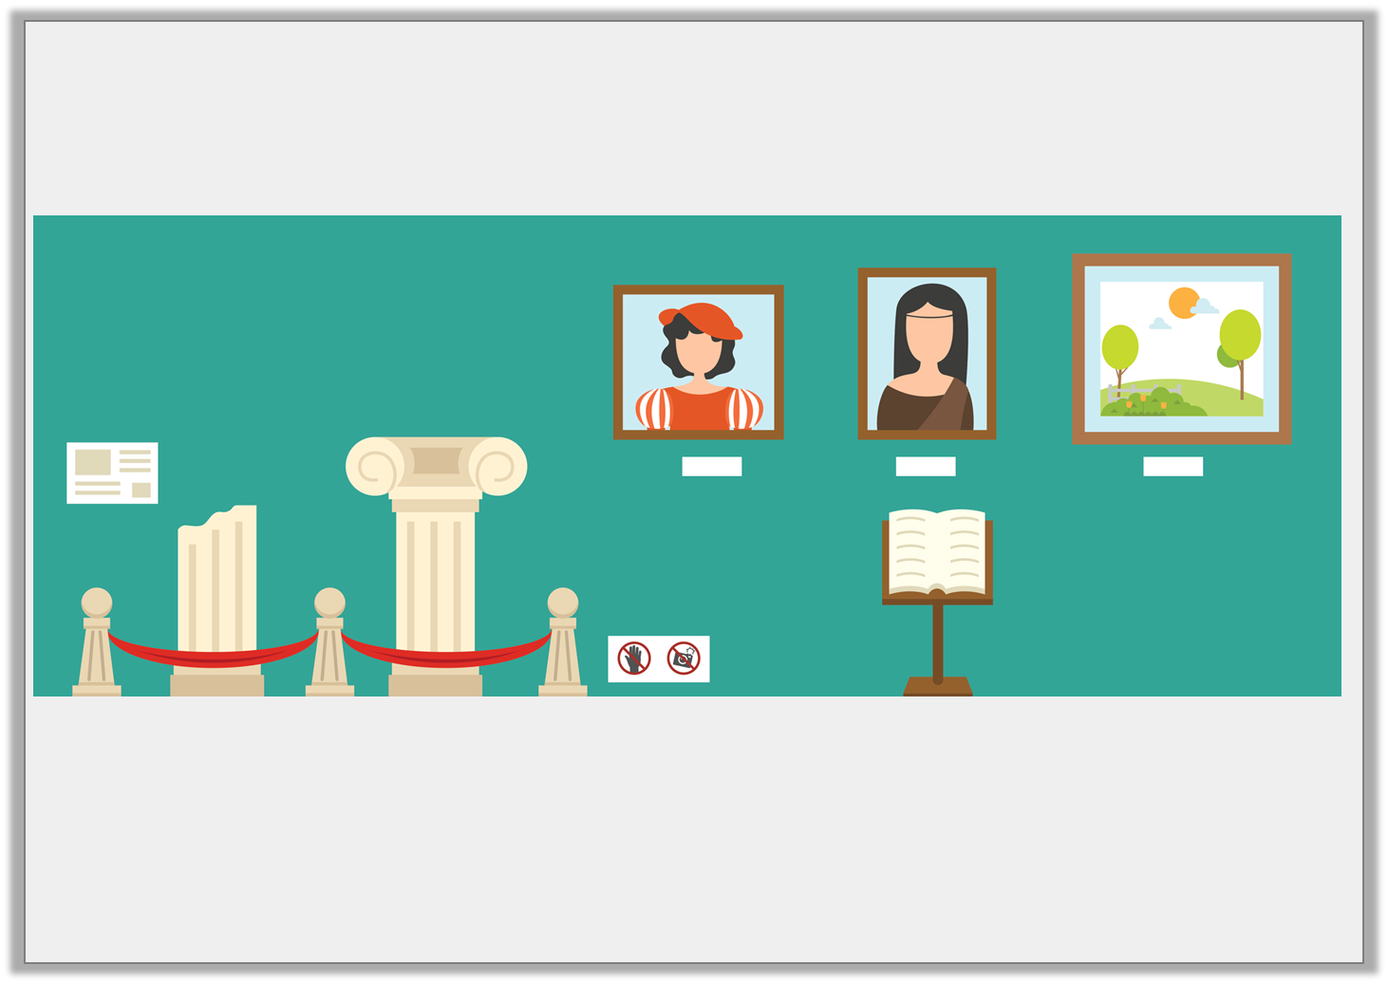
Introduction
Use prepositions to describe the position of people or objects in the picture below.
© Classroom Secrets Limited 2019

Slide 3
Introduction
Use prepositions to describe the position of people or objects in the picture below.
Various answers, for example:
The statues are behind the rope.
The book is near the painting.
The painting is on the wall.
© Classroom Secrets Limited 2019

Slide 4
Varied Fluency 1
Underline the noun in the sentence below.
They sat happily among the flowers.
© Classroom Secrets Limited 2019

Slide 5
Varied Fluency 1
Underline the noun in the sentence below.
They sat happily among the flowers.
© Classroom Secrets Limited 2019

Slide 6
Varied Fluency 2
Circle the preposition in the sentence below.
The water fountain is near the town hall.
© Classroom Secrets Limited 2019

Slide 7
Varied Fluency 2
Circle the preposition in the sentence below.
The water fountain is near the town hall.
© Classroom Secrets Limited 2019

Slide 8
Varied Fluency 3
Sort the nouns and prepositions into the table below.
across | after | bread
snake | behind | church
Nouns | Prepositions
© Classroom Secrets Limited 2019

Slide 9
Varied Fluency 3
Sort the nouns and prepositions into the table below.
Nouns | Prepositions
bread snake church | across after behind
© Classroom Secrets Limited 2019

Slide 10
Varied Fluency 4
Use a preposition from the word bank to complete the sentence.
I have known Andrew ______ last year.
beyond | off | since
© Classroom Secrets Limited 2019

Slide 11
Varied Fluency 4
Use a preposition from the word bank to complete the sentence.
I have known Andrew since last year.
beyond | off | since
© Classroom Secrets Limited 2019

Slide 12
Reasoning 1
Does the preposition make sense in the sentence below?
The children walked carefully across the busy main road.
Explain your reasoning.
Yes because…
© Classroom Secrets Limited 2019

Slide 13
Reasoning 1
Does the preposition make sense in the sentence below?
The children walked carefully across the busy main road.
Explain your reasoning.
Yes because ‘across’ shows where the children were in relation to the busy main road.
© Classroom Secrets Limited 2019

