Slide 1
LI: I can recognise and measure angles in degrees
Steps to Success:
I can identify the size of different angles
I can name different types of angles
I can use mathematical vocabulary to describe turns of an angle
Notes:
Understanding what 100% actually means, checks gaps.

Slide 2
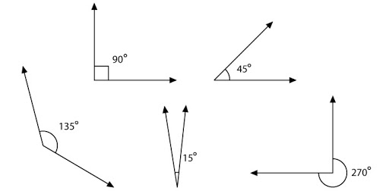
In focus task
A
B
C
D
E
Which angle is the biggest?
Which angle is the smallest?
Write down how you know this.
Notes:
Understanding what 100% actually means, checks gaps.

Slide 3
In focus task
A
B
C
D
E
Which angle is the biggest? C
Which angle is the smallest? D
Write down how you know this.
We know this because the size of the angle is shown.
Notes:
Understanding what 100% actually means, checks gaps.

Slide 4
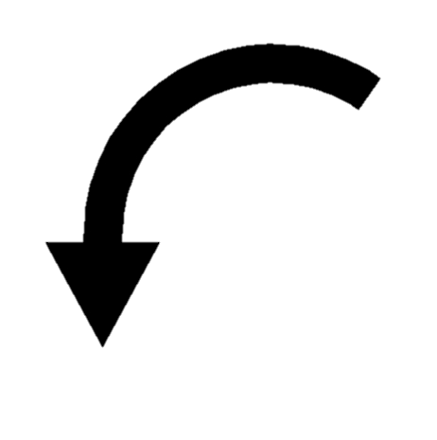
In focus task
Complete the following statements to make them true
A full turn is 360 degrees.
180
90
A half turn is ________ degrees.
A quarter turn is ________degrees.

Slide 5
New learning:
Between 0° and 89°
90° exactly
Between 91° and 179°
180° exactly
Between 181° and 359°

Slide 6
New learning:
Acute
Acute
Right angle
Right angle
Obtuse
Obtuse
Reflex
Straight angle
Use the word bank above to match identify the name of each angle

Slide 7
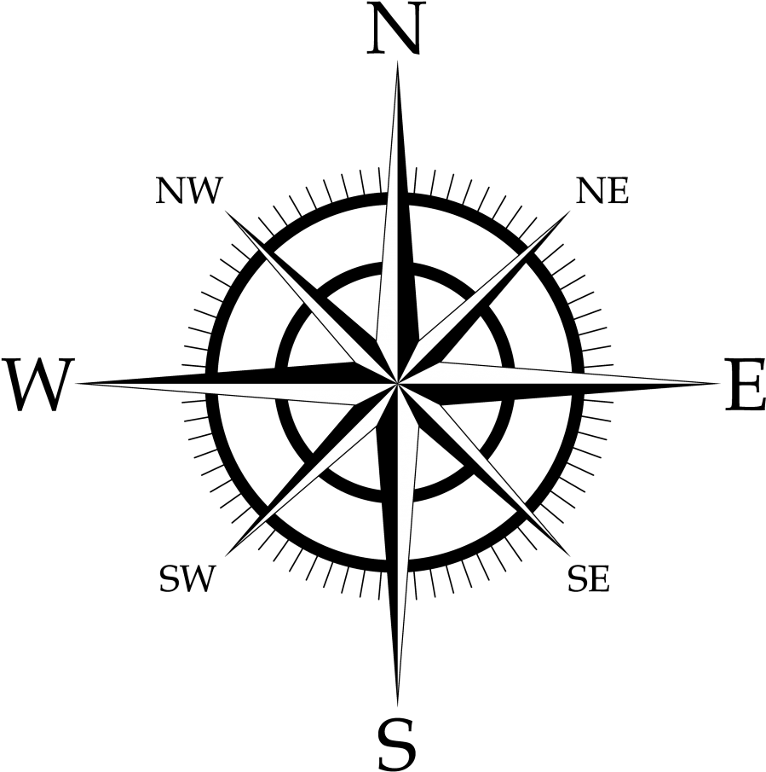
New learning:
Use the compass to find the number of degrees that is in each of the turns and the type of angle it is.
Turn | Degrees | Type of angle
North-East to South-East Clockwise | 90° | Right angle
North-East to South-West Clockwise | 180° | Straight angle
North to West Clockwise | 270° | Reflex angle
South-West to South-East Anti-clockwise | 90° | Right angle
Click to reveal answer
Click to reveal answer
Click to reveal answer
Click to reveal answer
Click to reveal answer
Click to reveal answer

Slide 8
Talk Task:
180°
45°
79°
270°
Which angle is the odd one out?
Could another angle be the odd one out for a different reason?
Always, sometimes or never true?
If I turn from North-East to North-West, I have turned 90°
2. If I turn from East to North-West, I will have turned through an obtuse angle?
3.If I turn from South-West to South, my turn will be larger than 350°

Slide 9
Talk Task:
180°
45°
79°
270°
A range of responses: 79° because the others are multiples of 45°. 270° is the only reflex angle.
Always, sometimes or never true?
All are sometimes true, depending on whether you turn clockwise or anti-clockwise or even more than 1 turn.

Slide 10
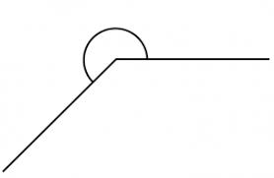
Develop Learning
Match each of these angles to the statements below.
A
B
C
D
Reflex angle
Obtuse angle
Right angle
Acute angle
Less than 90°
Between
181° and 359°
Between 91° and 179°
90°

Slide 11
Develop Learning
Match each of these angles to the statements below.
A
B
C
D
Acute angle
Reflex angle
Right angle
Less than 90°
90°
Obtuse angle
Between
181° and 359°
Between 91° and 179°

Slide 12
Independent Learning
Do the following activity three times with your partner before beginning the further independent tasks.
Pick a starting point on the compass and
describe a turn to your partner. Use the
mathematical words to describe your
turns:
• Clockwise
• Anti-clockwise
• Degrees
• Acute
• Obtuse
• Reflex
• Right angle
Can your partner identify where you will
finish?

