Slide 1
Monday 10th May 2021
GPS
LI year 5 & 6: Proofreading for words on the statutory list.

Slide 2
Spelling learning this week is to proofread to find and correct incorrect spellings. For each sentence, find the incorrect word and write the corrected word in your book.

Slide 3
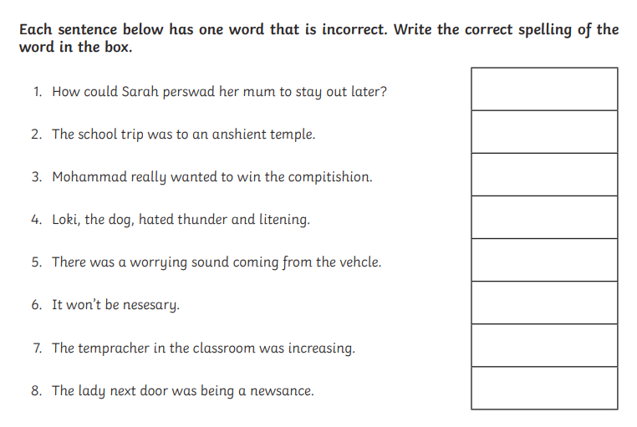
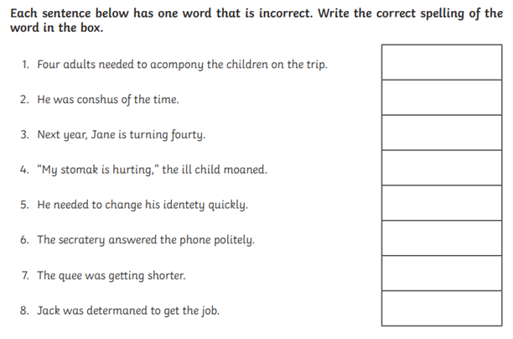
Find the incorrect spelling and write the corrected word in your book.

Slide 4
Find the incorrect spelling and write the corrected word in your book.
persuade
accompany
ancient
conscious
competition
forty
lightning
stomach
vehicle
persuade
necessary
identity
temperature
queue
nuisance
determined

