Slide 1
LI: I can understand the difference between Dreams and Goals and what I need to do to achieve them.

Slide 2
SETTING GOALS
Why is it important to set goals?

Slide 3
What goals have you set and met?
Think about a recent experience when you set a goal and met it.
How did you feel?
Have you ever given up on a challenge and wished that you hadn't?

Slide 4
What is a goal?
Something you really
want to do
Something you really want
to achieve
The best thing you would like to happen

Slide 6
These young people achieved their goals whilst still in school. Click on the link to find out about their stories.
https://www.bbc.co.uk/bitesize/articles/zdbtqp3
Do any of them have a dream similar to you?

Slide 7
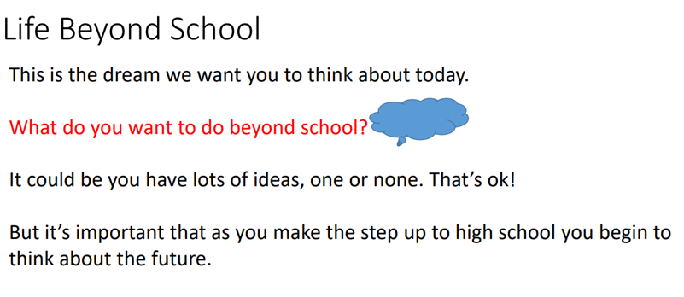

Slide 14
Your task
After choosing a job, find out what you need to achieve that goal.
What qualifications do you need?
What training?
How will you achieve this?
Remember, you will probably change your mind many times but it’s always good to have a goal to work towards!

