Slide 1
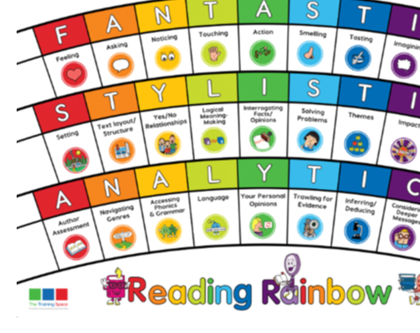
Lesson 1:
Band 4 Discuss and compare texts from a wider variety of genres and writers referring to authorial style, themes and features.
Band 5 Read and discuss an increasingly wide range of fiction, poetry, plays, non-fiction and reference books or textbooks.
Band 6 Explain and discuss his/her understanding of what he/she has read, through formal presentations and debates, maintaining a focus on the topic and using notes where necessary.
Initiate

Slide 2
Remind yourself of scene 1 and then read through scenes 2 & 3.
Lenses:
Imagining
Layout/structure
Your personal opinions
Sentence Starters:
Imagining
Our imagination is stretched when we read this story because ...
Text layout/structure
The most striking aspect of this book's layout is ...
Your personal opinions
The strengths and weaknesses of this playscript are ...

Slide 3
Lesson 2:
MODEL – please write this in the margin.

Slide 4
Imagining
How is our imagination stretched in scene 3?
Together: chot down unreal actions in the story.

Slide 5
Layout/structure
We have looked at features of a playscript, what are the most striking differences between playscript layouts and story layouts?
Together: chot down striking differences between playscripts and story writing.

Slide 6
Your personal opinions
This is a story that you know well, there are some differnces, what are the strengths and weaknesses of this version?
Together: chot down strengths and weaknesses of this version of the story.

Slide 7
Lesson 3:
ENABLE – please write this in the margin.

Slide 8
Session 3 – Enable (Independent comprehension) Thursday 17th June
In groups of 6, to show your understanding of playscripts, you are going to act out the three scenes/1 scene per group.
Remember to take note of the stage directions, the action directions and to express your spoken part according to what is happening and voice directions.
Teachers remember to take a photo to be stuck into Booktalk books.

