Slide 1
Tuesday 29th June
English
Learning Intentions:
4: I can compose sentences using rich vocabulary.
5 and 6: I can select appropriate vocabulary, understanding how choices will enhance the meaning.

Slide 2
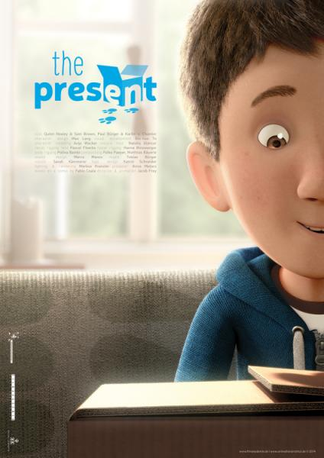
The Present
Over the next couple of weeks, we will be writing a narrative using The Present to help us.
We will be using sentence stacking lessons to collect vocabulary.
At the end of these lessons, you will create your own fictional story loosely based on this idea.

Slide 3
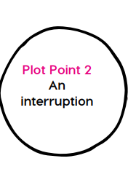
Time adverbial
Dialogue
Prefixes

Slide 4
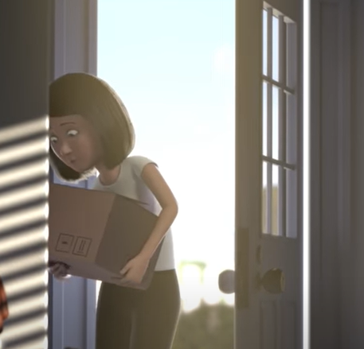
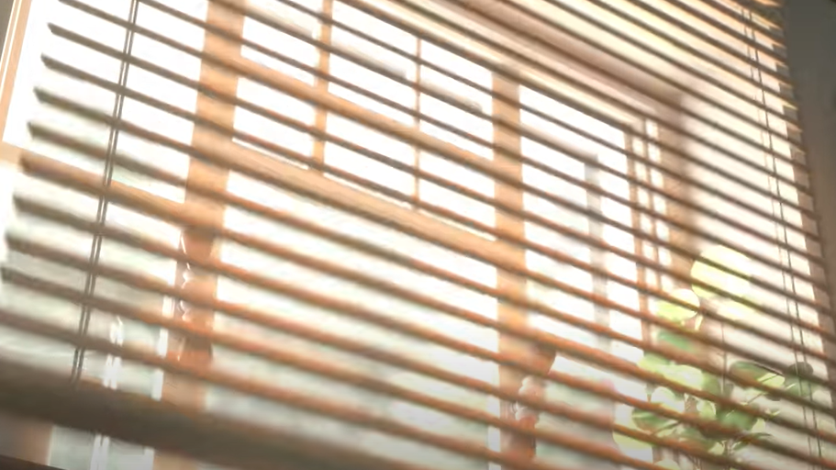
What time of day do you think it could be when Mum arrives home?
Think: collect time adverbials to describe the time of day it is.
E.g.
Later that morning
Early afternoon
Just before lunchtime

Slide 5
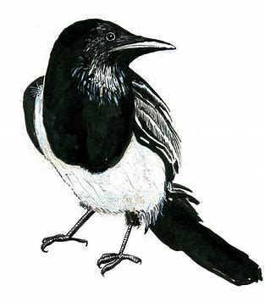
Time adverbial
This sentence sets the scene and explains how Mum interrupts Ben’s gaming time.
Chot down a time adverbial.
Chot down a synonym (alternative word) for interrupted.
*Use a thesaurus*
Time adverbial:
Later in the morning,
Shortly before lunchtime,
Early in the afternoon,
Several hours later,
Interrupted:
Disrupted
Disturbed
Interjected
Invaded
Ambushed

Slide 6
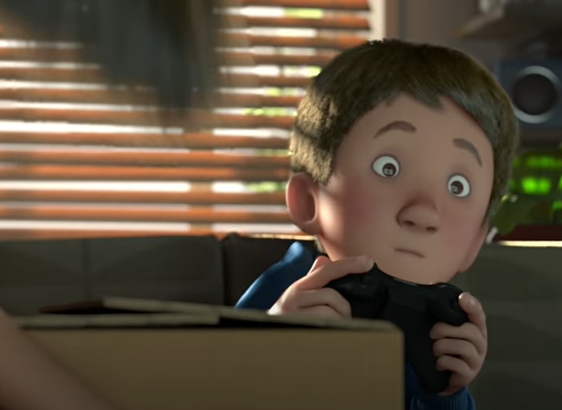
Time adverbial
Model: Early afternoon, Mum interrupted the war zone.
Your turn: Using a time adverbial and a synonym for interrupted, create your next sentence.
Remember: make sure you include your comma after the time adverbial.
Hint: ONLY if you need to, start by changing the underlined vocabulary to help.
Challenge: can you deepen the moment by adding another subordinate clause?

Slide 7
Dialogue
In small groups, freeze frame mum entering the house in this scene. What might she say? What pet names might she use for Ben?
Be ready to share examples!

Slide 8
Dialogue
Pet names for Ben:
Benny
Darling
Poppet
Sweetie
Sweetheart
Love
Present:
Gift
Surprise
Treat
An upbeat word for said:
Sang
Smiled
Chimed
Trilled
Tweeted
Placing down the box:
Delivering
Depositing
Presenting
Dropping
Carefully laying
Setting aside
Bestowing
In this sentence, we’ll include speech from Mum to Ben.
Chot down pet names for Ben
e.g. Darling
Chot down an upbeat word for said
E.g. chimed
Chot down another way of saying ‘placing down the box’

Slide 9
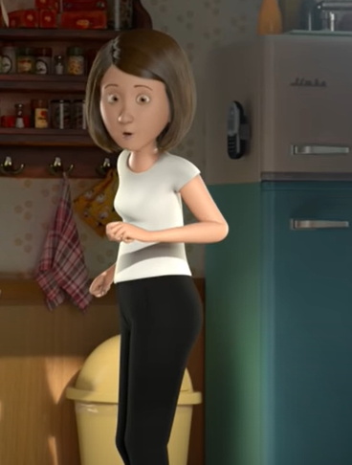
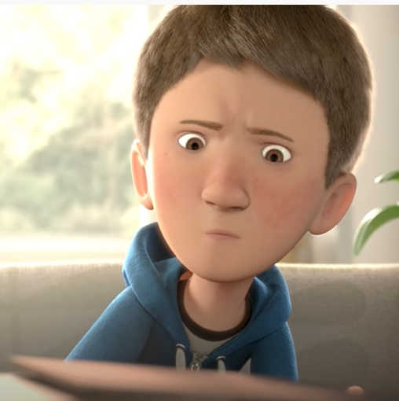
Dialogue
Model: : “Hi darling. A present for you!” chirped Mum, depositing a large cardboard box.
Your turn: Using speech, write your sentence that Mum would say to Ben when she arrives with the present.
Remember: make sure you include speech marks correctly.
Challenge: can you deepen the moment by adding adverbs, too?

Slide 10
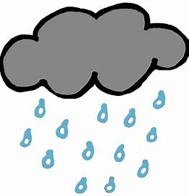
Prefixes
Dis-
Un-
Interested
Connected
Passionate
Impressed
Moved
Interested
The prefixes ‘un’ and ‘dis’ bring negative meanings when they are added to root words.
Can you think of any examples you could add?

Slide 11
Prefixes
We are going to explain how Ben ignores his Mum and the present at first.
Chot down negative words beginning with the prefixes dis- and/or un-
Chot down the actions that occurred when Mum came home with the present.
Dis/Un words:
Disappointed
Disinterested
Dissatisfied
Disapprovingly
Disgruntled
Unhappy
Unimpressed
Actions:
Ben continued his game
Mum walked towards Ben with the box
Mum opened the blinds
Ben ignored his Mum and the box
Mum tried to get Ben’s attention

Slide 12
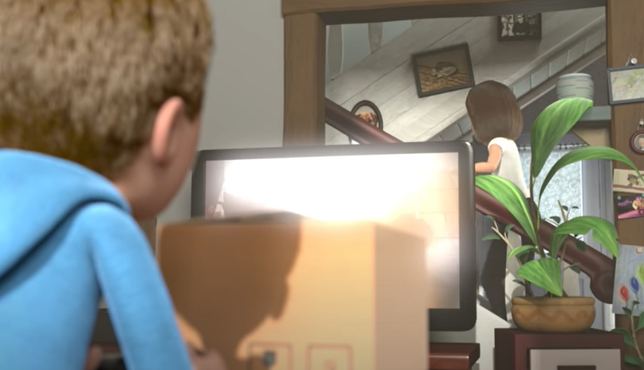
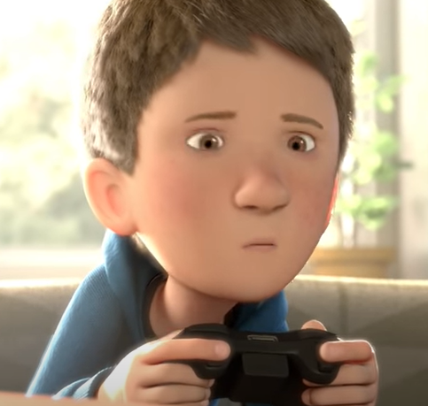
Prefixes
Model: Disinterested, Ben continued the war. Disappointed, Mum walked towards her little soldier.
Your turn: Using negative prefix words, describe an action by Ben and then an action by Mum when she first hands over the present.
Remember: make sure you include the commas correctly.
Challenge: can you deepen the moment by adding adjectives, too?

Slide 13
INDEPENDENT WRITING CHALLENGE:
IF you have finished your sentence stacking for the lesson, here is the independent writing challenge. Each day, you will have a mini challenge based on a gift in a mysterious place.
The Present at… the Bottom of the Well.
Imagine you find a mysterious gift at the bottom of a well. Describe the moment you find it, retrieve it and the moment you unwrap it. Stop on a cliffhanger!
Sentence stem:
The wind nipped at my bare ankles. I lent forwards, ever so slowly, and there it was. Laying at the bottom of the well.

