Slide 1
Term 4 Lesson 3 History
Who lived in a medieval castle?

Slide 2
Learning Intentions
L.I: To know who lived in a medieval castle.
Steps to success
*I know who lived in a medieval castle.
* I know which medieval were the most and least powerful.

Slide 3
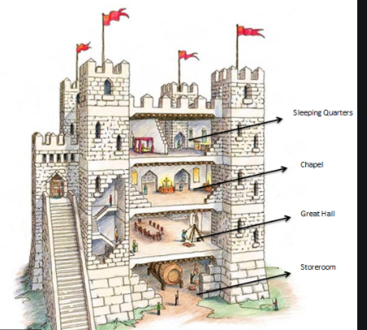
Castles 4
Today we will be... Finding out about people living in medieval castles.

Slide 4
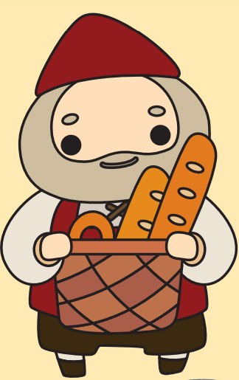
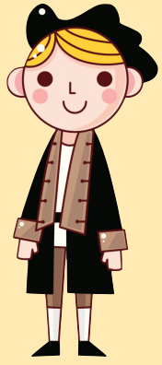
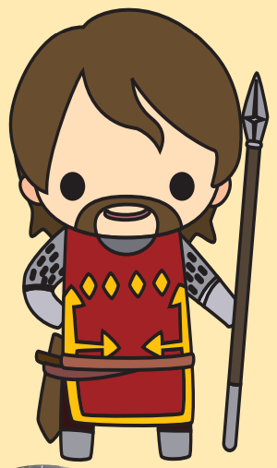
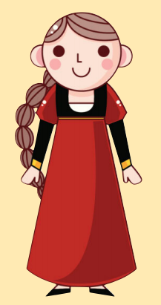
Who do you think lived inside a medieval castle?

Slide 5
Lots of different people lived and worked in a castle. The lord and lady owned the castle. They decided how much tax the villagers should pay. Some lords owned several castles!
Running a castle was a complicated job so they would have had people to help them. Who do you think helped the lord and lady?

Slide 6
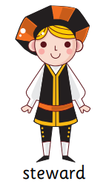
The lord and lady had clerks, stewards and marshals to help them run the estate. The clerk kept a record of the money being spent. The steward was in charge of the entire household. He told the cooks, musicians and servants what to do. The marshal was in charge of the horses, carters, boatmen and stewards.
These were important jobs so the clerk, steward and marshal could read and write.

Slide 7
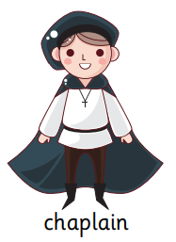
In medieval times people were very religious. Castles would have their own chapel or church and priest. The priest was called a chaplain. He was in charge of the choirboys.
The chaplain could also read and write. He wrote letters for the lord.

Slide 8
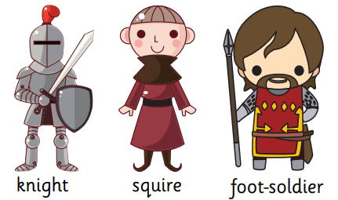
The knights were well-trained soldiers. They rode into battle on horses. Squires were training to be knights. Men-at-arms or footsoldiers were soldiers who were well trained but were not as important as knights.

Slide 9
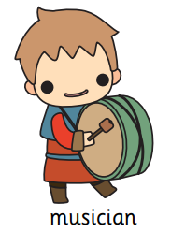
Jesters, acrobats and jugglers entertained the lord, the lady and their guests at feasts.
What else do you think was important at a feast?

Slide 10
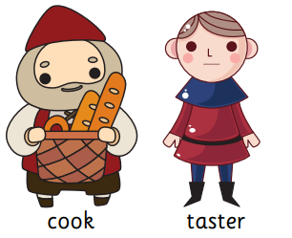
The cooks were very important at a feast. Without them there would be no food to eat! The cook had help from the butler who ordered the food and drinks. They were the lord’s servants.
Did you know some lords had tasters? Their job was to taste some of the lord's food to check it had not been poisoned!

Slide 11
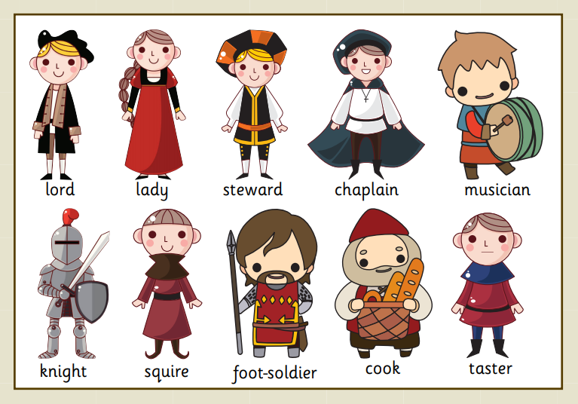
Who do you think had the easiest job?

Slide 12
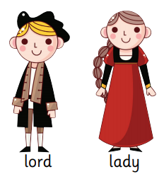
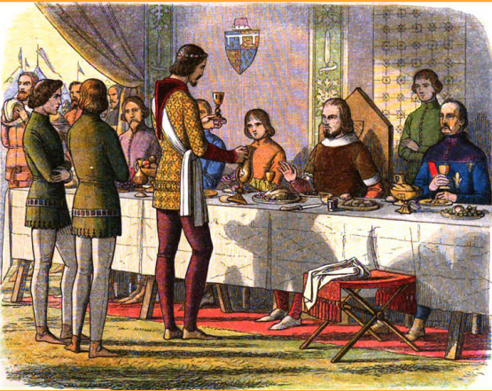
The lord and lady had the easiest jobs in the castle. They spent most of their time eating, drinking and entertaining guests.

Slide 13
Who do you think had the most dangerous job?
Think, pair, share. Who do you think had the most dangerous job?

Slide 14
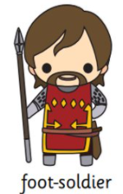
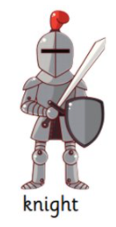
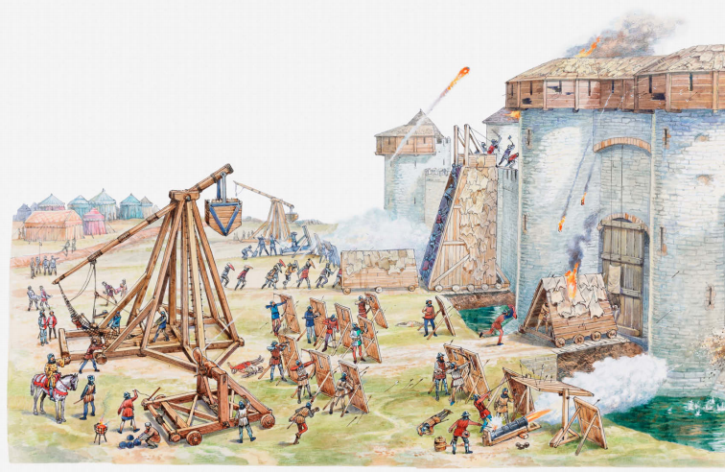
The knights and foot-soldiers had the most dangerous jobs. The squires’ and tasters’ jobs were not as dangerous.

Slide 15
Which job would you like to have had?
Think, pair, share. Who do you think had the most dangerous job?

Slide 16
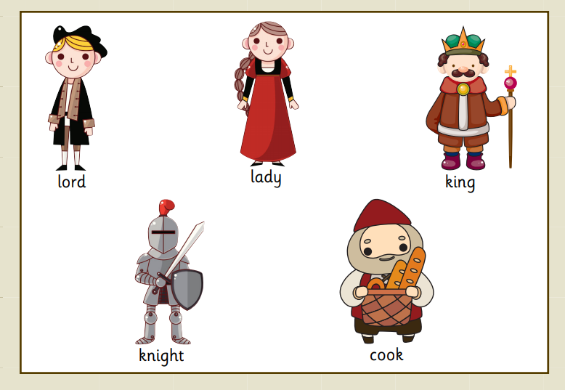
Can you put these medieval people in order from most powerful to least powerful?

Slide 17
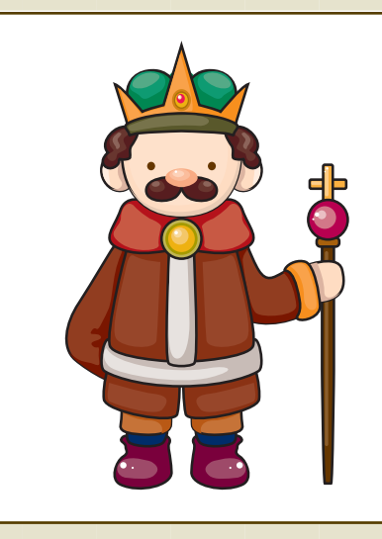
The king or the queen were the most powerful people in England. Everyone had to do what they commanded.

Slide 18
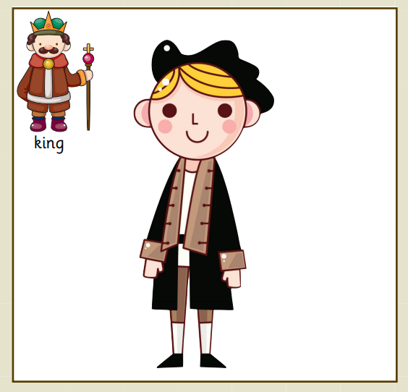
Lords lived in castles and had servants. They had to follow the king’s rules and sometimes they had to take their soldiers to fight for the king.

Slide 19
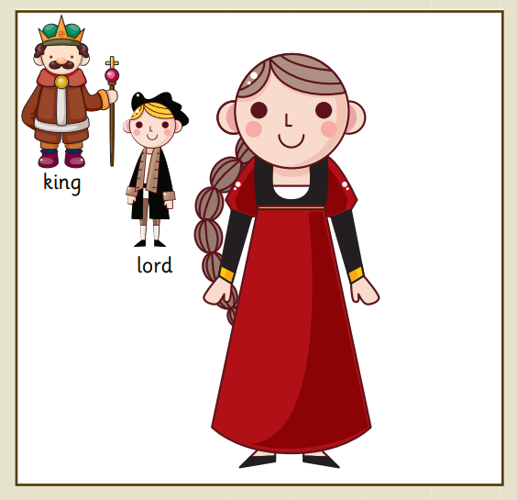
The lady always had to obey her husband. She would not have been able to do anything without his permission.

Slide 20
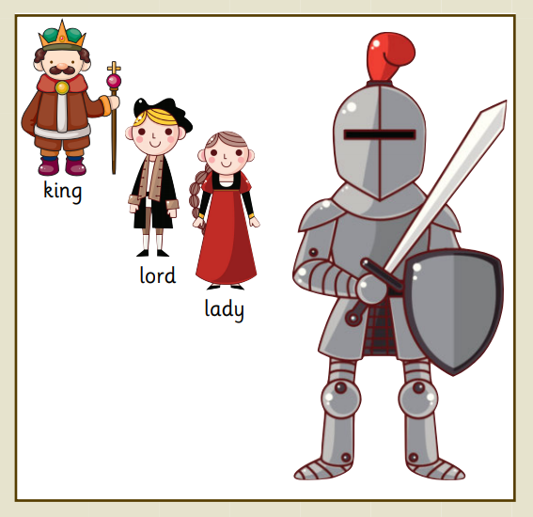
Knights were often from wealthy families. They hunted with the lord and were very skilled fighters.

Slide 21
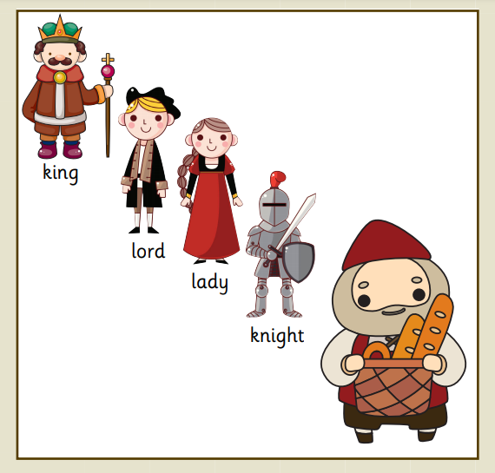
The cook was one of the lord’s servants. He had to make the meals the lord wanted and feed everyone in the castle.

Slide 22
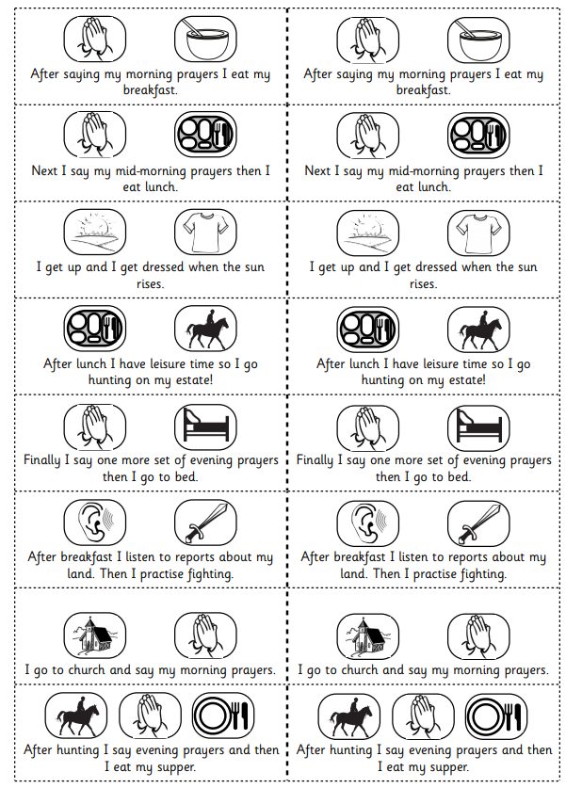
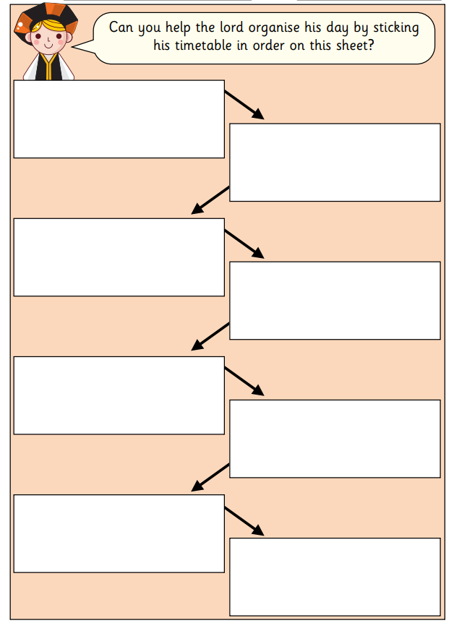

Slide 23
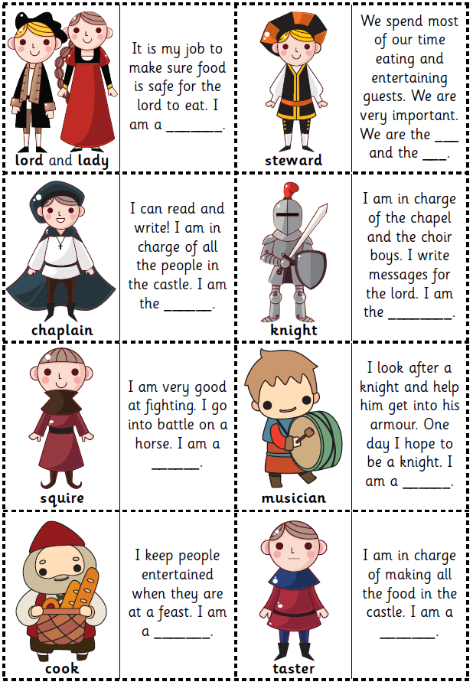
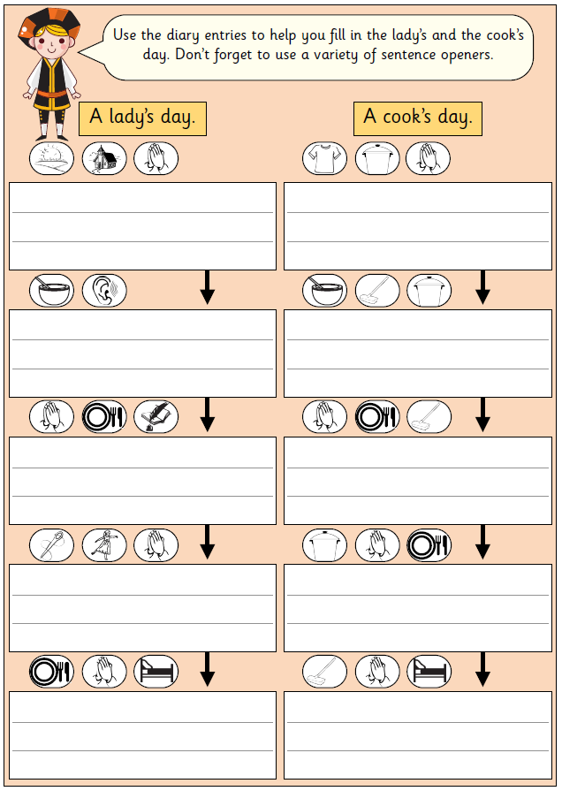
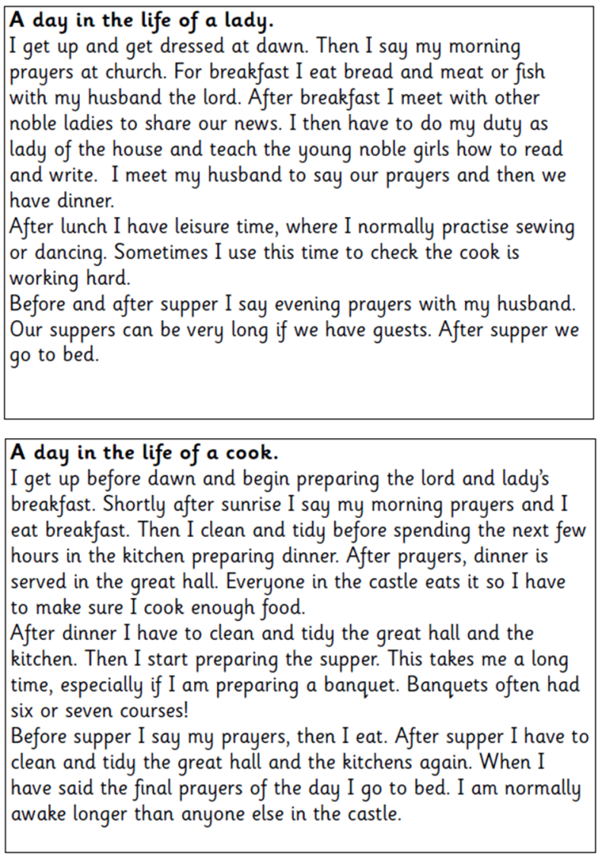
Task 1: Use the diary entry to help you fill in the lady’s and cook’s day. Try to get them in order.
Task 2: Dominoes game. Can you match the person to their job role?

