Slide 1
Term 4
Week 4
Year 1
GPS

Slide 2
Learning Intentions
L.I: To begin to punctuate with question marks.
Steps to success
* I can end the sentence with a question mark.
L.I: To join words and clauses using ’and’.
Steps to success
*I can use ‘and’ to join words.
*I can use ‘and’ to join clause.

Slide 3

L.I: To begin to punctuate with question marks.
When do we use a question mark?

Slide 4
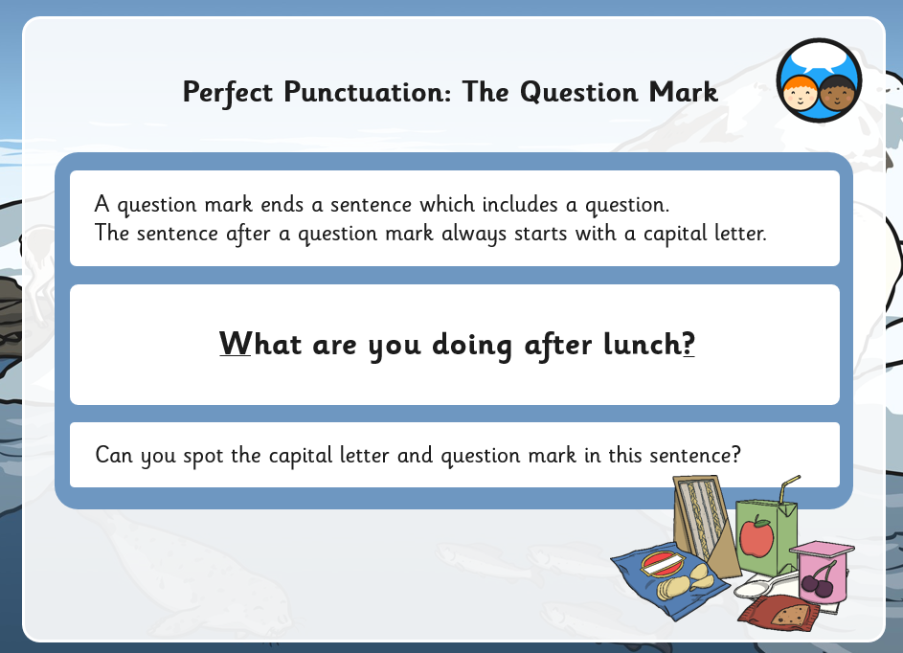

Slide 5
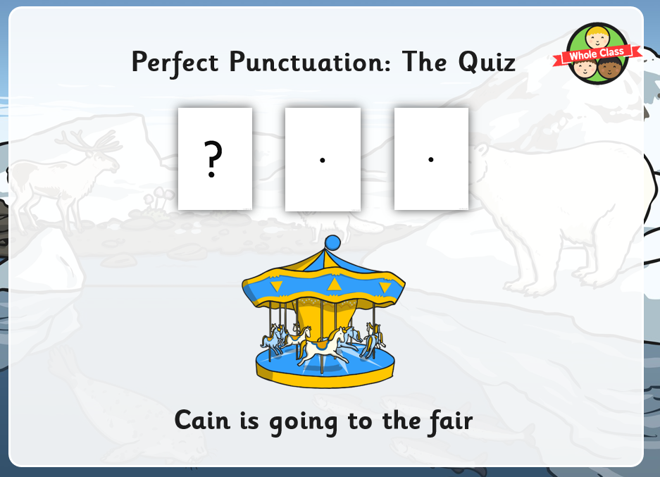
Do these sentences need a full stop or a question mark?

Slide 6
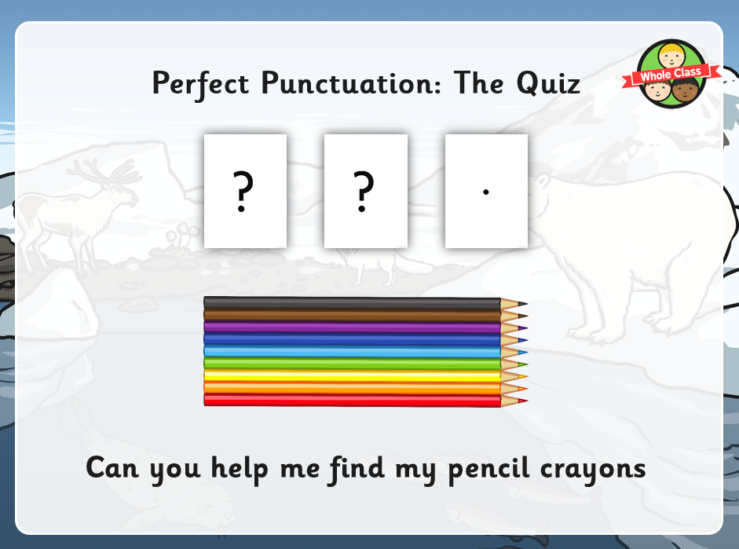

Slide 7
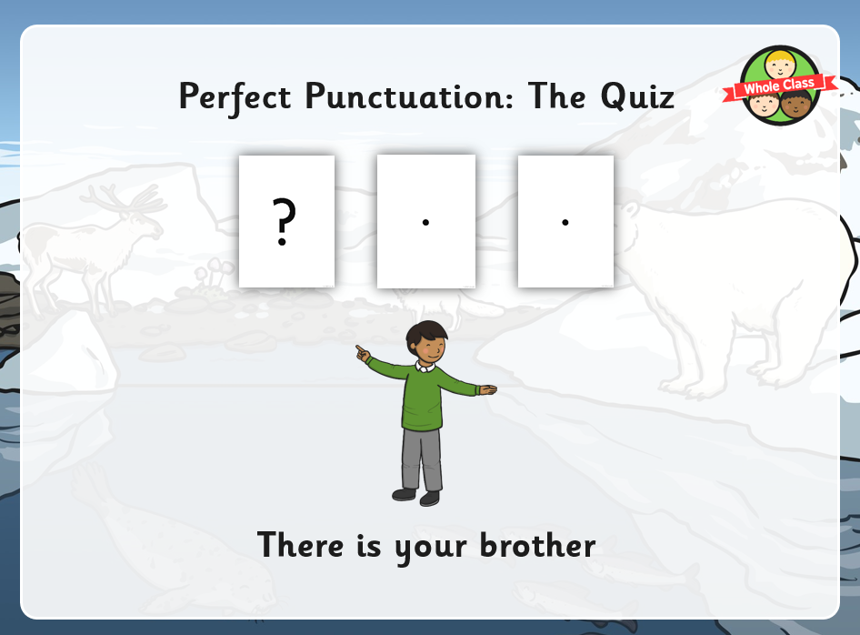

Slide 8
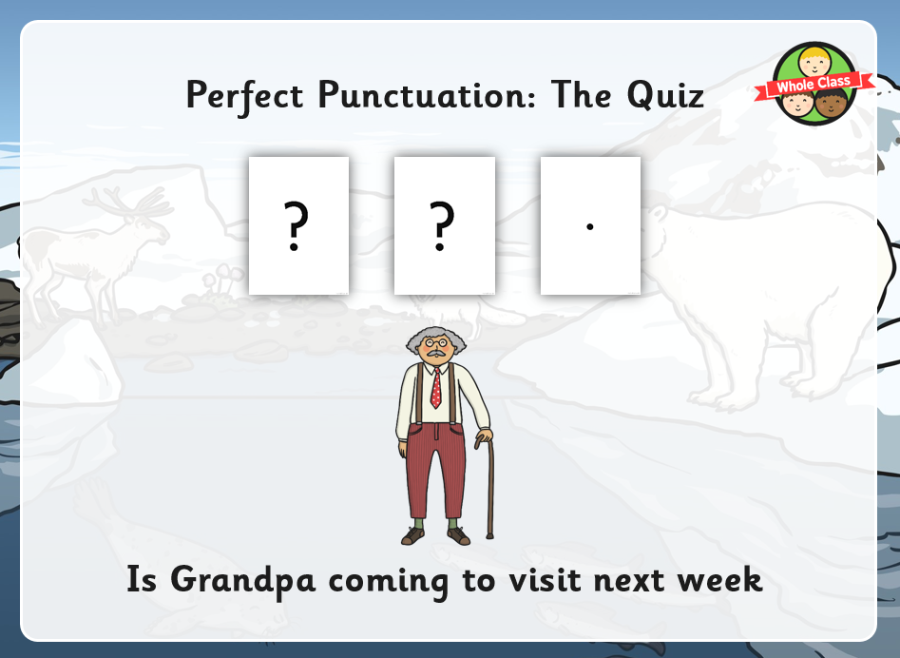

Slide 9
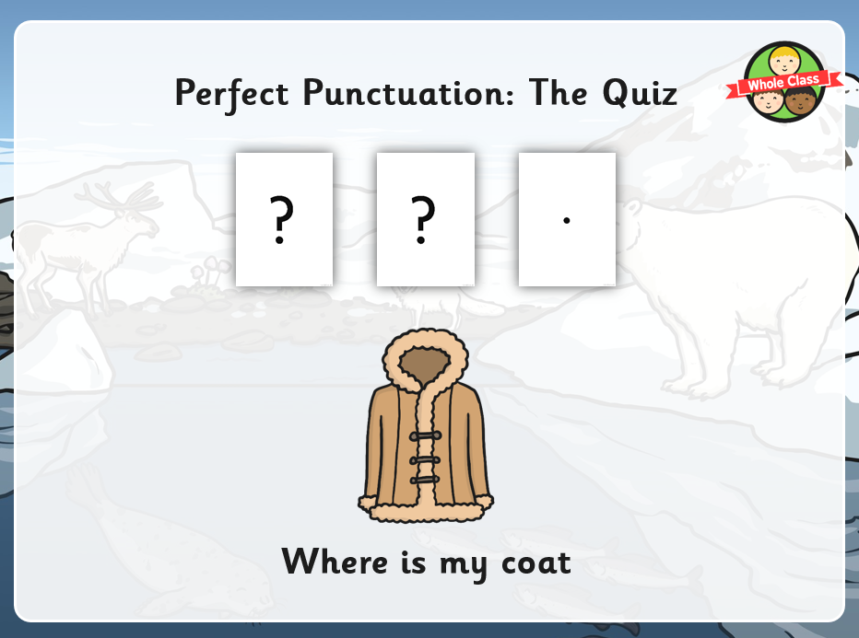

Slide 10
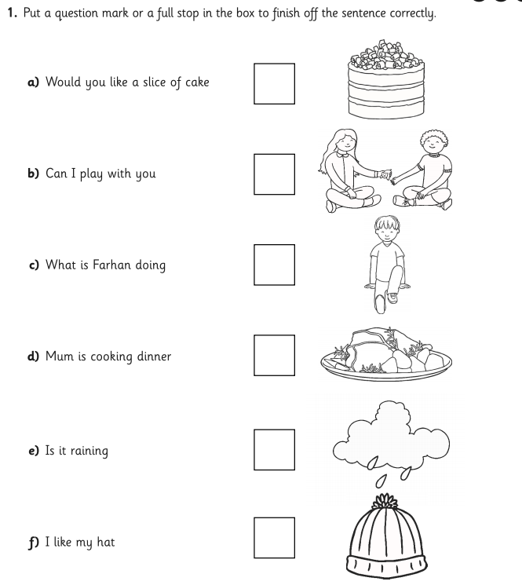
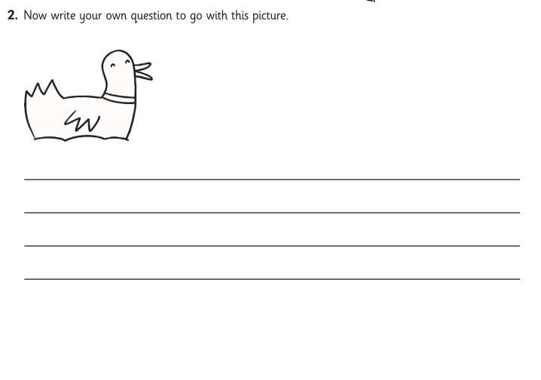
Task 1 Read through the sentences and decide whether you need to punctuate with a full stop or a question mark.

Slide 11
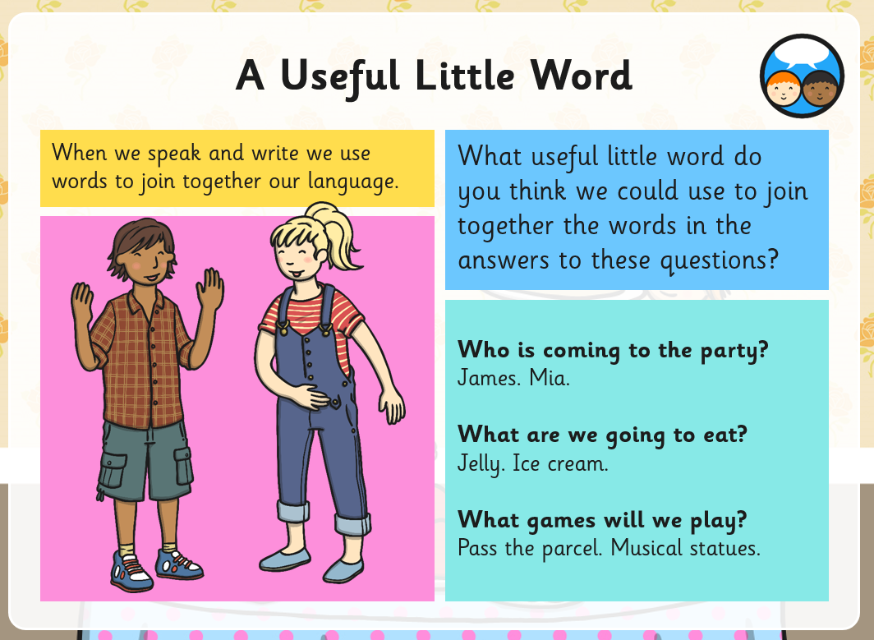
L.I: To join words and clauses using ’and’.

Slide 12
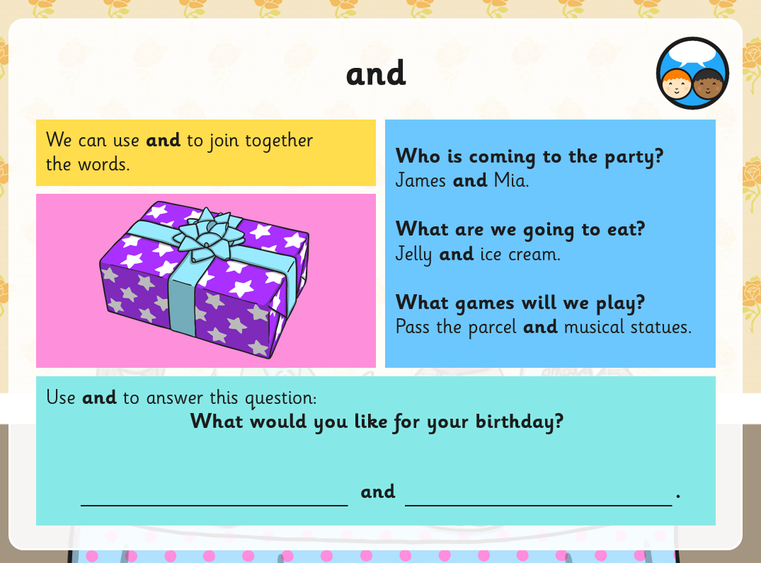

Slide 13
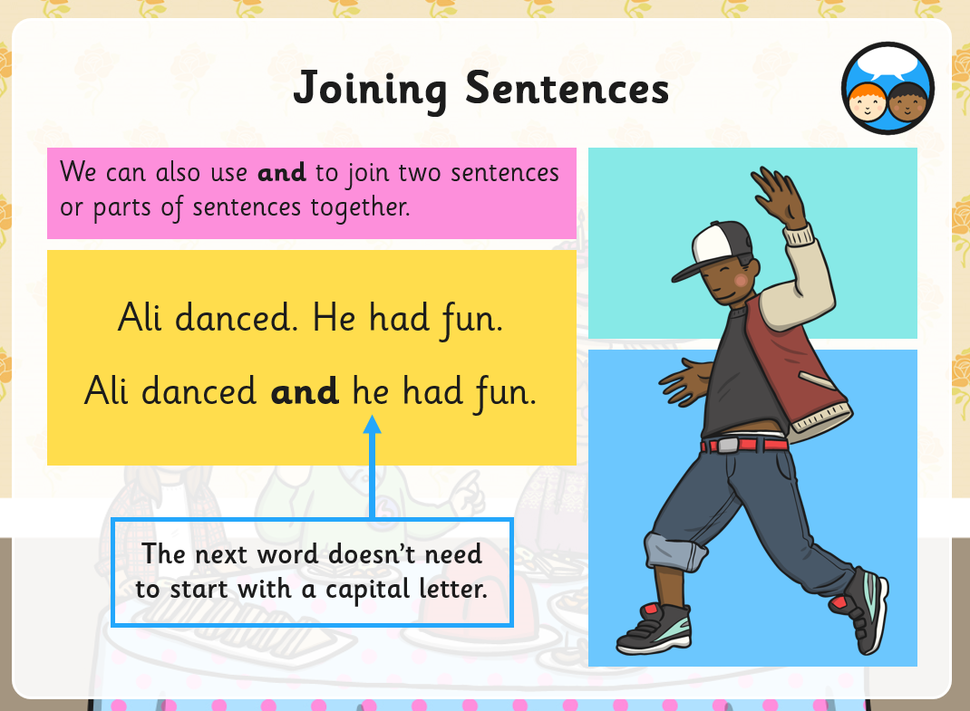

Slide 14
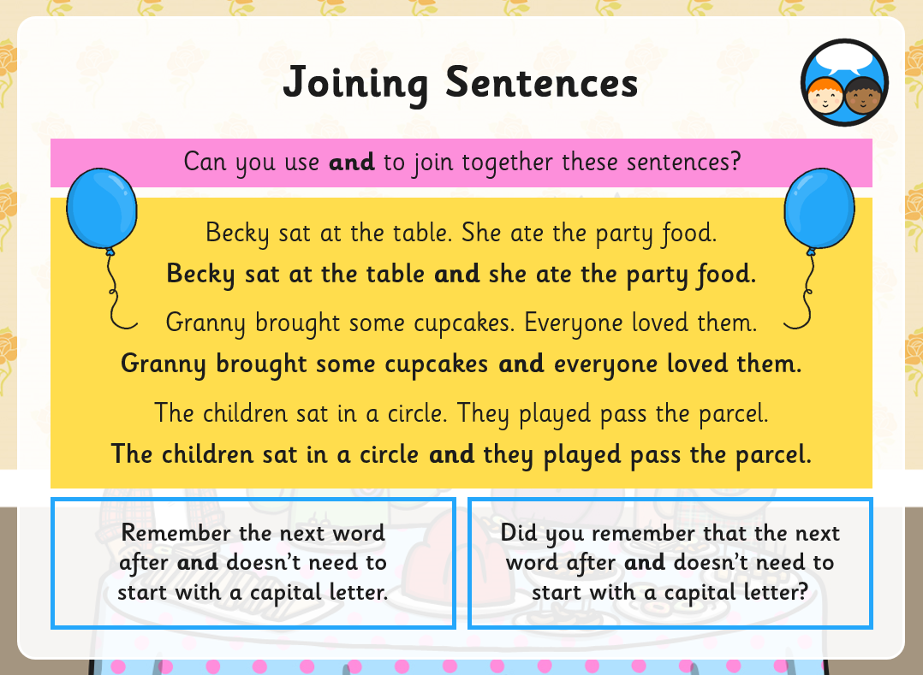

Slide 15
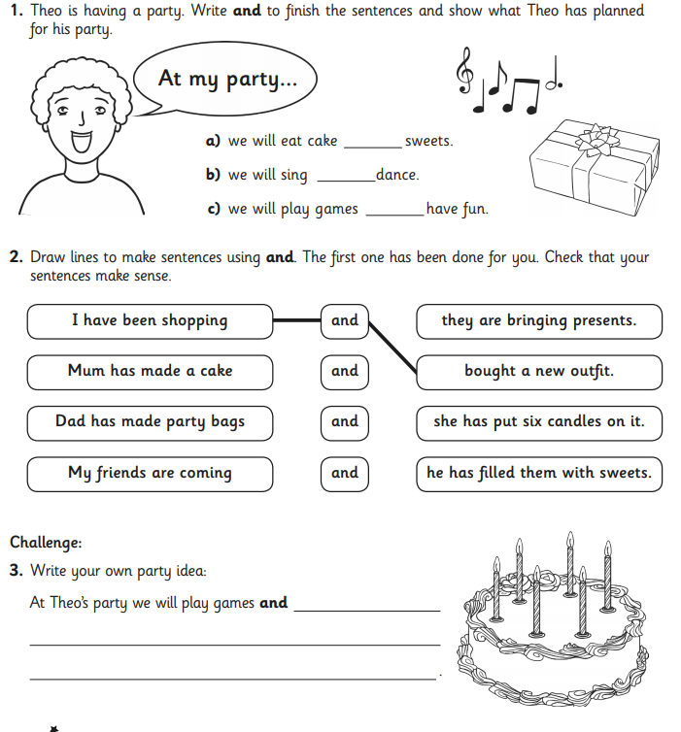
Task 2
To use ‘and’ to join words and sentences.

