Slide 1
Dr. Mae Jemison
Science Week

Slide 2
Story about Mae Jemison
Miss Eallonardo Reads "Mae Jemison" by Mary Nhin – YouTube
Mae Jemison: I Wanted To Go Into Space – YouTube

Slide 3
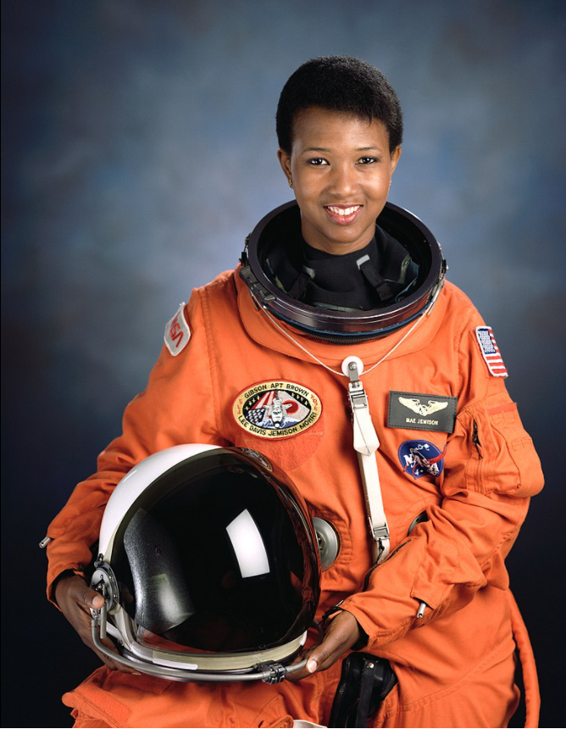
Dr Mae Jemison
Mae Jemison was born in was born on the 17th October 1956 in Alabama , USA.
Her mother was a teacher and her father was a carpenter and roofer.

Slide 4
Childhood
When Mae was a child she loved reading, especially books about science and astronomy.
By the time she was five she knew she wanted to be a scientist.
Mae also wanted to be a dancer.
Her uncle introduced her to science and she developed a lifelong interest in astronomy.

Slide 5
University
Mae studied science and medicine at university and became a doctor in 1981.
She worked as a doctor in West Africa for a few years before deciding in 1985 that she wanted to be an astronaut.
Mae joined NASA’s training programme in 1987.

Slide 6
Astronaut
In 1987 Mae became the first black woman in the astronaut training programme.
A few years later Mae flew into orbit as the first African American woman in space.

Slide 7
Mae’s life after NASA
In 1983 Mae left NASA and created her own company, the Jemison Group, which researches ways in which technology can help people in their daily lives.
In 1994 she launched, ‘ The Earth We Share, a science camp for children.

Slide 8
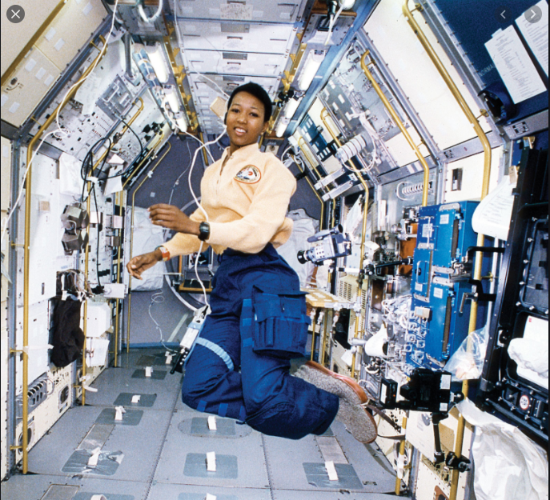
Task
To write some facts about Mae Jemison’s life
To draw a picture of Dr. Mae Jemison.

