Slide 1
Term 5 Week 1 Vincent Van Gogh Sunflowers Creating shades and tints.

Slide 2
L.I: Can I use colours and lines to create shade and tint? Steps to success *I can mix paints to create shades. * I can mix paints to create tints.

Slide 3
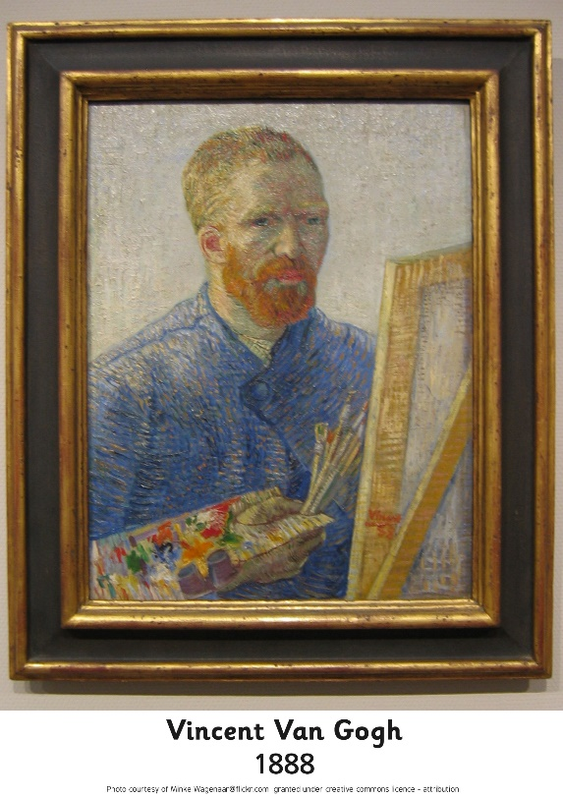
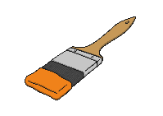
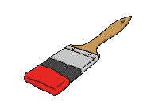
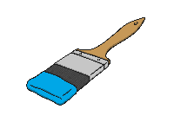
All about Vincent van Gogh
What do you already know about Vincent van Gogh?
Click on the picture to find out more.
Born: 1853
Job: Artist
He was born in the Netherlands.
He had two brothers and three sisters.
Died: 1890
Photo courtesy of Minke Wagenaar (@flickr.com) - granted under creative commons licence – attribution

Slide 4
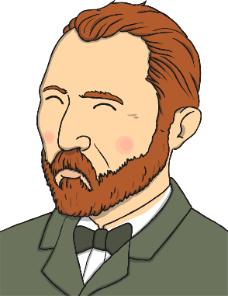
Van Gogh the Painter
Vincent van Gogh was a Dutch artist.
He painted portraits and landscapes.
He used watercolours and oil paints.
He is famous for using bright colours and bold brushstrokes in his work.
He painted in a style called Post-Impressionism.
Click on the words in bold to find out more.

Slide 5
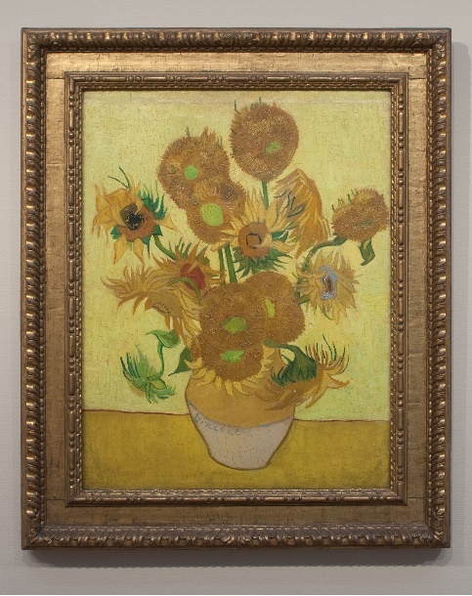
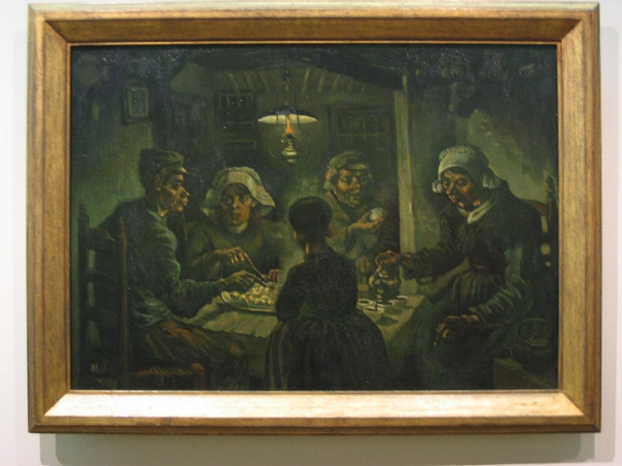
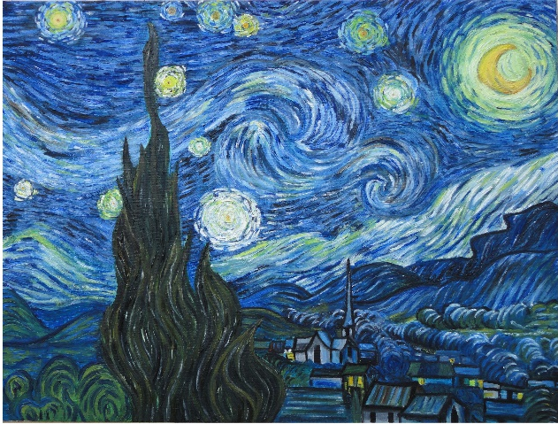
Famous Paintings by Van Gogh
Here is a gallery of Van Gogh’s most famous works. Click on each painting to find out more.
The Potato Eaters
1885
Starry Night
1889
Sunflowers
1888
The Potato Eaters Photo courtesy of Minke Wagenaar (@flickr.com) - granted under creative commons licence – attribution
Sunflowers Photo courtesy of Pachango (@flickr.com) - granted under creative commons licence – attribution
Starry Night Photo courtesy of Saad Faruque (@flickr.com) - granted under creative commons licence – attribution

Slide 6
Sunflowers, 1888
back
Van Gogh painted this for his friend, the artist Paul Gauguin.
He chose the colour yellow to represent happiness.
He made lots of paintings of sunflowers.
This is one of Van Gogh’s most popular and famous paintings.
Discuss It!
Which is your favourite colour? How does it make you feel? Can you think of any other colours which are used to represent an emotion?
click the picture to find out more!
Photo courtesy of Pachango (@flickr.com) - granted under creative commons licence – attribution

Slide 8
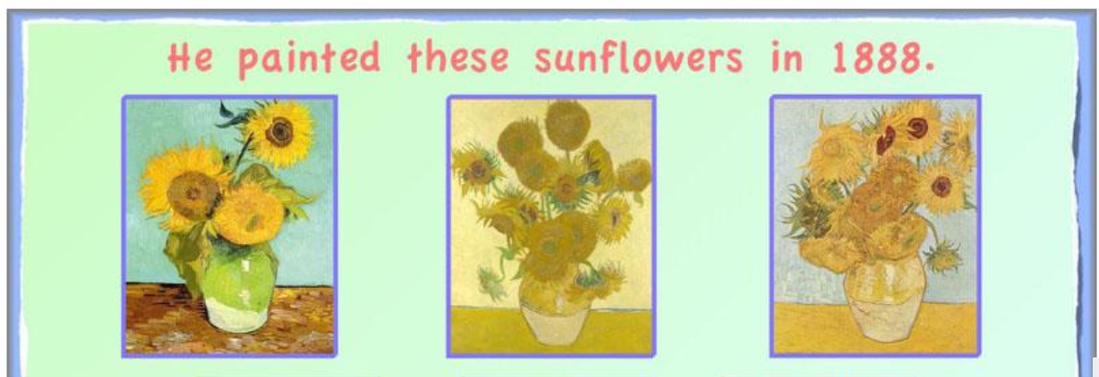
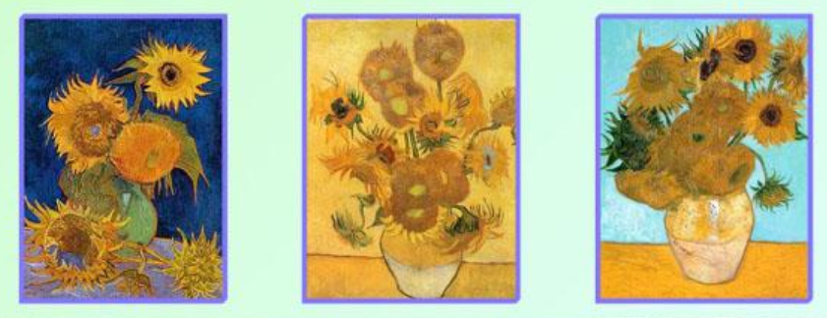

Slide 9
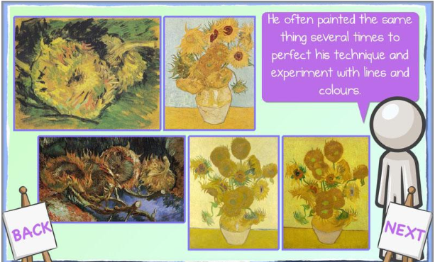

Slide 10
Your challenge is to sketch, then paint a sunflower petal. Make sure you use shades and tints and try to capture the lines in the petal.

Slide 11
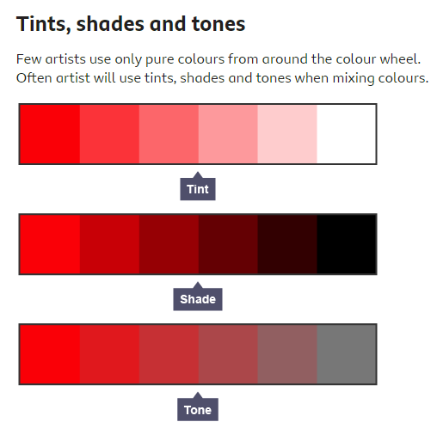

Slide 12
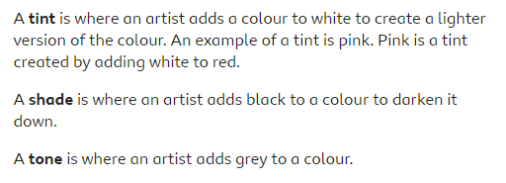

Slide 13
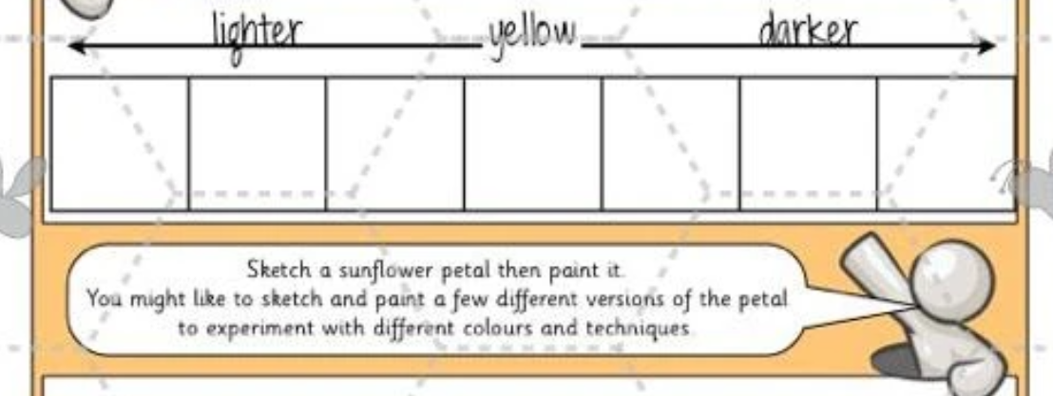

Slide 14
Activity Children to draw sunflower petals. Children to create different tints and shades of yellows and oranges to paint their sunflower petals.

Slide 15
Glossary
Impressionism – a style of painting using dabs of paint and colour, with visible brush strokes
Landscape – a painting showing a view of natural scenery, like the countryside
Portrait – a painting of a person
Post-Impressionism – the work of some famous artists including van Gogh, who used bright colours and symbols to show emotions and feelings in their artwork
Watercolour – a type of paint which is used with water to give transparent colour
Click on the word to take you to the relevant page.

