Slide 1
Monday 19th April
LI: To write instructions.
This lesson is in two parts: an experience session, followed by a cold task.
Click F5 to view the PowerPoint in full screen.
Why do we need instructions?
What are instructions?
Have you ever needed instructions?

Slide 2
Monday 19th April
LI: To write instructions.
Click F5 to view this PowerPoint on full screen.
Experience
Rye Bloom 2021 have asked the whole school to grow sunflowers.
Let's go and sow some seeds! Make sure that you listen carefully so you know what to do.

Slide 3
Monday 19th April
LI: To write instructions.
Click F5 to view this PowerPoint full screen.
Writing Challenge
Can you help me please key stage 1?
Sardines and Minnows need to sow their sunflower seeds for Rye Bloom 2021, but they don't know how to do it!
Please could you write them some instructions that tell them what to do?
Thank you so much for your help. I can't wait to read your amazing writing!

Slide 4
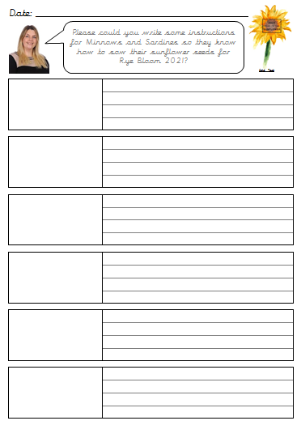
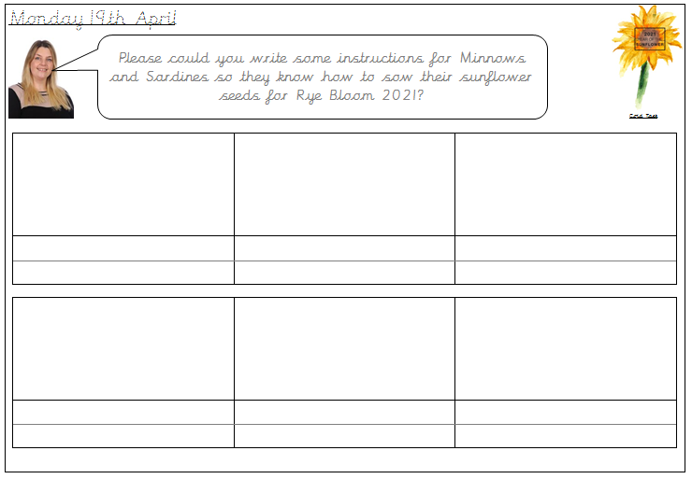
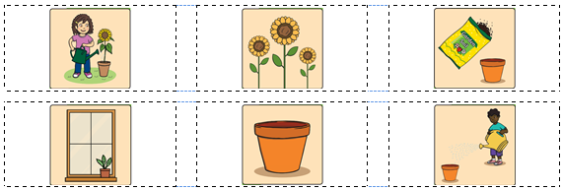
Monday 19th April
LI: To write instructions.
Writing Challenge
Band 2 - Write the date in your book.
Write instructions of how to sow a sunflower seed.
PKS - Sequence
Talk about your instructions.
Sound out the key words you need.
Band 1 - Use the pictures to help you to write your instructions.

