Slide 1
Term 5 Week 1
P.S.H.E
Can I identify the different members of my family,
understand my relationship with each of them and know why it is important to share
and cooperate?
Can I accept that everyone’s family is different and understand that most people value their family?

Slide 2
Learning Intentions
L.I. I can identify the different members of my family,
I understand my relationship with each of them and know why it is important to share and cooperate?
I can accept that everyone’s family is different and understand that most people value their family?

Slide 3
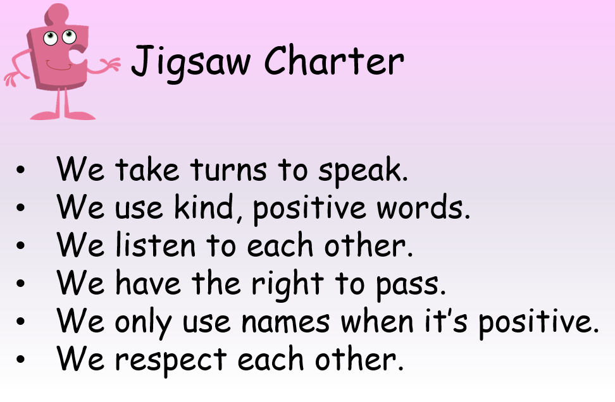

Slide 4
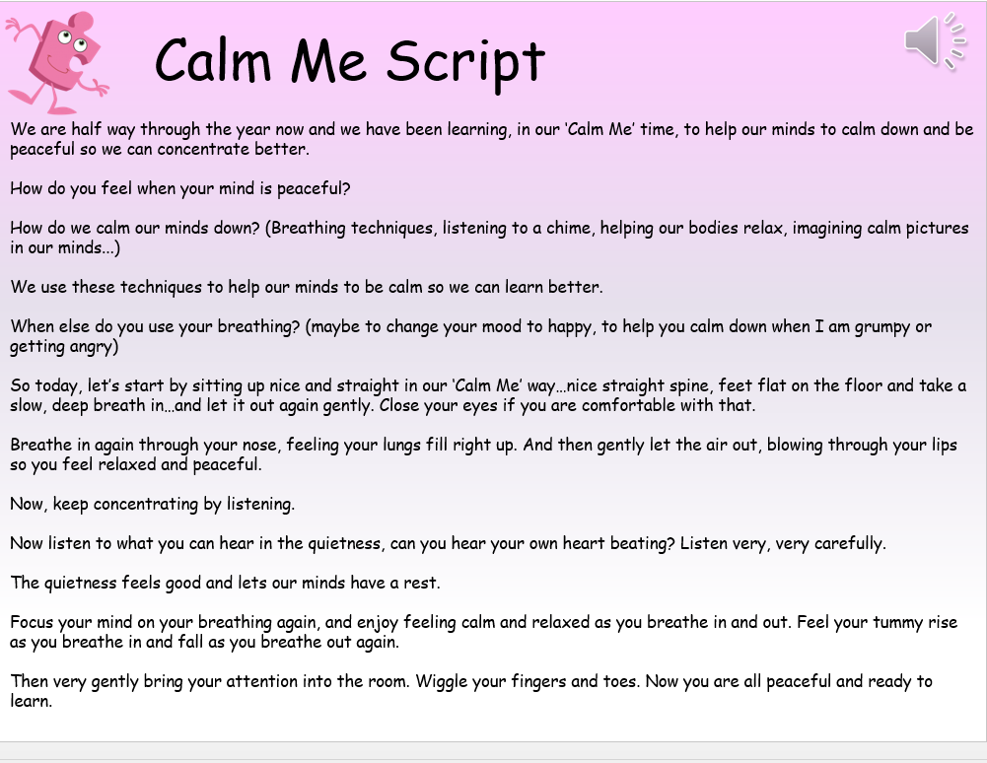

Slide 5


Slide 6
Look through the photos of different types of families.
Show children a selection of pictures of different types of families.
Explain that they are all families and that families come in all different shapes and sizes.
Why do we have families?
Explain they are there to protect us and love us. Talk about families and how we belong with them.

Slide 7
Listen to Something Special
Step Inside: Something Special – YouTube
From 3 minutes 5 seconds.
Ask children to choose a family member and say why that person is special.
Discuss the importance of sharing and cooperating for a harmonious household.

Slide 8
Recipe for a happy home.
What ingredients would we need for making the recipe?
Children to suggest ingredients for the recipe.

Slide 9
Activity
Level 1 – Children to draw or talk about 2-3 special ingredients for their family recipe – photo taken or discussion recorded for books.
Level 2/3- Children to make a recipe for a happy home, e.g. a pinch of laughter, a cup of love, a spoon of sharing, etc. Draw and label examples to establish the idea then ask the children to think of their own ‘ingredients’.
Go round the class collecting their ideas to make up the ‘recipe’.

Slide 10
Reflection
Children to write one vital ingredient that they think they can contribute to their own family.

